Slide 1
Data Structures and Algorithms
Lecture 6: Sorting Algorithms II
Insertion Sort

Slide 2
Insertion sort
Insertion sort: orders a list of values by repetitively inserting a particular value into a sorted subset of the list.
more specifically:
consider the first item to be a sorted sublist of length 1
insert the second item into the sorted sublist, shifting the first item if needed
insert the third item into the sorted sublist, shifting the other items as needed
repeat until all values have been inserted into their proper positions

Slide 3
Insertion sort
Simple sorting algorithm.
n-1 passes over the array
At the end of pass i, the elements that occupied A[0]…A[i] originally are still in those spots and in sorted order.
2 | 15 | 8 | 1 | 17 | 10 | 12 | 5
0 | 1 | 2 | 3 | 4 | 5 | 6 | 7
after
pass 2
2 | 8 | 15 | 1 | 17 | 10 | 12 | 5
0 | 1 | 2 | 3 | 4 | 5 | 6 | 7
after
pass 3
1 | 2 | 8 | 15 | 17 | 10 | 12 | 5
0 | 1 | 2 | 3 | 4 | 5 | 6 | 7

Slide 4
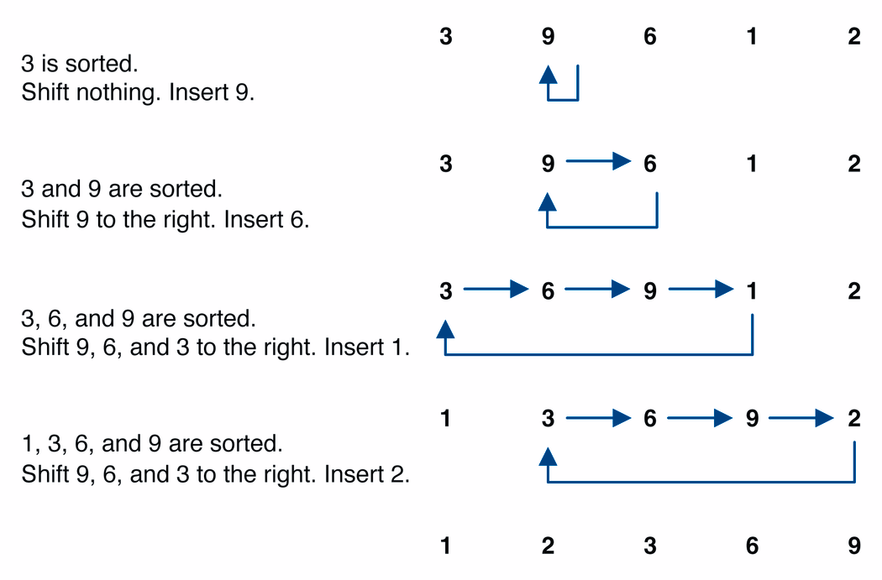
Insertion sort example

Slide 5
Insertion_ Sort Function
void insertion_sort(int x[ ],int k)
{ int nextval,nextpos,z;
nextpos = k;
nextval = x[nextpos];
z = shift(x,nextval,nextpos);
x[z] = nextval; }
int shift(int x[10],int nextval,int nextpos)
{
int done = 0;
while(done==0 &&nextpos>=1)
if(x[nextpos-1]>nextval)
{
x[nextpos]=x[nextpos-1];
nextpos --;
}
else
done=1;
return(nextpos);
}

Slide 6
Shift Function
int shift(int x[10],int nextval,int nextpos)
{
int done = 0;
while(done==0 &&nextpos>=1)
if(x[nextpos-1]>nextval)
{
x[nextpos]=x[nextpos-1];
nextpos --;
}
else
done=1;
return(nextpos);
}

Slide 7
Insertion sort code
public static void insertionSort(int[] a) {
for (int i = 1; i < a.length; i++) {
int temp = a[i];
// slide elements down to make room for a[i]
int j = i;
while (j > 0 && a[j - 1] > temp) {
a[j] = a[j - 1];
j--;
}
a[j] = temp;
}
}

Slide 8
Sorting practice problem
Consider the following array of int values.
[22, 11, 34, -5, 3, 40, 9, 16, 6]
(a) Write the contents of the array after 3 passes of the outermost loop of bubble sort.
(b) Write the contents of the array after 5 passes of the outermost loop of insertion sort.
(c) Write the contents of the array after 4 passes of the outermost loop of selection sort.

