Slide 1
File Management & Organization

Slide 2
Lecture 6
Chapter 1
Basic Organization Methods
(Hashing)

Slide 3
Contents of Lecture:
Basic file organizations
Hashing
What is Hashing?
Collisions
A Simple Hashing Algorithm
Example

Slide 4
4) Hashing
What is Hashing?
A Hash function is a function h(K) which transforms a key K into an address.
Hashing is like indexing in that it involves associating a key with a relative record address.

Slide 5
4) Hashing
What is Hashing?
Two important things:
With hashing, there is no connection between the key and the location.
With hashing, two different keys may be transformed to the same address (Collisions).
Example:
decide the file will have 1000 available addresses. Find the correct addresses for the following keys by hash function. Then draw the RAM addresses.

Slide 6
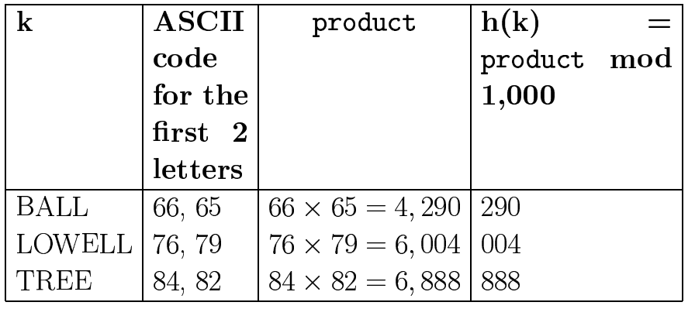
Example:

Slide 7
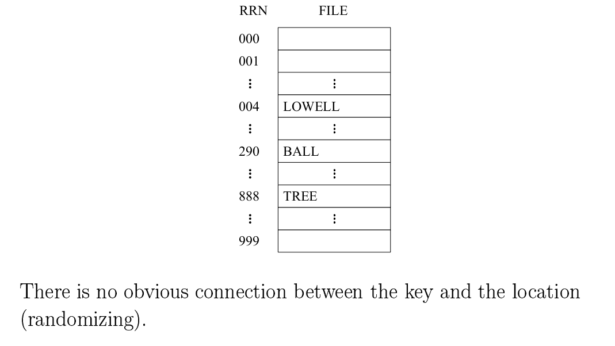
Example:
Draw the RAM addresses:

Slide 8
Collisions:
When two different keys produce the same address, there is a collision.
The keys involved are called synonyms.
Example of collision:

Slide 9
Collisions:
Possible Solutions:
Spread out the records
Use extra memory
Put more than one record at a single address.

Slide 10
A Simple Hashing Algorithm:
Step 1:
Represent the key in numerical form
Step 2:
Fold and Add
Step 3:
Divide by a prime number and use the remainder as the address.

Slide 11
A Simple Hashing Algorithm:
Step 1:
Represent the key in numerical form
Note: Number of characters in the key must be even and number of characters can be 6, 8, 10, 12 and more
Note: Use space to complete number of characters

Slide 12
A Simple Hashing Algorithm:
Step 2:

Slide 13
A Simple Hashing Algorithm:
Step 3:

Slide 14
Example:
We may decide the file will have 1000 available addresses. Find the correct addresses for the following keys by hash function by:
Complete the following table:
key
DEAN
EVANS
COLE
key | ASCII code for the first 2 characters | Product | H(key) = Product mod 1000
DEAN | 68,69 | 68*69 = 4692 | 692
EVANS | 69,86 | 69*86 = 5934 | 934
COLE | 67,79 | 67*79 = 5293 | 293

Slide 15
Example:
Draw the RAM addresses:
RRN | Key
000
001
002
…..
…..
293 | COLE
….
…..
…..
……
692 | DEAN
…..
…..
…..
934 | EVANS
……
999

Slide 16
Example:
Compute the Simple Hash Function for the following keys:
H (DEAN)
H (EVANS)
H (COLE)

Slide 17
Example:
Compute the Simple Hash Function for the following keys:
H (DEAN)
D | E | A | N | | | | | | |
68 69 65 78 32 32 32 32 32 32
6869 | 6578 | 3232 | 3232 | 3232
6869 + 6578 + 3232 + 3232 + 3232 = 23143
23143 mod 19937 = 3206
3206 mod 101 = 75

Slide 18
Example:
Compute the Simple Hash Function for the following keys:
H (EVANS)
E | V | A | N | S | | | | | |
69 86 65 78 83 32 32 32 32 32
6986 | 6578 | 8332 | 3232 | 3232
6986 + 6578 + 8332 + 3232 + 3232 = 28360
28360 mod 19937 = 8423
8423 mod 101 = 40

Slide 19
Example:
Compute the Simple Hash Function for the following keys:
H (COLE)
C | O | L | E | | | | | | |
67 79 76 69 32 32 32 32 32 32
6779 | 7669 | 3232 | 3232 | 3232
6779 + 7669 + 3232 + 3232 + 3232 = 24144
24144mod 19937 = 4207
4207 mod 101 = 66

