Slide 1
File Management & Organization

Slide 2
Lecture 10
Disk Management

Slide 3
Contents of Lecture:
Introduction
Disk formatting
File system
DOS FAT allocation table
Directory

Slide 4
Introduction:
Disk Management involves
Preparing disk for data storage (disk formatting).
Managing allocated and free disk space.
Managing disk I/O Buffer (part of main memory).
……
Disk Management done by System Software:
Operating Systems - File Manager
File Manager is a part of OS that is responsible for managing files, keeping tracks of files.

Slide 5
Disk formatting:
Disk formatting is the process of preparing a disk for data storage
Disk formatting has two type:
Physical format(low level format):
Specify how many bytes of data space of all sectors. Such as 256, 512, and 1,024 bytes.
Logical format(high level format):
Is to partition the disk into one or more groups of cylinders.
Is logical formatting, or creation of a file system.

Slide 6
File system:
File system is data structures used by OS to perform file management task.
These data structures may include:
Maps of free and allocated space (a FAT or inodes )
And an initial empty directory.
Examples of file systems:
FAT(File Allocation Table)
NTFS (New Technology File System)

Slide 7
DOS FAT allocation table:
A single File Allocation Table (FAT) that combines free list info and file allocation info.
In file descriptor/Directory, keep pointer to first block.
A FAT table entry contains either:
The block number of the next block in the file
A distinguished "end of file" (eof) value
A distinguished "free" value.

Slide 8
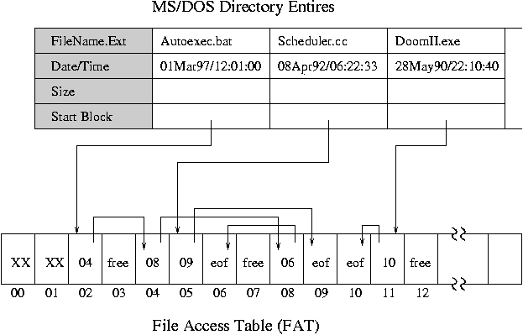
DOS FAT allocation table:

Slide 9
Directory:
Records information such as name, location, size, and type for all files on that volume.(File of records)
Operations that are to be performed on a directory:
Create a file.
Delete a file.
List a directory.
Rename a file

Slide 10
DBMS:
Operating systems give special programs the ability to use a disk partition as a large sequential array of logical blocks, without any file-system data structures.
This array is sometimes called the raw disk.
Some database systems prefer raw I/O because it enables them to control the exact disk location where each database record is stored.

