Slide 1
Operating System Concepts

Slide 2
Lecture 8
C
Deadlocks (cont..)
References for Lecture:
Abraham Silberschatz, Peter Bear Galvin and Greg Gagne, Operating System Concepts, 9th Edition, Chapter 7

Slide 3
Contents of Lecture
System Model
Deadlock Characterization
Methods for Handling Deadlocks
Deadlock Prevention
Deadlock Avoidance
Deadlock Detection
Recovery from Deadlock

Slide 4
Deadlock Avoidance
An alternative method for avoiding deadlocks is to require additional information about how resources are to be requested.
For example, in a system with one tape drive and one printer, the system might need to know that process P will request first the tape drive and then the printer before releasing both resources, whereas process Q will request first the printer and then the tape drive.
With this knowledge of the complete sequence of requests and releases for each process, the system can decide for each request whether or not the process should wait in order to avoid a possible future deadlock.

Slide 5
Deadlock Avoidance
Requires that the system has some additional a priori information available:
Simplest and most useful model requires that each process declare the maximum number of resources of each type that it may need
The deadlock avoidance algorithm dynamically examines the resource allocation state to ensure that there can never be a circular wait condition
Resource allocation state is defined by the number of available and allocated resources, and the maximum demands of the processes

Slide 6
Deadlock Avoidance
Avoidance Algorithms:
Single instance of a resource type
Use a resource-allocation graph algorithm
Multiple instances of a resource type
Use the banker’s algorithm

Slide 7
Resource-allocation graph algorithm
In addition to the request and assignment edges already described, introduce a new type of edge, called a claim edge.
A claim edge Pi → Rj indicates that process Pi may request resource Rj at some time in the future.
This edge resembles a request edge in direction but is represented in the graph by a dashed line.
The algorithm:
Claim edge converts to request edge when a process requests a resource
Request edge converted to an assignment edge when the resource is allocated to the process
When a resource is released by a process, assignment edge reconverts to a claim edge

Slide 8
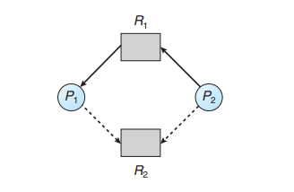
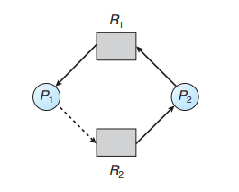
Resource-allocation graph algorithm
To illustrate the algorithm.
An unsafe state in a resource-allocation graph

Slide 9
Banker’s algorithm
When a new process enters the system, it must declare the maximum number of instances of each resource type that it may need.
When a user requests a set of resources, the system must determine whether the allocation of these resources will leave the system in a safe state.
If it will, the resources are allocated;
Otherwise, the process must wait until some other process releases enough resources.

Slide 10
Banker’s algorithm
Data structures for banker’s algorithm
Let n is the number of processes in the system and m is the number of resource types:
Available: A vector of length m indicates the number of available resources of each type.
If Available [j] equals k, then k instances of resource type Rj are available.
Max: An n × m matrix defines the maximum demand of each process.
If Max[i][j] equals k, then process Pi may request at most k instances of resource type Rj .

Slide 11
Banker’s algorithm
Data structures for banker’s algorithm
Let n is the number of processes in the system and m is the number of resource types:
Allocation: An n × m matrix defines the number of resources of each type currently allocated to each process.
If Allocation[i][j] equals k, then process Pi is currently allocated k instances of resource type Rj .
Need: An n × m matrix indicates the remaining resource need of each process.
If Need[i][j] equals k, then process Pi may need k more instances of resource type Rj to complete its task.
Note that
Need[i][j] equals Max[i][j] − Allocation[i][j]

Slide 12
Banker’s algorithm
Safety algorithm
Let Work and Finish be vectors of length m and n, respectively. Initialize:
Work = Available
Finish [i] = false for i = 0, 1, …, n- 1
Find an i such that both:
(a) Finish [i] = false
(b) Needi <= Work
If no such i exists, go to step 4
Work = Work + Allocation i
Finish[i] = true
go to step 2
If Finish [i] == true for all i, then the system is in a safe state

Slide 13
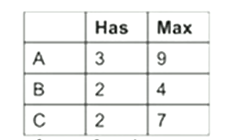
Banker’s algorithm
Example with a Banker
Consider a banker with 3 clients (A, B, C)
Each client has certain limits (totaling 20 units)
The banker know that max credits will not be used at once, so keeps only 10 units
Total: 10 units free: 3 units
Client declare maximum credits in advance. The banker can allocate credits provided no unsafe state is reached.

Slide 14
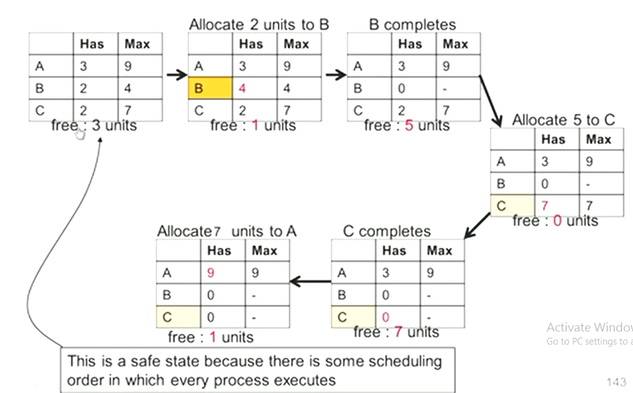
Banker’s algorithm
Example with a Banker
Safe state

Slide 15
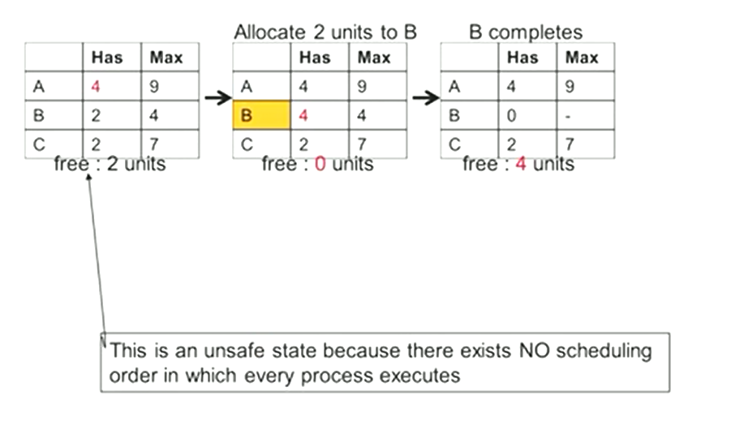
Banker’s algorithm
Example with a Banker
Unsafe state

Slide 16
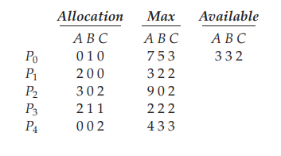
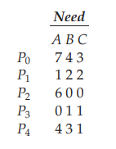
Banker’s algorithm
Example
To illustrate the use of the banker’s algorithm, consider the following:
5 processes P0 through P4;
3 resource types:
A (10 instances), B (5instances), and C (7 instances)
Snapshot at time T0:
The content of the matrix Need is defined to be Max−Allocation and is as:
The system is in a safe state since the sequence < P1, P3, P4, P2, P0> satisfies safety criteria

Slide 17
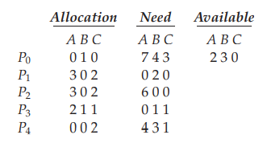
Banker’s algorithm
Example
Suppose now that process P1 requests one additional instance of resource type A and two instances of resource type C, so Request1 = (1,0,2) ≤ (3,3,2).
Executing safety algorithm shows that sequence < P1, P3, P4, P0, P2> satisfies safety requirement
Exercise:
Can request for (3,3,0) by P4 be granted?
Can request for (0,2,0) by P0 be granted?

Slide 18
Deadlock Detection
Allow system to enter deadlock state, after that used:
Detection algorithm
Recovery scheme

Slide 19
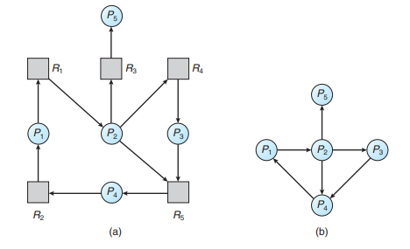
Deadlock Detection
Single Instance of Each Resource Type
If all resources have only a single instance, then can define a deadlock detection algorithm that uses a variant of the resource-allocation graph, called a wait-for graph.
An edge from Pi to Pj in a wait-for graph implies that process Pi is waiting for process Pj to release a resource that Pi needs.
An edge Pi → Pj exists in a wait-for graph if and only if the corresponding resource allocation graph contains two edges Pi → Rq and Rq → Pj for some resource Rq .
As before, a deadlock exists in the system if and only if the wait-for graph contains a cycle.

Slide 20
Deadlock Detection
Several Instances of a Resource Type
The algorithm employs several data structures that are similar to those used in the banker’s algorithm:
Available: A vector of length m indicates the number of available resources of each type.
Allocation: An n × m matrix defines the number of resources of each type currently allocated to each process.
Request: An n × m matrix indicates the current request of each process.
If Request[i][j] equals k, then process Pi is requesting k more instances of resource type Rj

Slide 21
Deadlock Detection
Detection algorithm
Let Work and Finish be vectors of length m and n, respectively. Initialize:
Work = Available.
For i = 0, 1, ..., n–1,
if Allocation i ≠ 0,
then Finish[i] =false.
Otherwise, Finish[i] = true.
Find an index i such that both
a. Finish[i] == false
b. Requesti ≤ Work
If no such i exists, go to step 4.

Slide 22
Deadlock Detection
Detection algorithm
Work = Work + Allocation i
Finish[i] = true
Go to step 2.
If Finish[i] == false for some i, 0 ≤ i < n, then the system is in a deadlocked state. Moreover, if Finish[i] == false, then process Pi is deadlocked.

Slide 23
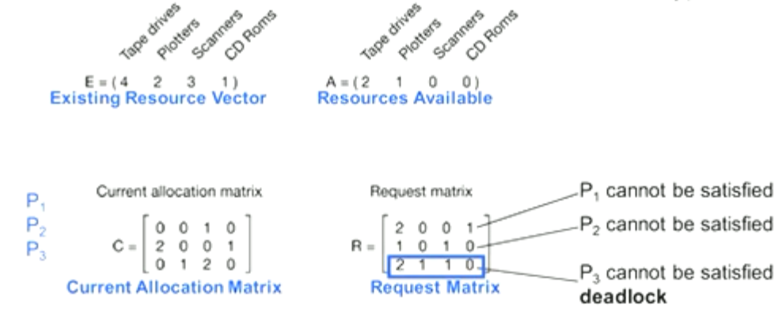
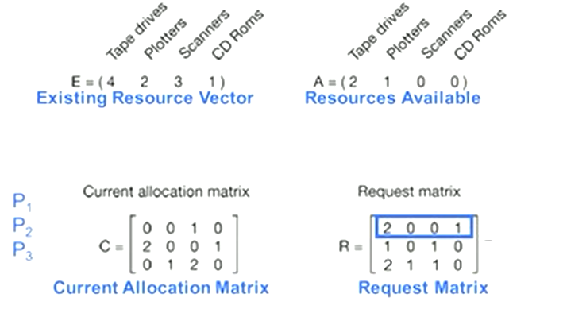
Deadlock Detection
Example
Check if there is any sequence of allocation by which all current request can be met. If so, there is no deadlock.

Slide 24
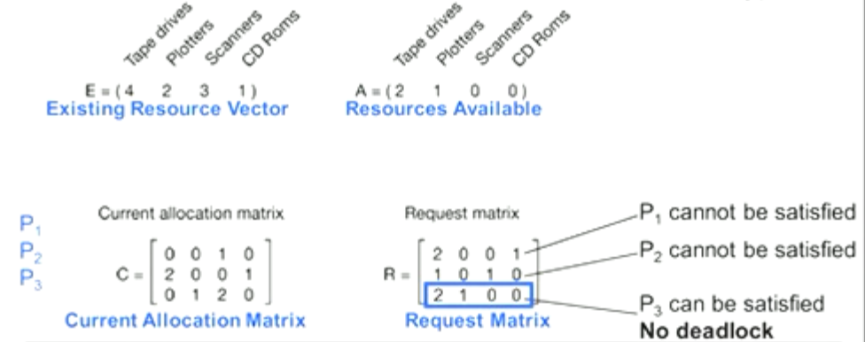
Deadlock Detection
Example
If P3 change the request to (2 1 0 0) as following. P3 can be satisfied, so, no deadlock.

Slide 25
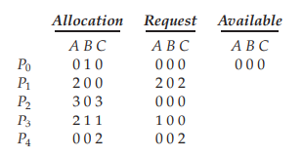
Deadlock Detection
Example
Consider the following:
Claim that the system is not in a deadlocked state, if execute t the sequence <P0, P2, P3, P1, P4>.

Slide 26
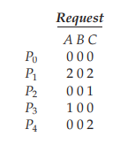
Deadlock Detection
Example
Suppose now that process P2 makes one additional request for an instance of type C. The Request matrix is modified as follows:
A deadlock exists, consisting of processes P0, P1, P2, P3, and P4.

Slide 27
Recovery from Deadlock
There are two options for breaking a deadlock.
One is simply to abort one or more processes to break the circular wait.
The other is to preempt some resources from one or more of the deadlocked processes.

Slide 28
Recovery from Deadlock
Process Termination
To eliminate deadlocks by aborting a process, one of two methods used:
Abort all deadlocked processes
Abort one process at a time until the deadlock cycle is eliminated
Many factors may affect which process is chosen, including:
What the priority of the process is
How long the process has computed and how much longer the process will compute before completing its designated task
How many and what types of resources the process has used (for example, whether the resources are simple to preempt)
How many more resources the process needs in order to complete
How many processes will need to be terminated
Whether the process is interactive or batch

Slide 29
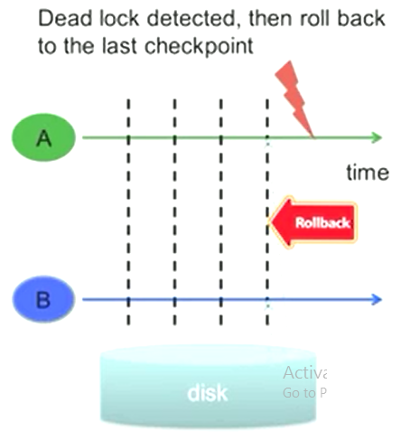
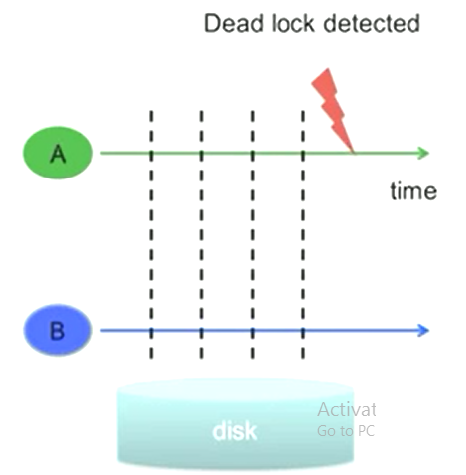
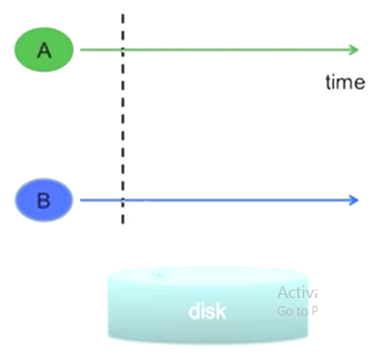
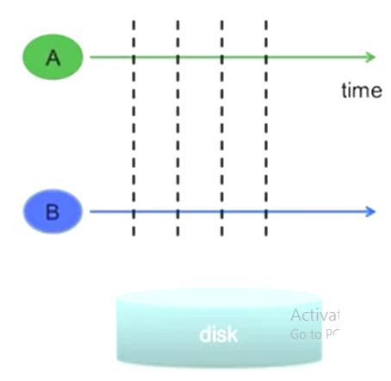
Recovery from Deadlock
Resource Preemption
Preempt some resources from processes and give these resources to other processes until the deadlock cycle is broken.
If preemption is required to deal with deadlocks, then three issues need to be addressed:
Selecting a victim: Which resources and which processes are to be preempted? As in process termination, must determine the order of preemption to minimize cost.
Rollback: Checkpoint states and then rollback.
Starvation: same process may always be picked as victim, include number of rollback in cost factor

