Slide 1
Operating System Concepts

Slide 2
Lecture 7
C
Deadlocks
References for Lecture:
Abraham Silberschatz, Peter Bear Galvin and Greg Gagne, Operating System Concepts, 9th Edition, Chapter 7

Slide 3
Contents of Lecture
System Model
Deadlock Characterization
Methods for Handling Deadlocks
Deadlock Prevention

Slide 4
System Model
A system consists of a finite number of resources to be distributed among a number of processes.
The resources may be partitioned into several types (or classes (R1, R2, . . ., Rm).
CPU cycles, files, and I/O devices (such as printers and DVD drives).
Each resource type Ri has Wi instances.
If a system has two CPUs, then the resource type CPU has two instances. Similarly, the resource type printer may have five instances
A process may utilize a resource in only the following sequence:
Request
Use
Release

Slide 5
Deadlock Characterization
Necessary Conditions
A deadlock situation can arise if the following four conditions hold simultaneously in a system:
Mutual exclusion: At least one resource must be held in a non sharable mode; only one process at a time can use the resource. If another process requests that resource, the requesting process must be delayed until the resource has been released.
Hold and wait: A process must be holding at least one resource and waiting to acquire additional resources that are currently being held by other processes.

Slide 6
Deadlock Characterization
Necessary Conditions
A deadlock situation can arise if the following four conditions hold simultaneously in a system:
No preemption: Resources cannot be preempted; a resource can be released only by the process holding it, after that process has completed its task.
Circular wait: There exists a set {P0, P1, ..., Pn} of waiting processes must exist such that P0 is waiting for a resource held by P1, P1 is waiting for a resource held by P2, ..., Pn−1 is waiting for a resource held by Pn, and Pn is waiting for a resource held by P0.

Slide 7
Deadlock Characterization
Resource-Allocation Graph
This graph consists of a set of vertices V and a set of edges E.
The set of vertices V is partitioned into two different types of nodes:
P = {P1, P2, ..., Pn}, the set consisting of all the active processes in the system.
R = {R1, R2, ..., Rm}, the set consisting of all resource types in the system.
A directed edge Pi → Rj is called a request edge.
A directed edge Rj → Pi is called an assignment edge.

Slide 8
Deadlock Characterization
Resource-Allocation Graph
Representation of graph:
Process: Represent each process Pi as a circle
Resource: Each resource type Rj as a rectangle and represent each such instance as a dot within the rectangle Resource Type with 4 instances
Request edge : Pi requests instance of Rj
Assignment edge: Pi is holding an instance of Rj

Slide 9
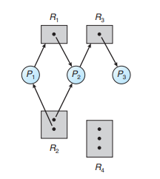
Deadlock Characterization
Resource-Allocation Graph
Example of graph:
The sets P, R, and E:
P = {P1, P2, P3}
R = {R1, R2, R3, R4}
E = {P1 → R1, P2 → R3, R1 → P2, R2 → P2, R2 → P1, R3 → P3}

Slide 10
Deadlock Characterization
Resource-Allocation Graph
Example of graph:
Resource instances:
One instance of resource type R1
Two instances of resource type R2
One instance of resource type R3
Three instances of resource type R4

Slide 11
Deadlock Characterization
Resource-Allocation Graph
Example of graph:
Process states :
Process P1 is holding an instance of resource type R2 and is waiting for an instance of resource type R1.
Process P2 is holding an instance of R1 and an instance of R2 and is waiting for an instance of R3.
Process P3 is holding an instance of R3.

Slide 12
Deadlock Characterization
Resource-Allocation Graph
Basic Facts:
If graph contains no cycles → no deadlock
If graph contains a cycle →
if only one instance per resource type, then deadlock
if several instances per resource type, possibility of deadlock

Slide 13
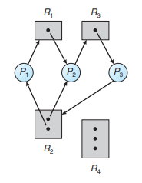
Deadlock Characterization
Resource-Allocation Graph
Example of graph with a deadlock:
Two cycles exist:
P1 → R1 → P2 → R3 → P3 → R2 → P1
P2 → R3 → P3 → R2 → P2

Slide 14
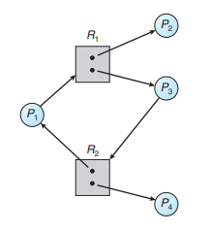
Deadlock Characterization
Resource-Allocation Graph
Example of graph without a deadlock:
Have a cycles exist:
P1 → R1 → P3 → R2 → P1

Slide 15
Methods for Handling Deadlocks
Generally, can deal with the deadlock problem in one of three ways:
Can use a protocol to prevent or avoid deadlocks, ensuring that the system will never enter a deadlocked state.
Deadlock prevention
Deadlock avoidence
Can allow the system to enter a deadlocked state, detect it, and recover.
Can ignore the problem and pretend that deadlocks never occur in the system (used by most operating systems, including UNIX).

Slide 16
Deadlock Prevention
To occur a deadlock, there are four necessary conditions must hold. By ensuring that at least one of these conditions cannot hold, can prevent the occurrence of a deadlock.
Mutual Exclusion: not required for sharable resources (e.g., read-only files); must hold for non-sharable resources
Hold and Wait: must guarantee that whenever a process requests a resource, it does not hold any other resources
Require process to request and be allocated all its resources before it begins execution.
Or allow process to request resources only when the process has none allocated to it.
Low resource utilization; starvation possible

Slide 17
Deadlock Prevention
To occur a deadlock, there are four necessary conditions must hold. By ensuring that at least one of these conditions cannot hold, can prevent the occurrence of a deadlock.
No Preemption: If a process that is holding some resources requests another resource that cannot be immediately allocated to it, then all resources currently being held are released
Preempted resources are added to the list of resources for which the process is waiting
Process will be restarted only when it can regain its old resources, as well as the new ones that it is requesting
Circular Wait: impose a total ordering of all resource types, and require that each process requests resources in an increasing order of enumeration

Slide 18
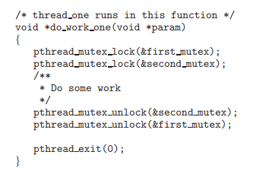
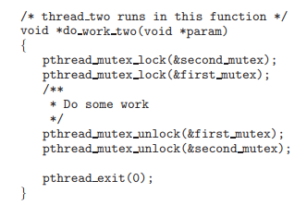
Deadlock Prevention
Deadlock example

Slide 19
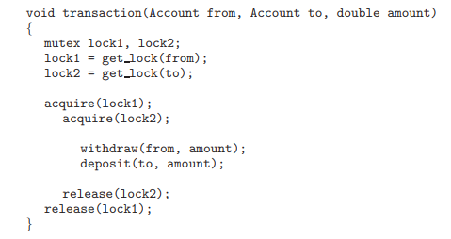
Deadlock Prevention
Deadlock example with lock ordering

