Slide 1

Operating System Concepts

Slide 2
Lecture 3
CProcesses
References for Lecture:
  Abraham Silberschatz, Peter Bear Galvin and Greg Gagne, Operating System Concepts, 9th Edition, Chapter 3

Slide 3
Contents of Lecture
Process Concept
Process Scheduling
Operations on Processes

Slide 4
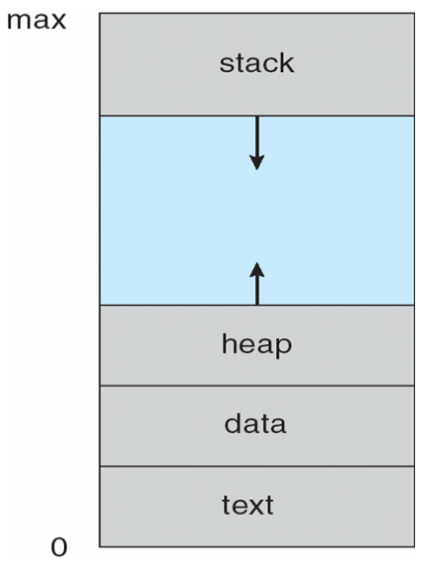
Process Concept
Process is a program in execution; process execution must progress in sequential fashion.
A process is more than the program code, which is sometimes known as the text section. It also includes:
  The current activity, as represented by the value of the program counter and the contents of the processor’s registers.
  Stack containing temporary data
    Function parameters, return addresses, local variables
  Data section containing global variables
  Heap containing memory dynamically allocated during run time
The structure of a process in memory is shown in next figure.

Slide 5
Process Concept
A program is a passive entity, such as a file containing a list of instructions stored on disk (often called an executable file).
  Program becomes process when executable file loaded into memory (process is an active entity).
Execution of program started via GUI mouse clicks, command line entry of its name, etc.
One program can be several processes
  Consider multiple users executing the same program

Slide 6
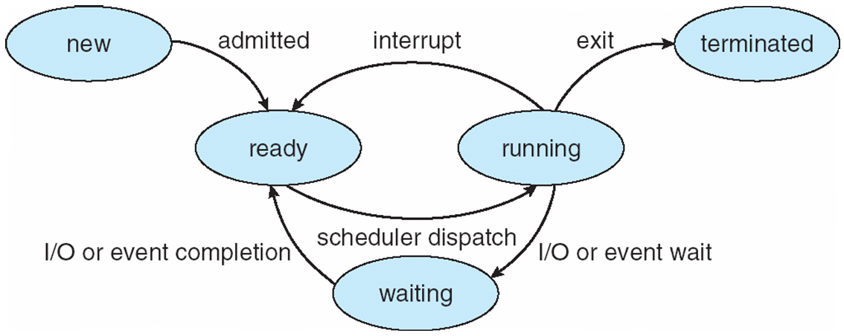
Process Concept
Process State
As a process executes, it changes state. The state of a process is defined in part by the current activity of that process.
A process may be in one of the following states:
  New: The process is being created.
  Ready: The process is waiting to be assigned to a processor.
  Running: Instructions are being executed.
  Waiting: The process is waiting for some event to occur (such as an I/O completion or reception of a signal).
  Terminated: The process has finished execution.

Slide 7
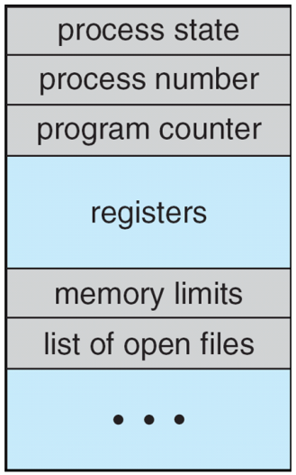
Process Concept
Process Control Block (PCB)
Each process is represented in the operating system by a process control block (PCB) also called a task control block.
It contains many pieces of information associated with a specific process, including these:
Process state: The state may be new, ready, running, waiting, halted, and so on.
Program counter: The counter indicates the address of the next instruction to be executed for this process.
CPU registers: The registers vary in number and type, depending on the computer architecture.

Slide 8
Process Concept
Process Control Block (PCB)
Each process is represented in the operating system by a process control block (PCB) also called a task control block.
It contains many pieces of information associated with a specific process, including these:
CPU scheduling information: This information includes a process priority, pointers to scheduling queues, and any other scheduling parameters.
Accounting information: This information includes the amount of CPU and real time used, time limits, account numbers, job or process numbers, and so on.

Slide 9
Process Concept
Process Control Block (PCB)
Each process is represented in the operating system by a process control block (PCB) also called a task control block.
It contains many pieces of information associated with a specific process, including these:
Memory-management information: This information may include such items as the value of the base and limit registers and the page tables, or the segment tables, depending on the memory system used by the operating system.
I/O status information: This information includes the list of I/O devices allocated to the process, a list of open files, and so on.

Slide 10
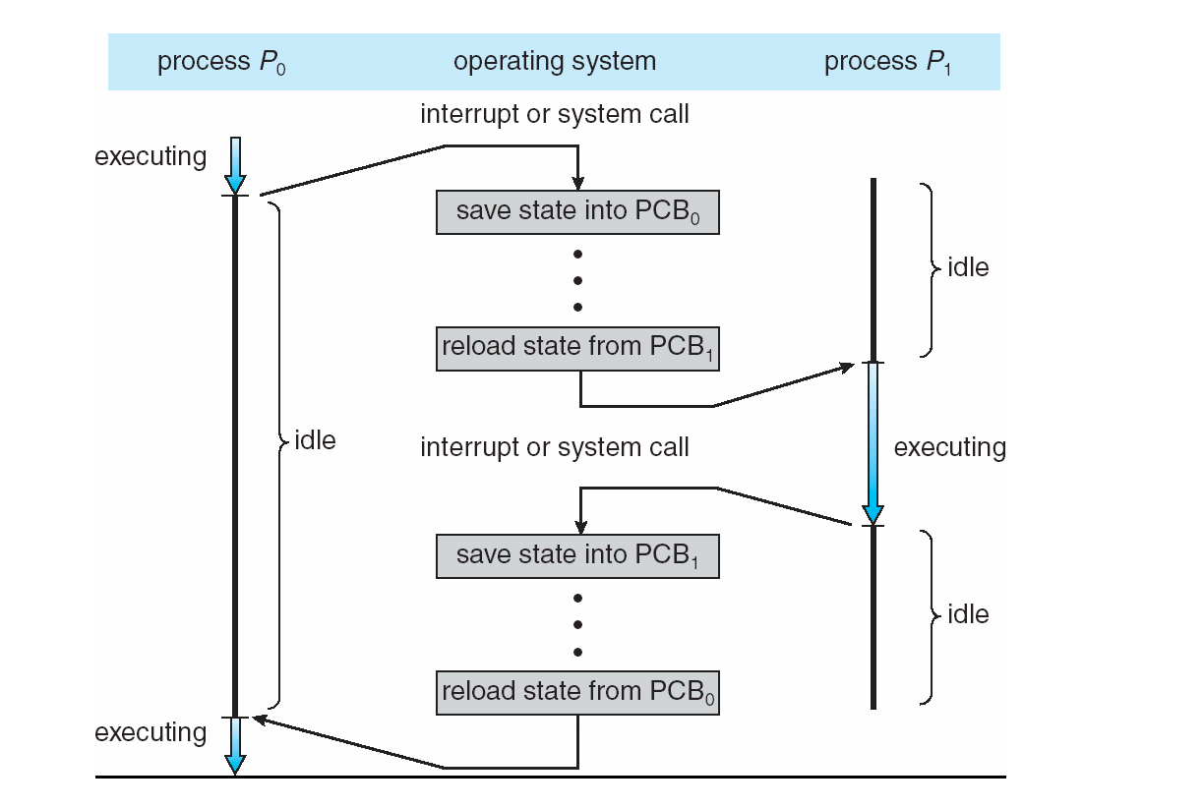
Process Concept
Process Control Block (PCB)
Diagram showing CPU switch from process to process

Slide 11
Process Scheduling
The objective of multiprogramming is to have some process running at all times, to maximize CPU utilization.
The objective of time sharing is to switch the CPU among processes so frequently that users can interact with each program.
  Maximize CPU use, quickly switch processes onto CPU for time sharing
Process scheduler selects an available process (possibly from a set of several available processes) for program execution on the CPU.

Slide 12
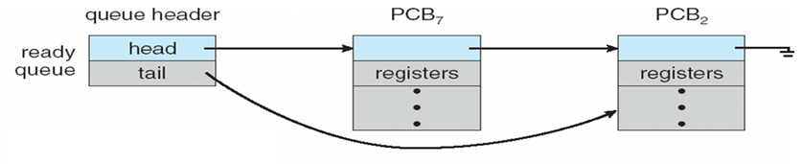
Process Scheduling
Scheduling queues
Job queue:
  As processes enter the system, they are put into a job queue, which consists of all processes in the system.
Ready queue:
  The processes that are residing in main memory and are ready and waiting to execute are kept on a list called the ready queue.
    This queue is generally stored as a linked list.
    A ready-queue header contains pointers to the first and final PCBs in the list.
    Each PCB includes a pointer field that points to the next PCB in the ready queue.

Slide 13
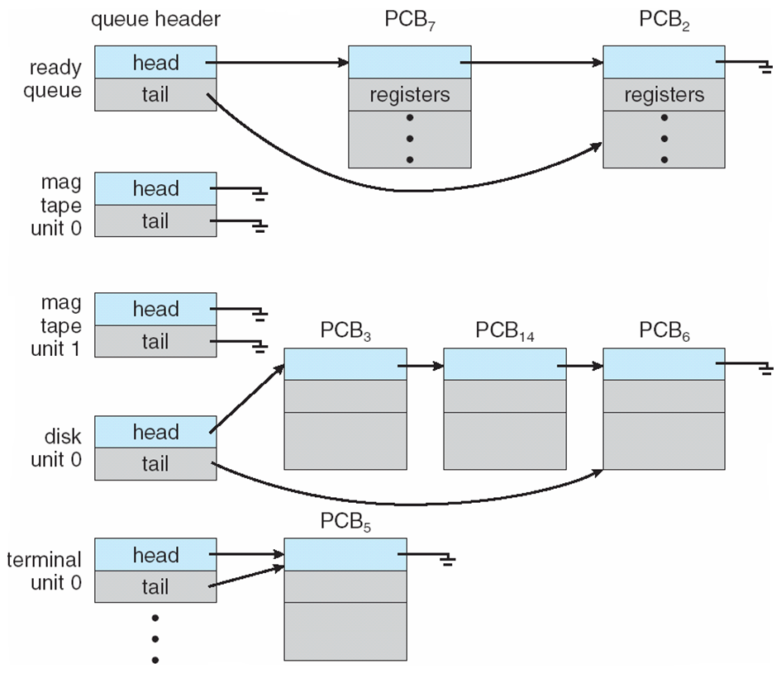
Process Scheduling
Scheduling queues
Device queue:
  The list of processes waiting for a particular I/O device is called a device queue. Each device has its own device queue next figure.

Slide 14
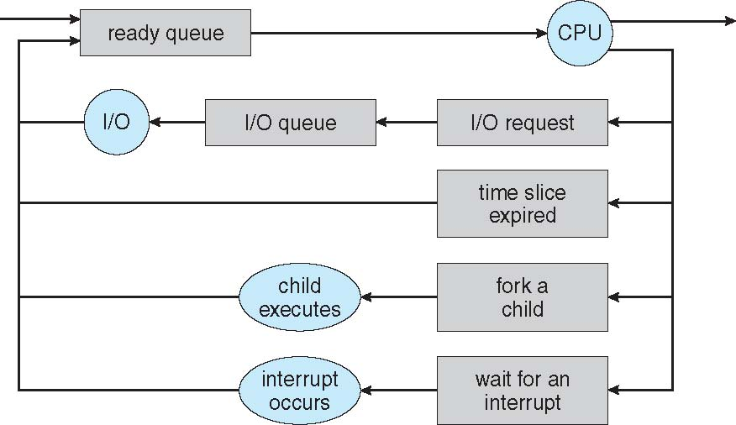
Process Scheduling
The circles represent the resources that serve the queues, and the arrows indicate the flow of processes in the system.
A new process is initially put in the ready queue. It waits there until it is selected for execution.
The process could create a new child process and wait for the child’s termination.
Once the process is allocated the CPU and is executing, one of several events could occur:
The process could issue an I/O request and then be placed in an I/O queue.
The process could be removed from the CPU, as a result of an interrupt, and be put back in the ready queue.
Each rectangular box represents a queue. Two types of queues present:
The ready queue and a set of device queues.
Queueing diagram
A common representation of process scheduling is a queueing diagram, such as that in next figure.
1
2
3

Slide 15
Process Scheduling
Schedulers
A process migrates among the various scheduling queues throughout its lifetime.
The operating system must select, for scheduling purposes, processes from these queues in some fashion.
The selection process is carried out by the appropriate scheduler.

Slide 16
Process Scheduling
Schedulers
Long-term scheduler (or job scheduler):
Often, in a batch system, more processes are submitted than can be executed immediately. These processes are spooled to a mass-storage device (typically a disk), where they are kept for later execution.
The long-term scheduler, or job scheduler, selects processes from this pool and loads them into memory for execution.
  Selects which processes should be brought into the ready queue
  Controls the degree of multiprogramming (the number of processes in memory).
Long-term scheduler is invoked infrequently (seconds, minutes) → (may be slow)

Slide 17
Process Scheduling
Schedulers
Short-term scheduler (or CPU scheduler):
The short-term scheduler, or CPU scheduler, selects from among the processes that are ready to execute and allocates the CPU to one of them.
  selects which process should be executed next and allocates CPU
Sometimes the only scheduler in a system
Short-term scheduler is invoked frequently (milliseconds) →(must be fast)

Slide 18
Process Scheduling
Schedulers
Processes can be described as either:
I/O-bound process:
  Spends more time doing I/O than computations, many short CPU bursts
CPU-bound process:
  Spends more time doing computations; few very long CPU bursts

Slide 19
Process Scheduling
Context Switch
When CPU switches to another process, the system must save the state of the old process and load the saved state for the new process via a context switch.
Context of a process represented in the PCB.
Context-switch time is overhead; the system does no useful work while switching
The more complex the OS and the PCB → the longer the context switch
Time dependent on hardware support
Some hardware provides multiple sets of registers per CPU → multiple contexts loaded at once

Slide 20
Operations on Processes
The processes in most systems can execute concurrently, these systems must provide a mechanism for:
    Process creation
    Process termination

Slide 21
Operations on Processes
    Process creation
During the course of execution, a process may create several new processes.
  The creating process is called a parent process, and the new processes are called the children of that process.
  Each of these new processes may in turn create other processes, forming a tree of processes.
Most operating systems (including UNIX, Linux, and Windows) identify processes according to a unique process identifier (or pid), which is typically an integer number.
Next figure illustrates a typical process tree for the Linux operating system, showing the name of each process and its pid:

Slide 22
Operations on Processes
The init process (which always has a pid of 1) serves as the root parent process for all user processes.
Using the bash command-line interface, this user has created the process ps as well as the emacs editor.
On UNIX and Linux systems, we can obtain a listing of processes by using the ps command. For example, the command ( ps –el ).
The sshd process is responsible for managing clients that connect to the system by using ssh (which is short for secure shell).
The login process is responsible for managing clients that directly log onto the system.
In this example, a client has logged on and is using the bash shell, which has been assigned pid 8416.
The kthreadd process is responsible for creating additional processes that perform tasks on behalf of the kernel (in this situation, khelper and pdflush).
In the following figure, we see the children of init :
    Process creation

Slide 23
Operations on Processes
    Process creation
Resource sharing options
In general, when a process creates a child process, that child process will need certain resources (CPU time, memory, files, I/O devices) to accomplish its task.
    Parent and children share all resources
    Children share subset of parent’s resources
    Parent and child share no resources

Slide 24
Operations on Processes
    Process creation
Execution options
When a process creates a new process, two possibilities for execution exist:
  The parent continues to execute concurrently with its children.
  The parent waits until some or all of its children have terminated.
Address-space
There are also two address-space possibilities for the new process:
  The child process is a duplicate of the parent process (it has the same program and data as the parent).
  The child process has a new program loaded into it.

Slide 25
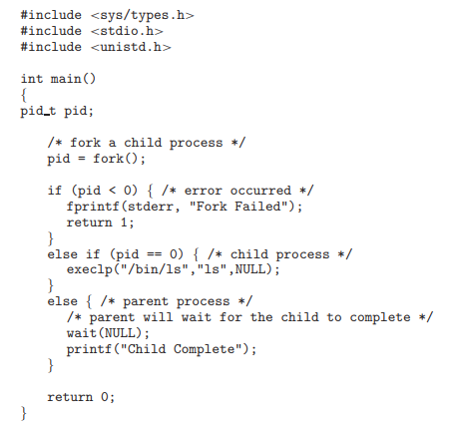
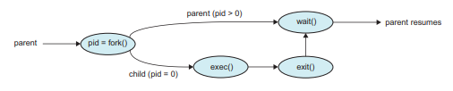
Operations on Processes
    Process creation
UNIX examples
The C program shown in next figure illustrates the UNIX system calls. Have two different processes running copies of the same program.

Slide 26
Operations on Processes
    Process termination
A process terminates when it finishes executing its final statement and asks the operating system to delete it by using the exit() system call. At that point:
  The child process return a status value (typically an integer) to its parent process (via the wait() system call).
  All the resources of the process (including physical and virtual memory, open files, and I/O buffers ) are deallocated by the operating system.

Slide 27
Operations on Processes
    Process termination
A parent may terminate the execution of one of its children processes using the abort() system call for a variety of reasons, such as these:
  The child has exceeded its usage of some of the resources that it has been allocated. (To determine whether this has occurred, the parent must have a mechanism to inspect the state of its children.)
  The task assigned to the child is no longer required.
  The parent is exiting, and the operating system does not allow a child to continue if its parent terminates.

Slide 28
Operations on Processes
    Process termination
Some operating systems do not allow child to exists if its parent has terminated. If a process terminates, then all its children must also be terminated.
  Cascading termination. All children, grandchildren, etc. are terminated.
  The termination is initiated by the operating system.

Slide 29
Operations on Processes
    Process termination
The parent process may wait for termination of a child process by using the wait() system call. The call returns status information and the pid of the terminated process
    pid t pid;
    int status;
    pid = wait(&status);
If no parent waiting (did not invoke wait()) process is a zombie
If parent terminated without invoking wait , process is an orphan

