Slide 1
Operating System Concepts

Slide 2
Lecture 10
C
Virtual Memory
References for Lecture:
Abraham Silberschatz, Peter Bear Galvin and Greg Gagne, Operating System Concepts, 9th Edition, Chapter 9

Slide 3
Contents of Lecture
Background
Demand Paging
Page Replacement
Page and Frame Replacement Algorithms

Slide 4
Background
The requirement that instructions(Code) must be in physical memory to be executed, the entire program is not needed:
Programs often have code to handle unusual error conditions (Error code).
large data structures (Arrays, lists, tables)
Certain options and features of a program may be used rarely (unusual routines).
Even in those cases where the entire program is needed, it may not all be needed at the same time.

Slide 5
Background
Virtual memory: technique that allows the execution of processes that are not completely in memory
Separation of user logical memory from physical memory
Only part of the program needs to be in memory for execution
Allows address spaces to be shared by several processes
Allows for more efficient process creation
More programs running concurrently
Less I/O needed to load or swap processes
Virtual memory can be implemented via Demand paging

Slide 6
Demand Paging
Demand Paging is a technique bring a page into memory only when it is needed during program execution
Similar to paging system with swapping
If page needed and not memory resident
Need to load the page into memory from storage

Slide 7
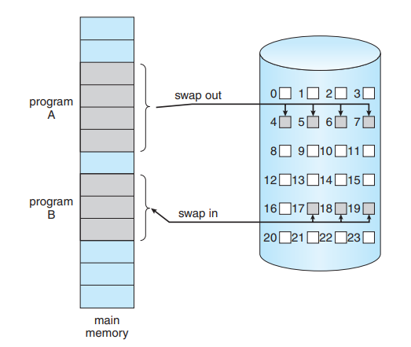
Demand Paging
Transfer of a paged memory to contiguous disk space.

Slide 8
Demand Paging
Basic Concepts
With swapping, pager (swapper) guesses which pages will be used before swapping out again
Instead, pager brings in only those pages (pages that will be used ) into memory
If page needed and not memory resident
Need to detect and load the page into memory from storage
Without changing program behavior
Without programmer needing to change code

Slide 9
Demand Paging
Valid-Invalid Bit
hardware support needed to distinguish between the pages that are in memory and the pages that are on the disk.
With each page table entry a valid–invalid bit is associated
v → in-memory (memory resident)
i → not-in-memory
Initially valid–invalid bit is set to i on all entries

Slide 10
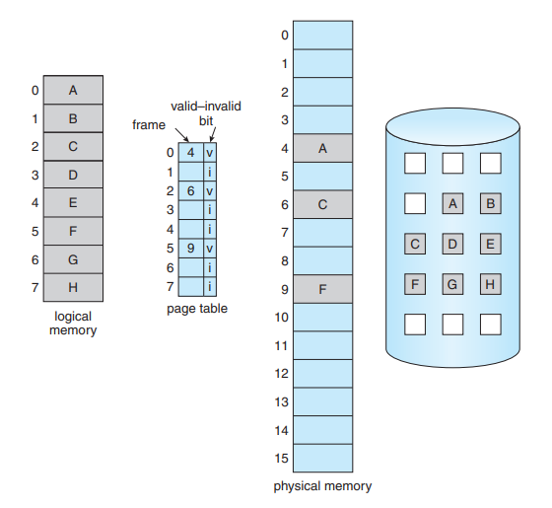
Demand Paging
Valid-Invalid Bit
Page table when some pages are not in main memory

Slide 11
Demand Paging
During MMU address translation, if valid–invalid bit in page table and entry is i then access to it causes page fault
Page Fault handling steps

Slide 12
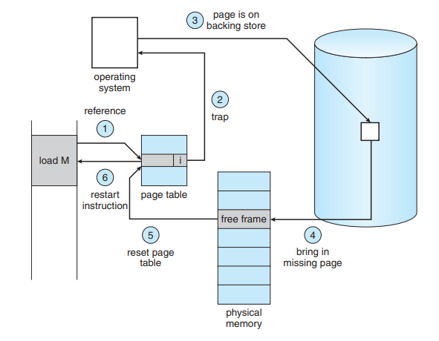
Demand Paging
v

Slide 13
Demand Paging
Aspects of Demand Paging
Extreme case – start process with no pages in memory
OS sets instruction pointer to first instruction of process, if it non-memory-resident -> page fault
And for every other process pages on first access
Pure demand paging:
Never bring a page into memory until it is required.
Hardware support needed for demand paging
Page table with valid / invalid bit
Secondary memory (swap device with swap space)
Instruction restart

Slide 14
Demand Paging
What Happens if There is no Free Frame?
Page replacement – find some page in memory, but not really in use, page it out
Algorithm: terminate? swap out? replace the page?
Performance: want an algorithm which will result in minimum number of page faults
Same page may be brought into memory several times

Slide 15
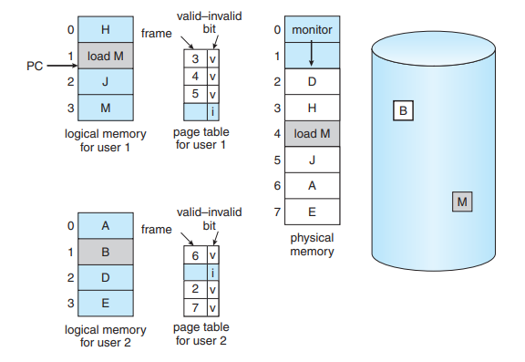
Page Replacement
If no frame is free find one that is not currently being used and free it.

Slide 16
Page Replacement
If no frame is free find one that is not currently being used and free it.
Write its contents to swap space and changing the page table (and all other tables) to indicate that the page is no longer in memory
Use the freed frame to hold the page for which the process faulted.
Use modify (dirty) bit to reduce overhead of page transfers – only modified pages are written to disk
Page replacement completes separation between logical memory and physical memory – large virtual memory can be provided on a smaller physical memory

Slide 17
Page Replacement
Need for page replacement.

Slide 18
Page Replacement
Basic Page Replacement
Find the location of the desired page on the disk.
Find a free frame:
If there is a free frame, use it.
If there is no free frame, use a page-replacement algorithm to select a victim frame.
Write the victim frame to the disk; change the page and frame tables accordingly.
Read the desired page into the newly freed frame; change the page and frame tables.
Continue the user process from where the page fault occurred.

Slide 19
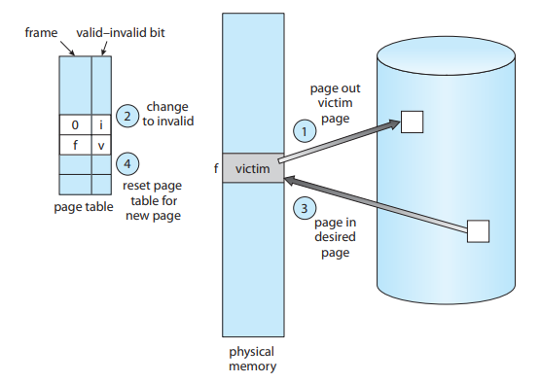
Page Replacement
Basic Page Replacement
Page replacement

Slide 20
Page &Frame Replacement Algorithms
Frame-allocation algorithm: determines
How many frames to give each process
Which frames to replace
Page-replacement algorithm: want lowest page-fault rate on both first access and re-access
Evaluate algorithm by running it on a particular string of memory references (reference string) and computing the number of page faults on that string
String is just page numbers, not full addresses
Repeated access to the same page does not cause a page fault
Results depend on number of frames available
Note :In all our examples, the reference string of referenced page numbers is
7,0,1,2,0,3,0,4,2,3,0,3,0,3,2,1,2,0,1,7,0,1

Slide 21
1. First-In-First-Out (FIFO) Algorithm
The simplest page-replacement algorithm is a first-in, first-out (FIFO) algorithm.
When a page must be replaced, the oldest page is chosen.
Replace the page at the head of the queue. When a page is brought into memory, insert it at the tail of the queue.
Reference string: 7,0,1,2,0,3,0,4,2,3,0,3,0,3,2,1,2,0,1,7,0,1
3 frames (3 pages can be in memory at a time per process)

Slide 22
1. First-In-First-Out (FIFO) Algorithm

Slide 23
2. Optimal Algorithm
Replace the page that will not be used for the longest period of time.
This algorithm that has the lowest page-fault rate of all algorithms.

Slide 24
3. Least Recently Used (LRU) Algorithm
Use past knowledge rather than future
LRU replacement associates with each page the time of that page’s last use.
When a page must be replaced, LRU chooses the page that has not been used for the longest period of time

