Slide 1
Operating Systems Concepts
Chapter (1)
Introduction
University of Science and Technology
Faculty of Computer Science and Information Technology
Instructor: Diaa Eldein Mustafa Ahmed
2018

Slide 2
Course Schedule
Week | Covered Topics
1 | Chapter 1 - Introduction
2 | Chapter 2 - OS Structures
3 | Chapter 3 - Processes
4 | Chapter 4 - Threads
5 | Chapter 5 - Process Synchronization
6 | Chapter 6 - CPU Scheduling
7 | Mid-term Exam:
8 | Chapter 7 - Dead locks
 | Chapter 8 - Main Memory Organization
9
10 | Chapter 9 - Virtual Memory Management
11 | Chapter 10-Mass Storage Structure
12 | Chapter 11-File System Interface
13 | Chapter 12-File System Implémentation
14 | Chapter 13-I/O Systems
 | Final Exam:

Slide 3
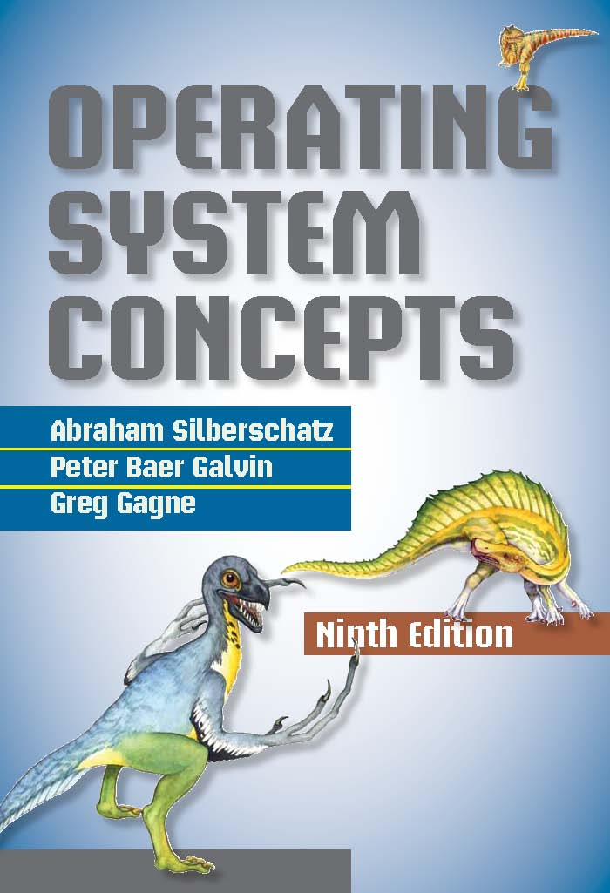
Assessment and Textbook
Course work = 40 % (Lab. Assignment + Midterm Exam)
Final Exam = 60%
Textbook
Operating System Concepts
Ninth Edition
Avi Silberschatz
Peter Baer Galvin
Greg Gagne

Slide 4
Chapter 1: Introduction
What Operating Systems Do ?
Computer-System Organization
Computer-System Architecture
Operating-System Structure
Operating-System Operations
Process Management
Memory Management
Storage Management
Protection and Security
Kernel Data Structures
Computing Environments
Open-Source Operating Systems

Slide 5
System Software, Application Software and Driver Programs
System Software- Performs essential operation tasks
  Operating system
  Utility programs (anti viruses , network Management Sys. etc..)
Application Software - Performs specific tasks for users
  Business application
  Communications application
  Multimedia application
  Entertainment and educational software
  Engineering , Medical , internet (Web Browsers ) applications
Driver Programs (Device Driver) –Performs communication
  small program that allows a specific input or output device(Printer , camera , scanner ..) to communicate with the rest of the computer system.

Slide 6
What is an Operating System?
A program that acts as an intermediary between a user of a computer and the computer hardware.
Operating system goals:
  Execute user programs and make solving user problems easier.
  Make the computer system convenient to use (abstraction of hardware resources for user programs).
  Use the computer hardware in an efficient manner (Efficiency of usage of CPU, memory, etc..)
  Protect user from unauthorized release and modification of information.

Slide 7
What is an Operating System?
Operating system is a System Software
Act as interface b/w User and the Hardware
Organized set of programs(scheduling user programs)
Controls & manage computer resources
(H/W, S/W) manage (storage ,CPU ,file system, ..)

Slide 8
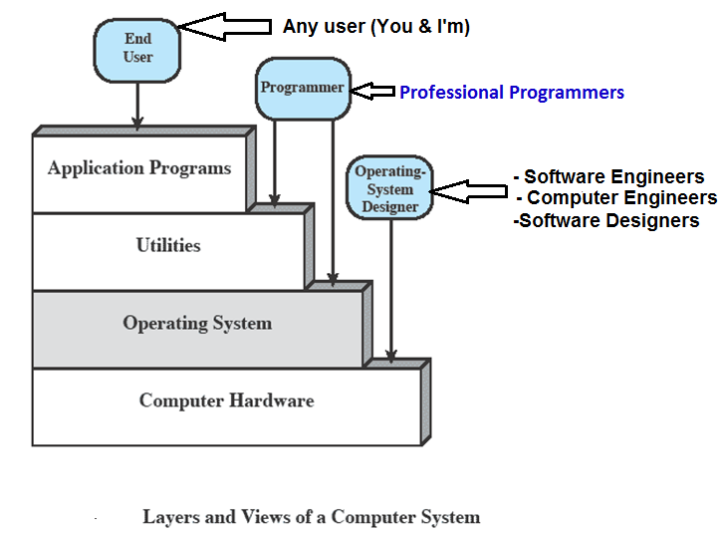
Layers and Views

Slide 9
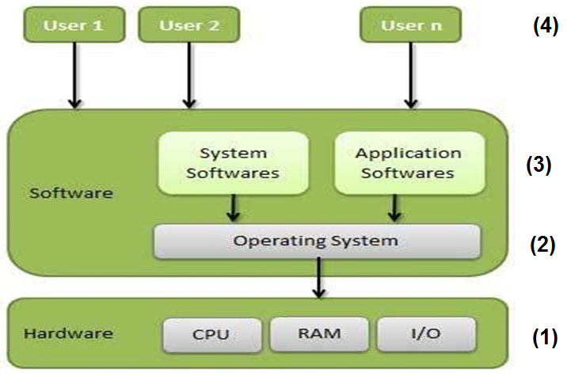
Four Components of a Computer System

Slide 10
Computer System Structure
Computer system can be divided into four components:
  Hardware – provides basic computing resources
    CPU, memory, I/O devices
  Operating system
    Controls and coordinates use of hardware among various applications and users
  Application programs – define the ways in which the system resources are used to solve the computing problems of the users
    Word processors, compilers, web browsers, database systems, video games
  Users
    People, machines, other computers

Slide 11
Services Provided by the OS
Program development
  Editors ,Compilers ,Linkers ,and debuggers
Program execution
Access I/O devices
Controlled access to files
System access
Error detection and response
  Internal and external hardware errors
  Software errors
  Operating system cannot grant request of application

Slide 12
Services Provided by the OS Cont.
Accounting
  Collect usage statistics
  Monitor performance
  Used to anticipate future enhancements
  Used for billing purposes

Slide 13
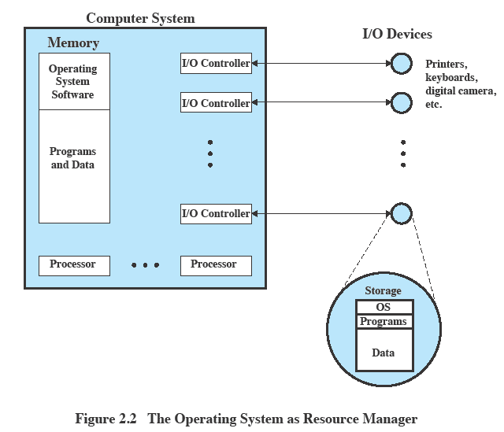
OS as Resource Manager

Slide 14
Kernel
Portion of operating system that is in main memory.
A kernel is a program that allocates and controls hardware and software resources in a system.
Contains most frequently used functions
Also called the nucleus.
The one program running at all times on the computer” is the kernel.
Everything else is either a system program (ships with the operating system) or an application program.

Slide 15
Operating System Responsibilities
OS is a resource allocator
  Manages all resources.
  Decides between conflicting requests for efficient and fair resource use.
OS is a control program
  Controls execution of programs to prevent errors and improper use of the computer.

Slide 16
Types of OS
Batch processing
Multi-tasking
Types of Operating System
Multi-programming
Multi- processor
Time-sharing
Distributed OS
Network OS
Embedded OS.
On-line & Real time OS

Slide 17
Types of OS
  Early OS or serial processing
  Batch OS
  Multi-programmed OS
  Multitasking OS
  Time sharing OS
  Multiprocessing OS
  Real time OS
  Distributed OS

Slide 18
Early O.S or processing O.S
In serial operating system only one job resides in computer memory and it remains there till it is executed. After completion of job, next job is entered.
Disadvantages:-
CPU remains idle for most of time.
Very slow
Waiting time of jobs are more
Advantages:-
Resource management is very easy.
allocation is very easy.
O.S
User Program Area

Slide 19
Batch O.S
It process a batch of jobs
Does not allow user to interact computer directly.
Each user prepares his job and submits to the operator.
Major task is to transfer control automatically from one job to next.
Advantages:-
Faster than serial processing
Resource allocation and management is very easy.
Disadvantages:-
Lack of interaction between user and job.
Turnaround time is high.
Off line debugging.

Slide 20
Multiprogramming O.S
It refers to holding more than one process in memory and executing them concurrently.
It increase cpu utilisation such that cpu always has one to execute.
Example of multiprogramming is given below:
Main memory
Secondary disk storage
SUPERVISOR
PROGRAM A
PROGRAM B
PROGRAM C (waiting for CPU)
Writing O/P data
Execution in progress
CPU

Slide 21
Multiprogramming O.S.
Advantages
It Increase CPU utilization and reduce CPU idle time.
Decreases total read time needed to execute a job as the jobs are in main memory.
Disadvantages
It is fairly sophisticated and more complex as compared to Uni-programming system.
Process can consume more than available memory. In such case system slows down or it may hang some time.

Slide 22
Time Sharing
Processor’s time is shared among multiple users
Multiple users simultaneously access the system through terminals.
Advantages:-
Reduce CPU idle time.
Provides advantage of quick response.
Disadvantages:-
Problem of data communication.
Question of security and integrity of user program and data

Slide 23
Time sharing process
Main memory
time sharing supervisor
User 1
User 2
User n
User n
Terminal 1
User 1
User 1
Terminal 2
User 2
User 2
Terminal n
User n
CPU
Online storage

Slide 24
Multi processing or parallel processing O.S
This technique consist of two or more CPUs, perform more than one job at a time.
Fig:-
CPU 1
Main memory
CPU 2
I/O processor
I/O processor
I/O units
I/O units

Slide 25
Multi processing or parallel processing O.S
Advantages
Better throughput
Better reliability
Saving cost
Disadvantages
Large main memory is required
Such system are expensive.

Slide 26
Real time O.S
It is a multiprogramming system that aims at executing real time applications.
Its main objective is their quick and predictable response to events (high response for an emergent events) .
Examples are:-
  ATM machine
  Flight control etc.
Advantages:-
  Better throughput
  Response time is very less
Disadvantages:-
  Very costly
  Large memory required

Slide 27
Embedded system
embedded system
usually has the operating system built into the computer, and is used to control external hardware.
There is little or no application software in an embedded system.
Examples here are the Palm Pilot, the electronic diaries that everybody seems to have, and of course the
computers built into VCRs, microwaves, and into most cars.

Slide 28
Distributed Operating System
A distributed system uses multiple central processors to serve multiple real time applications.
Data processing jobs are distributed among the processors accordingly.
With distributed processing, related data at all terminals is synchronized, updated simultaneously.
It allows the user to access remote resources in the same manner as local resources as they do.
It is a collection of processors that do not share memory. Each processor has its own local memory.
The use of multiple processors is invisible to the user i.e. the users are not aware of where these file are residing. These are handled automatically and efficiently by the os.

Slide 29
Distributed Operating System Cont.
The advantages of distributed systems are as follows −
With resource sharing facility, a user at one site may be able to use the resources available at another.
Speedup the exchange of data with one another via electronic mail.
Fault tolerance ,if one site fails in a distributed system, the remaining sites can potentially continue operating.
Better service to the customers.
Reduction of the load on the host computer.
Reduction of delays in data processing.

Slide 30
Computer Startup
bootstrap program is loaded at power-up or reboot.
  Typically stored in ROM or EPROM, generally known as firmware.
  Initializes all aspects of system.
  Loads operating system kernel and starts execution.

Slide 31
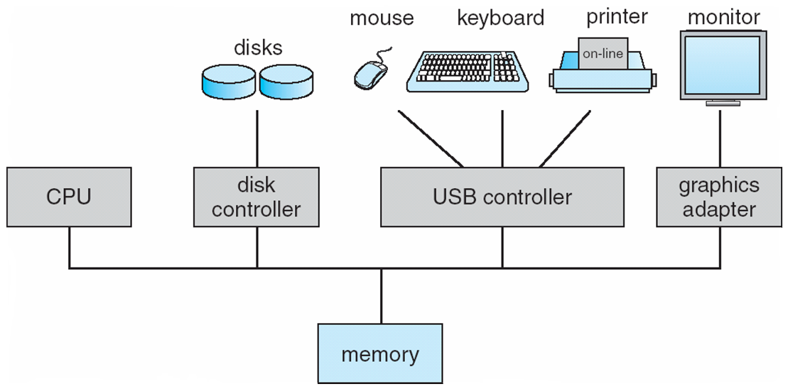
Computer System Organization
Computer-system operation
  One or more CPUs, device controllers connect through common bus providing access to shared memory
  Concurrent execution of CPUs and devices competing for memory cycles

Slide 32
Computer-System Operation
I/O devices and the CPU can execute concurrently.
Each device controller is in charge of a particular device type.
Each device controller has a local buffer.
CPU moves data from/to main memory to/from local buffers.
I/O is from the device to local buffer of controller.
Device controller informs CPU that it has finished its operation by causing an interrupt.

Slide 33
Common Functions of Interrupts
Interrupt transfers control to the interrupt service routine generally, through the interrupt vector, which contains the addresses of all the service routines.
Interrupt architecture must save the address of the interrupted instruction.
A trap or exception is a software-generated interrupt caused either by an error or a user request.
An operating system is interrupt driven.

Slide 34
Interrupt Handling
The operating system preserves the state of the CPU by storing registers and the program counter.
Determines which type of interrupt has occurred:
  polling
  vectored interrupt system.
Separate segments of code determine what action should be taken for each type of interrupt.

Slide 35
I/O Structure
After I/O starts, control returns to user program only upon I/O completion.
  Wait instruction idles the CPU until the next interrupt.
  Wait loop (contention for memory access).
  At most one I/O request is outstanding at a time, no simultaneous I/O processing.
After I/O starts, control returns to user program without waiting for I/O completion.

Slide 36
I/O Structure
  System call – request to the OS to allow user to wait for I/O completion.
  Device-status table contains entry for each I/O device indicating its type, address, and state
  OS indexes into I/O device table to determine device status and to modify table entry to include interrupt.

Slide 37
Storage Definitions and Notation Review
The basic unit of computer storage is the bit.
A bit can contain one of two values, 0 and 1.
All other storage in a computer is based on collections of bits.
A byte is 8 bits, and on most computers it is the smallest convenient chunk of storage. For example, most computers don’t have an instruction to move a bit but do have one to move a byte.
A less common term is word, which is a given computer architecture’s native unit of data.
  A word is made up of one or more bytes. For example, a computer that has 64-bit registers and 64-bit memory addressing typically has 64-bit (8-byte) words.
  A computer executes many operations in its native word size rather than a byte at a time.

Slide 38
Storage Definitions and Notation Review
Computer storage, is generally measured and manipulated in bytes and collections of bytes.
Kilobyte, or KB, is 1,024 bytes
Megabyte, or MB, is 1,024² bytes
Gigabyte, or GB, is 1,024³ bytes
Terabyte, or TB, is 1,024⁴ bytes
Petabyte, or PB, is 1,024⁵ bytes
Computer manufacturers often round off these numbers and say that a megabyte is 1 million bytes and a gigabyte is 1 billion bytes. Networking measurements are an exception to this general rule; they are given in bits (because networks move data a bit at a time).

Slide 39
Direct Memory Access Structure
Used for high-speed I/O devices able to transmit information at close to memory speeds.
Device controller transfers blocks of data from buffer storage directly to main memory without CPU intervention.
Only one interrupt is generated per block, rather than the one interrupt per byte.

Slide 40
Storage Structure
Main memory – only large storage media that the CPU can access directly
  Random access
  Typically volatile
Secondary storage – extension of main memory that provides large nonvolatile storage capacity
Magnetic disks – rigid metal or glass platters covered with magnetic recording material
  Disk surface is logically divided into tracks, which are subdivided into sectors
  The disk controller determines the logical interaction between the device and the computer
Solid-state disks – faster than magnetic disks, nonvolatile
  Various technologies
  Becoming more popular

Slide 41
Storage Hierarchy
Storage systems organized in hierarchy
  Speed
  Cost
  Volatility
Caching – copying information into faster storage system; main memory can be viewed as a cache for secondary storage
Device Driver for each device controller to manage I/O
  Provides uniform interface between controller and kernel

Slide 42
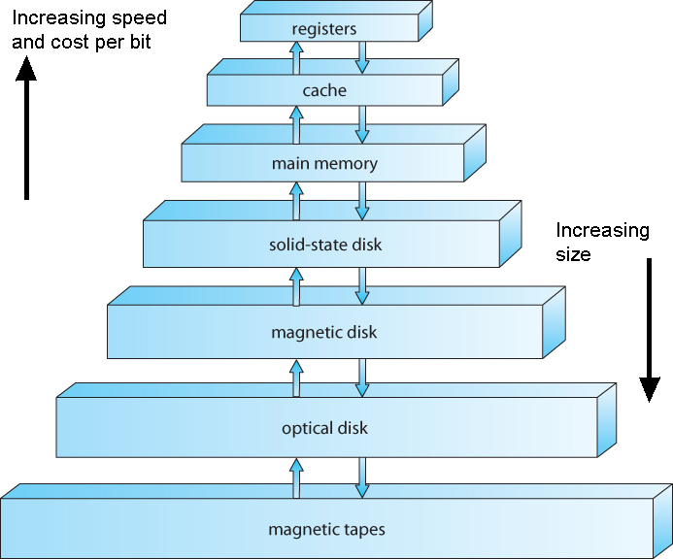
Storage-Device Hierarchy

Slide 43
Caching
Important principle, performed at many levels in a computer (in hardware, operating system, software)
Information in use copied from slower to faster storage temporarily
Faster storage (cache) checked first to determine if information is there
  If it is, information used directly from the cache (fast)
  If not, data copied to cache and used there
Cache smaller than storage being cached
  Cache management important design problem
  Cache size and replacement policy

Slide 44
Computer-System Architecture
Most systems use a single general-purpose processor (PDAs through mainframes)
  Most systems have special-purpose processors as well
Multiprocessors systems growing in use and importance
  Also known as parallel systems, tightly-coupled systems
  Advantages include:
    Increased throughput
    Economy of scale
    Increased reliability – graceful degradation or fault tolerance
  Two types:
    Asymmetric Multiprocessing
    Symmetric Multiprocessing

Slide 45
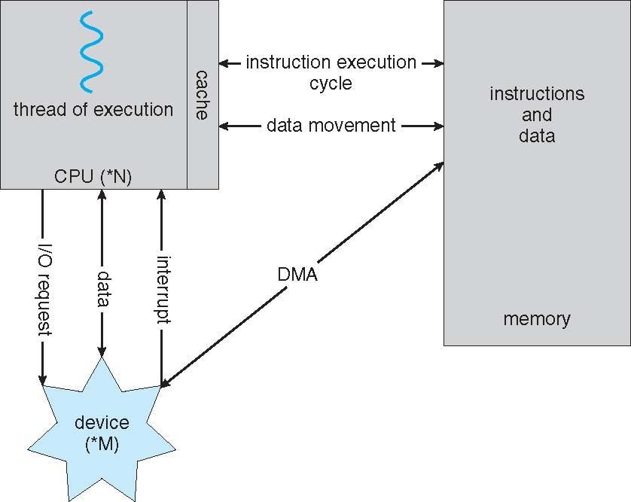
How a Modern Computer Works
A von Neumann architecture

Slide 46
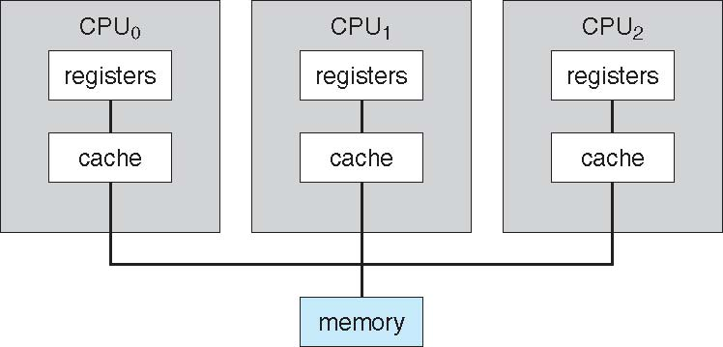
Symmetric Multiprocessing Architecture

Slide 47
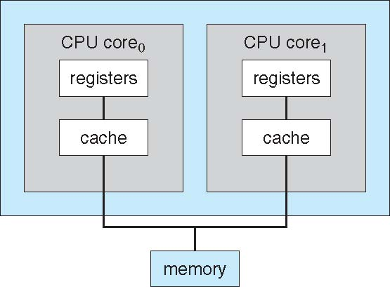
A Dual-Core Design
UMA and NUMA architecture variations
Multi-chip and multi-core
Systems containing all chips vs. blade servers
  Chassis containing multiple separate systems

Slide 48
Clustered Systems
Like multiprocessor systems, but multiple systems working together
  Usually sharing storage via a storage-area network (SAN)
  Provides a high-availability service which survives failures
    Asymmetric clustering has one machine in hot-standby mode
    Symmetric clustering has multiple nodes running applications, monitoring each other
  Some clusters are for high-performance computing (HPC)
    Applications must be written to use parallelization
  Some have distributed lock manager (DLM) to avoid conflicting operations

Slide 49
Clustered Systems

Slide 50
Operating System Structure
Multiprogramming needed for efficiency
  Single user cannot keep CPU and I/O devices busy at all times.
  Multiprogramming organizes jobs (code and data) so CPU always has one to execute.
  A subset of total jobs in system is kept in memory.
  One job selected and run via job scheduling
  When it has to wait (for I/O for example), OS switches to another job.

Slide 51
Operating System Structure
Timesharing (multitasking) is logical extension in which CPU switches jobs so frequently that users can interact with each job while it is running, creating interactive computing.
  Response time should be < 1 second
  Each user has at least one program executing in memory process
  If several jobs ready to run at the same time  CPU scheduling
  If processes don’t fit in memory, swapping moves them in and out to run
  Virtual memory allows execution of processes not completely in memory

Slide 52
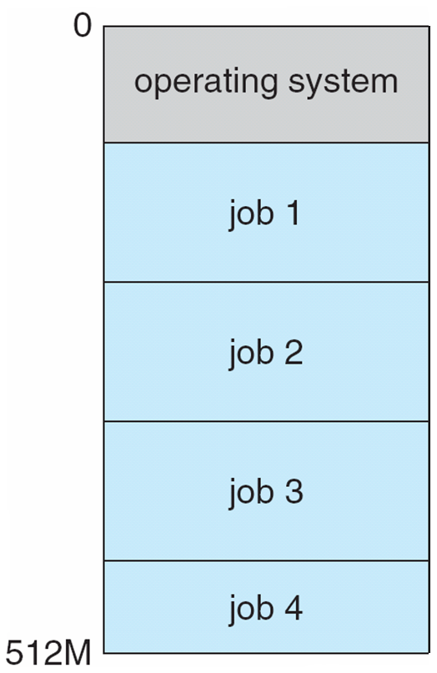
Memory Layout for Multiprogrammed System

Slide 53
Operating-System Operations
Interrupt driven by hardware
Software error or request creates exception or trap
  Division by zero, request for operating system service
Other process problems include infinite loop, processes modifying each other or the operating system
Dual-mode operation allows OS to protect itself and other system components
  User mode and kernel mode
  Mode bit provided by hardware
    Provides ability to distinguish when system is running user code or kernel code
    Some instructions designated as privileged, only executable in kernel mode
    System call changes mode to kernel, return from call resets it to user
Increasingly CPUs support multi-mode operations
  i.e. virtual machine manager (VMM) mode for guest VMs

Slide 54
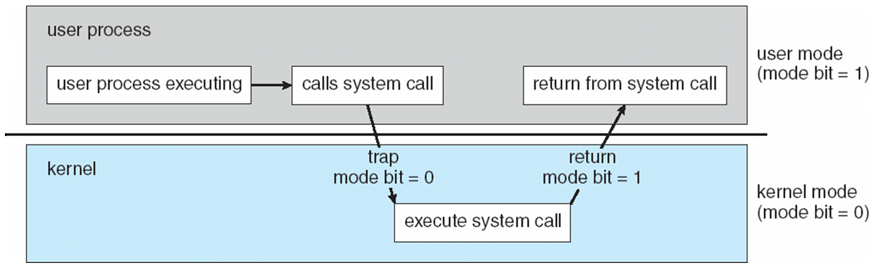
Transition from User to Kernel Mode
Timer to prevent infinite loop / process hogging resources
  Set interrupt after specific period
  Operating system decrements counter
  When counter zero generate an interrupt
  Set up before scheduling process to regain control or terminate program that exceeds allotted time

Slide 55
Process Management
A process is a program in execution. It is a unit of work within the system. Program is a passive entity, process is an active entity.
Process needs resources to accomplish its task
  CPU, memory, I/O, files
  Initialization data
Process termination requires reclaim of any reusable resources
Single-threaded process has one program counter specifying location of next instruction to execute
  Process executes instructions sequentially, one at a time, until completion
Multi-threaded process has one program counter per thread
Typically system has many processes, some user, some operating system running concurrently on one or more CPUs
  Concurrency by multiplexing the CPUs among the processes / threads

Slide 56
Process Management Activities
The operating system is responsible for the following activities in connection with process management:
Creating and deleting both user and system processes
Suspending and resuming processes
Providing mechanisms for process synchronization
Providing mechanisms for process communication
Providing mechanisms for deadlock handling

Slide 57
Memory Management
All data in memory before and after processing
All instructions in memory in order to execute
Memory management determines what is in memory when
  Optimizing CPU utilization and computer response to users
Memory management activities
  Keeping track of which parts of memory are currently being used and by whom
  Deciding which processes (or parts thereof) and data to move into and out of memory
  Allocating and deallocating memory space as needed

Slide 58
Storage Management
OS provides uniform, logical view of information storage
  Abstracts physical properties to logical storage unit - file
  Each medium is controlled by device (i.e., disk drive, tape drive)
    Varying properties include access speed, capacity, data-transfer rate, access method (sequential or random)
File-System management
  Files usually organized into directories
  Access control on most systems to determine who can access what
  OS activities include
    Creating and deleting files and directories
    Primitives to manipulate files and dirs
    Mapping files onto secondary storage
    Backup files onto stable (non-volatile) storage media

Slide 59
Mass-Storage Management
Usually disks used to store data that does not fit in main memory or data that must be kept for a “long” period of time
Proper management is of central importance
Entire speed of computer operation hinges on disk subsystem and its algorithms
OS activities
  Free-space management
  Storage allocation
  Disk scheduling

Slide 60
Mass-Storage Management
Some storage need not be fast
  Tertiary storage includes optical storage, magnetic tape
  Still must be managed – by OS or applications
  Varies between WORM (write-once, read-many-times) and RW (read-write)

Slide 61
Performance of Various Levels of Storage
Movement between levels of storage hierarchy can be explicit or implicit

Slide 62
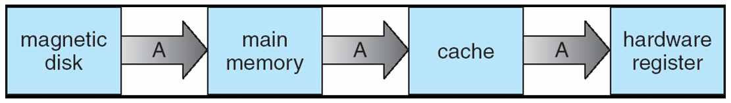
Migration of Integer A from Disk to Register
Multitasking environments must be careful to use most recent value, no matter where it is stored in the storage hierarchy.
Multiprocessor environment must provide cache coherency in hardware such that all CPUs have the most recent value in their cache
Distributed environment situation even more complex
  Several copies of a datum can exist
  Various solutions covered in Chapter 17

Slide 63
I/O Subsystem
One purpose of OS is to hide peculiarities of hardware devices from the user
I/O subsystem responsible for
  Memory management of I/O including buffering (storing data temporarily while it is being transferred), caching (storing parts of data in faster storage for performance), spooling (the overlapping of output of one job with input of other jobs)
  General device-driver interface
  Drivers for specific hardware devices

Slide 64
Protection and Security
Protection – any mechanism for controlling access of processes or users to resources defined by the OS
Security – defense of the system against internal and external attacks
  Huge range, including denial-of-service, worms, viruses, identity theft, theft of service
Systems generally first distinguish among users, to determine who can do what
  User identities (user IDs, security IDs) include name and associated number, one per user
  User ID then associated with all files, processes of that user to determine access control
  Group identifier (group ID) allows set of users to be defined and controls managed, then also associated with each process, file
  Privilege escalation allows user to change to effective ID with more rights

Slide 65
Computing Environments - Traditional
Stand-alone general purpose machines
But blurred as most systems interconnect with others (i.e. the Internet)
Portals provide web access to internal systems
Network computers (thin clients) are like Web terminals
Mobile computers interconnect via wireless networks
Networking becoming ubiquitous – even home systems use firewalls to protect home computers from Internet attacks

Slide 66
Computing Environments - Mobile
Handheld smartphones, tablets, etc
What is the functional difference between them and a “traditional” laptop?
Extra feature – more OS features (GPS, gyroscope)
Allows new types of apps like augmented reality
Use IEEE 802.11 wireless, or cellular data networks for connectivity
Leaders are Apple iOS and Google Android

Slide 67
Computing Environments – Distributed
Distributed
  Collection of separate, possibly heterogeneous, systems networked together
    Network is a communications path, TCP/IP most common
      Local Area Network (LAN)
      Wide Area Network (WAN)
      Metropolitan Area Network (MAN)
      Personal Area Network (PAN)
  Network Operating System provides features between systems across network
    Communication scheme allows systems to exchange messages
    Illusion of a single system

Slide 68
Computing Environments – Client-Server
Client-Server Computing
  Dumb terminals supplanted by smart PCs
  Many systems now servers, responding to requests generated by clients
    Compute-server system provides an interface to client to request services (i.e., database)
    File-server system provides interface for clients to store and retrieve files

Slide 69
Computing Environments - Peer-to-Peer
Another model of distributed system.
P2P does not distinguish clients and servers.
  Instead all nodes are considered peers
  May each act as client, server or both
  Node must join P2P network
    Registers its service with central lookup service on network, or
    Broadcast request for service and respond to requests for service via discovery protocol
  Examples include Napster and Gnutella, Voice over IP (VoIP) such as Skype

Slide 70
Computing Environments - Virtualization
Allows operating systems to run applications within other OSes
  Vast and growing industry
Emulation used when source CPU type different from target type (i.e. PowerPC to Intel x86)
  Generally slowest method
  When computer language not compiled to native code – Interpretation
Virtualization – OS natively compiled for CPU, running guest OSes also natively compiled
  Consider VMware running WinXP guests, each running applications, all on native WinXP host OS
  VMM provides virtualization services

Slide 71
Computing Environments - Virtualization
Use cases involve laptops and desktops running multiple OSes for exploration or compatibility
  Apple laptop running Mac OS X host, Windows as a guest
  Developing apps for multiple OSes without having multiple systems
  QA testing applications without having multiple systems
  Executing and managing compute environments within data centers
VMM can run natively, in which case they are also the host
  There is no general purpose host then (VMware ESX and Citrix XenServer)

Slide 72
Computing Environments - Virtualization

Slide 73
Computing Environments – Cloud Computing
Delivers computing, storage, even apps as a service across a network
Logical extension of virtualization as based on virtualization
  Amazon EC2 has thousands of servers, millions of VMs, PBs of storage available across the Internet, pay based on usage
Many types
  Public cloud – available via Internet to anyone willing to pay
  Private cloud – run by a company for the company’s own use
  Hybrid cloud – includes both public and private cloud components
  Software as a Service (SaaS) – one or more applications available via the Internet (i.e. word processor)
  Platform as a Service (PaaS) – software stack ready for application use via the Internet (i.e a database server)
  Infrastructure as a Service (IaaS) – servers or storage available over Internet (i.e. storage available for backup use)

Slide 74
Computing Environments – Cloud Computing
Cloud computing environments composed of traditional OSes, plus VMMs, plus cloud management tools
  Internet connectivity requires security like firewalls
  Load balancers spread traffic across multiple applications

Slide 75
Computing Environments – Real-Time Embedded Systems
Real-time embedded systems most prevalent form of computers
  Vary considerable, special purpose, limited purpose OS, real-time OS
  Use expanding
Many other special computing environments as well
  Some have OSes, some perform tasks without an OS
Real-time OS has well-defined fixed time constraints
  Processing must be done within constraint
  Correct operation only if constraints met

Slide 76
Open-Source Operating Systems
Operating systems made available in source-code format rather than just binary closed-source
Counter to the copy protection and Digital Rights Management (DRM) movement
Started by Free Software Foundation (FSF), which has “copyleft” GNU Public License (GPL)
Examples include GNU/Linux and BSD UNIX (including core of Mac OS X), and many more
Can use VMM like VMware Player (Free on Windows), Virtualbox (open source and free on many platforms - http://www.virtualbox.com)
  Use to run guest operating systems for exploration

Slide 77
End of Chapter (1)
Thank You
Questions ??

Slide 78
