Slide 1
Operating Systems Concepts and Design
Chapter (4)
CPU Scheduling
University of Science and Technology
Faculty of Computer Science and Information Technology
Instructor: Diaa Eldein Mustafa Ahmed
2018

Slide 2
Chapter 6: CPU Scheduling
Basic Concepts
Scheduling Criteria
Scheduling Algorithms
Thread Scheduling
Multiple-Processor Scheduling
Real-Time CPU Scheduling
Operating Systems Examples
Algorithm Evaluation

Slide 3
Objectives
To introduce CPU scheduling, which is the basis for multi-programmed operating systems
To describe various CPU-scheduling algorithms
To discuss evaluation criteria for selecting a CPU-scheduling algorithm for a particular system
To examine the scheduling algorithms of several operating systems

Slide 4
Basic Concepts
Maximum CPU utilization obtained with multiprogramming
CPU–I/O Burst Cycle – Process execution consists of a cycle of CPU execution and I/O wait
CPU burst followed by I/O burst
CPU burst distribution is of main concern

Slide 5
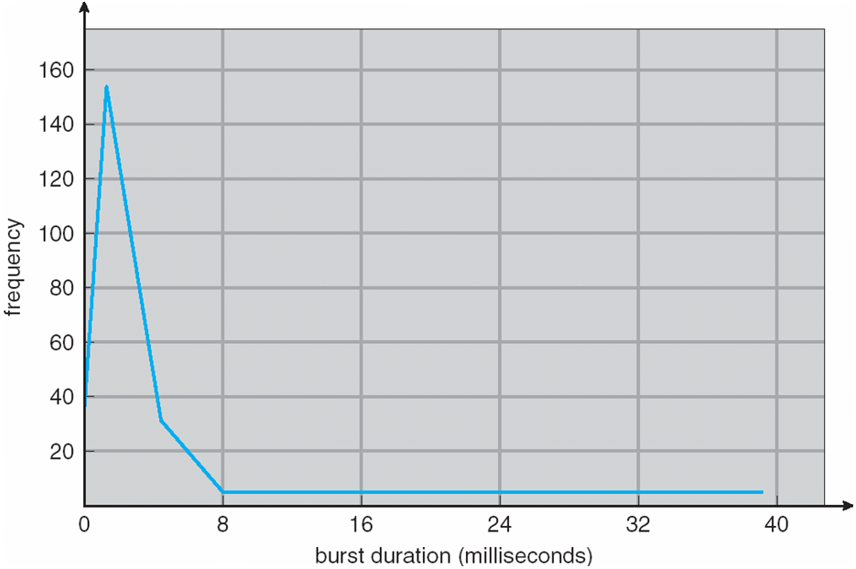
Histogram of CPU-burst Times

Slide 6
CPU Scheduler
Short-term scheduler selects from among the processes in ready queue, and allocates the CPU to one of them
  Queue may be ordered in various ways
CPU scheduling decisions may take place when a process:
  1. Switches from running to waiting state
  2. Switches from running to ready state
  3. Switches from waiting to ready
  Terminates
Scheduling under 1 and 4 is non-preemptive
All other scheduling is preemptive
  Consider access to shared data
  Consider preemption while in kernel mode
  Consider interrupts occurring during crucial OS activities

Slide 7
Dispatcher
Dispatcher module gives control of the CPU to the process selected by the short-term scheduler; this involves:
  switching context
  switching to user mode
  jumping to the proper location in the user program to restart that program
Dispatch latency – time it takes for the dispatcher to stop one process and start another running

Slide 8
Scheduling Criteria
CPU utilization – keep the CPU as busy as possible
Throughput – # of processes that complete their execution per time unit
Turnaround time – amount of time to execute a particular process
Waiting time – amount of time a process has been waiting in the ready queue
Response time – amount of time it takes from when a request was submitted until the first response is produced, not output (for time-sharing environment)

Slide 9
Scheduling Algorithm Optimization Criteria
Max CPU utilization
Max throughput
Min turnaround time
Min waiting time
Min response time

Slide 10
FIRST-COME, FIRST SERVED(FCFS):
  ( FCFS) same as FIFO
  Simple, fair, but poor performance. Average queueing time may be long.
  What are the average queueing and residence times for this scenario?
  How do average queueing and residence times depend on ordering of these processes in the queue?

Slide 11
First-Come, First-Served (FCFS) Scheduling
Process Burst Time
P₁ 24
P₂ 3
P₃ 3
Suppose that the processes arrive in the order: P₁ , P₂ , P₃
The Gantt Chart for the schedule is:
Waiting time for P₁ = 0; P₂ = 24; P₃ = 27
Average waiting time: (0 + 24 + 27)/3 = 17
P₁
P₂
P₃
0
24
27
30

Slide 12
FCFS Scheduling (Cont.)
Suppose that the processes arrive in the order:
P₂ , P₃ , P₁
The Gantt chart for the schedule is:
Waiting time for P₁ = 6; P₂ = 0; P₃ = 3
Average waiting time: (6 + 0 + 3)/3 = 3
Much better than previous case
Convoy effect - short process behind long process
  Consider one CPU-bound and many I/O-bound processes
P₂
P₃
P₁
0
3
6
30

Slide 13
FCFS Scheduling (Cont.)
Departure Time | Waiting Time | Process Time | Arrival Time | Process
8 | 0 | 8 | 0 | P1
12 | 7 | 4 | 1 | P2
21 | 10 | 9 | 2 | P3
26 | 18 | 5 | 3 | P4
FCFS
P1
P2
P3
P4
0
8
12
21
26
Average wait = ( 0+7+10+18)/4= 8.75
Residence Time
at the CPU

Slide 14
Shortest-Job-First (SJF) Scheduling
Optimal for minimizing queuing time, but impossible to implement. Tries to predict the process to schedule based on previous history.
Predicting the time the process will use on its next schedule:
SJF is optimal – gives minimum average waiting time for a given set of processes
  The difficulty is knowing the length of the next CPU request
  Could ask the user

Slide 15
Example of SJF
Process Arrive Time Burst Time
P₁ 0.0 6
P₂ 2.0 8
P₃ 4.0 7
P₄ 5.0 3
SJF scheduling chart
Average waiting time = (3 + 16 + 9 + 0) / 4 = 7
P₄
P₁
P₃
P₂
0
3
9
16
24

Slide 16
CPU SCHEDULING
Scheduling
Algorithms
Departure Time | Waiting Time | Process Time | Arrival Time | Process
17 | 9 | 8 | 0 | P1
5 | 0 | 4 | 1 | P2
26 | 15 | 9 | 2 | P3
10 | 2 | 5 | 3 | P4
Preemptive Shortest Job First
P1
P2
P4
P1
P3
0
1
5
10
17
26
Average waiting time = [(10-1)+(1-1)+(17-2)+5-3)]/4 = 26/4 = 6.5 msec

Slide 17
Determining Length of Next CPU Burst
Can only estimate the length – should be similar to the previous one
  Then pick process with shortest predicted next CPU burst
Can be done by using the length of previous CPU bursts, using exponential averaging
Commonly, α set to ½
Preemptive version called shortest-remaining-time-first

Slide 18
Prediction of the Length of the
Next CPU Burst

Slide 19
Examples of Exponential Averaging
α =0
  τ_{n+1} = τ_{n}
  Recent history does not count
α =1
  τ_{n+1} = α t_{n}
  Only the actual last CPU burst counts
If we expand the formula, we get:
    τ_{n+1} = α t_{n}+(1 - α)α t_{n} ₋₁ + …
    +(1 - α )^{j} α t_{n} _{-j} + …
    +(1 - α )^{n +1} τ₀
Since both α and (1 - α) are less than or equal to 1, each successive term has less weight than its predecessor

Slide 20
Example of Shortest-remaining-time-first
Now we add the concepts of varying arrival times and preemption to the analysis
ProcessA arri Arrival TimeT Burst Time
P₁ 0 8
P₂ 1 4
P₃ 2 9
P₄ 3 5
Preemptive SJF Gantt Chart
Average waiting time = [(10-1)+(1-1)+(17-2)+5-3)]/4 = 26/4 = 6.5 msec
P₁
P₂
P₄
P₁
P₃
0
1
5
10
17
26

Slide 21
Priority Scheduling
A priority number (integer) is associated with each process
The CPU is allocated to the process with the highest priority (smallest integer ≡ highest priority)
  Preemptive
  Nonpreemptive
SJF is priority scheduling where priority is the inverse of predicted next CPU burst time
Problem ≡ Starvation – low priority processes may never execute
Solution ≡ Aging – as time progresses increase the priority of the process

Slide 22
Example of Priority Scheduling
ProcessA arri Burst TimeT Priority
P₁ 10 3
P₂ 1 1
P₃ 2 4
P₄ 1 5
P₅ 5 2
Priority scheduling Gantt Chart
Average waiting time = 8.2 msec
P₂
P₅
P₁
P₃
P₄
0
1
6
16
18
19

Slide 23
Round Robin (RR)
Each process gets a small unit of CPU time (time quantum q), usually 10-100 milliseconds. After this time has elapsed, the process is preempted and added to the end of the ready queue.
If there are n processes in the ready queue and the time quantum is q, then each process gets 1/n of the CPU time in chunks of at most q time units at once. No process waits more than (n-1)q time units.
Timer interrupts every quantum to schedule next process
Performance
  q large ⇒ FIFO
  q small ⇒ q must be large with respect to context switch, otherwise overhead is too high

Slide 24
Example of RR with Time Quantum = 4
Process Burst Time
P₁ 24
P₂ 3
P₃ 3
The Gantt chart is:
Typically, higher average turnaround than SJF, but better response
q should be large compared to context switch time
q usually 10ms to 100ms, context switch < 10 usec
P₁
P₂
P₃
P₁
P₁
P₁
P₁
P₁
0
4
7
10
14
18
22
26
30

Slide 25
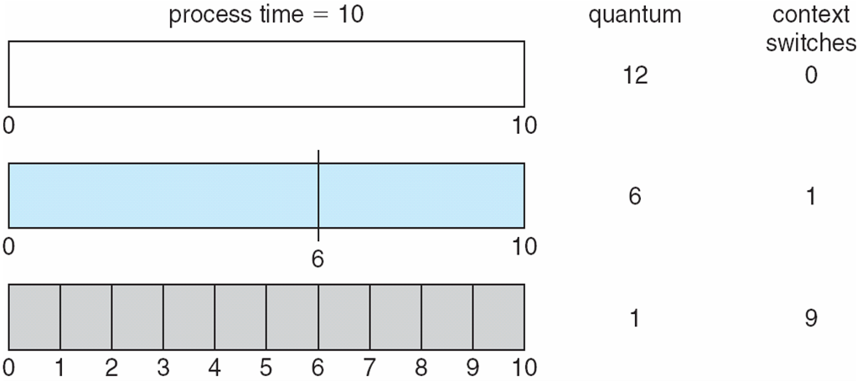
Time Quantum and Context Switch Time

Slide 26
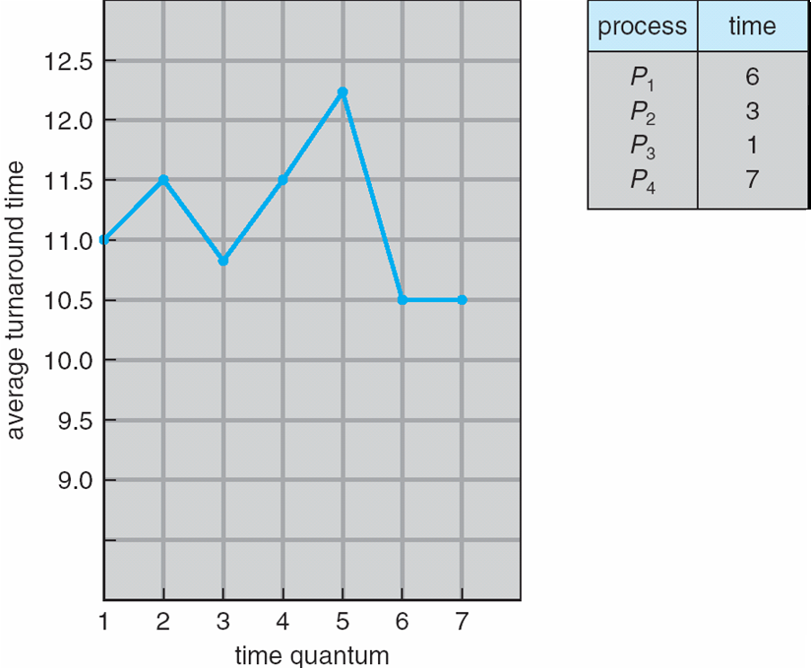
Turnaround Time Varies With
The Time Quantum
80% of CPU bursts should be shorter than q

Slide 27
Multilevel Queue
Ready queue is partitioned into separate queues, eg:
  foreground (interactive)
  background (batch)
Process permanently in a given queue
Each queue has its own scheduling algorithm:
  foreground – RR
  background – FCFS
Scheduling must be done between the queues:
  Fixed priority scheduling; (i.e., serve all from foreground then from background). Possibility of starvation.
  Time slice – each queue gets a certain amount of CPU time which it can schedule amongst its processes; i.e., 80% to foreground in RR
  20% to background in FCFS

Slide 28
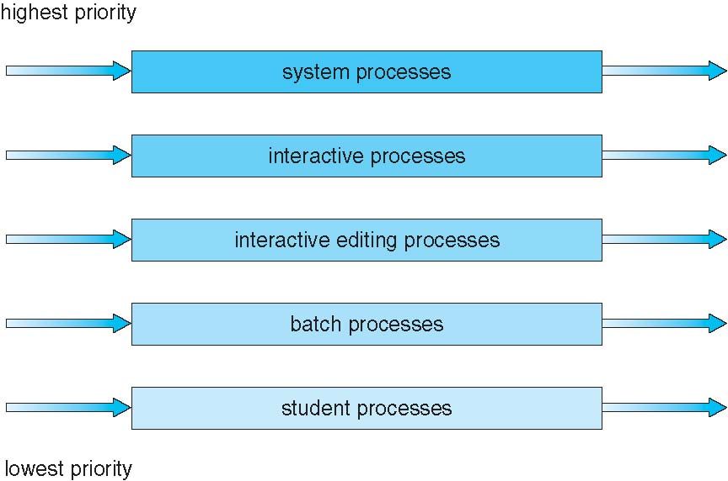
Multilevel Queue Scheduling

Slide 29
Multilevel Feedback Queue
A process can move between the various queues; aging can be implemented this way
Multilevel-feedback-queue scheduler defined by the following parameters:
  number of queues
  scheduling algorithms for each queue
  method used to determine when to upgrade a process
  method used to determine when to demote a process
  method used to determine which queue a process will enter when that process needs service

Slide 30
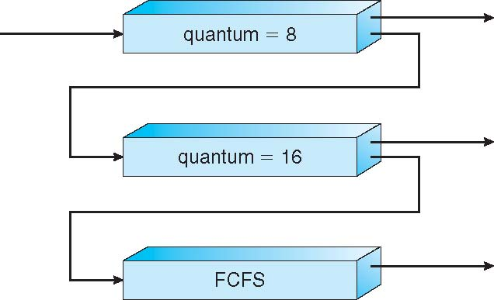
Example of Multilevel Feedback Queue
Three queues:
  Q₀ – RR with time quantum 8 milliseconds
  Q₁ – RR time quantum 16 milliseconds
  Q₂ – FCFS
Scheduling
  A new job enters queue Q₀ which is served FCFS
    When it gains CPU, job receives 8 milliseconds
    If it does not finish in 8 milliseconds, job is moved to queue Q₁
  At Q₁ job is again served FCFS and receives 16 additional milliseconds
    If it still does not complete, it is preempted and moved to queue Q₂

Slide 31
Thread Scheduling
Distinction between user-level and kernel-level threads
When threads supported, threads scheduled, not processes
Many-to-one and many-to-many models, thread library schedules user-level threads to run on LWP
  Known as process-contention scope (PCS) since scheduling competition is within the process
  Typically done via priority set by programmer
Kernel thread scheduled onto available CPU is system-contention scope (SCS) – competition among all threads in system

Slide 32
Pthread Scheduling
API allows specifying either PCS or SCS during thread creation
  PTHREAD_SCOPE_PROCESS schedules threads using PCS scheduling
  PTHREAD_SCOPE_SYSTEM schedules threads using SCS scheduling
Can be limited by OS – Linux and Mac OS X only allow PTHREAD_SCOPE_SYSTEM

Slide 33
Pthread Scheduling API
#include <pthread.h>
#include <stdio.h>
#define NUM_THREADS 5
int main(int argc, char *argv[]) {
int i, scope;
pthread_t tid[NUM THREADS];
pthread_attr_t attr;
/* get the default attributes */
pthread_attr_init(&attr);
/* first inquire on the current scope */
if (pthread_attr_getscope(&attr, &scope) != 0)
fprintf(stderr, "Unable to get scheduling scope\n");
else {
if (scope == PTHREAD_SCOPE_PROCESS)
printf("PTHREAD_SCOPE_PROCESS");
else if (scope == PTHREAD_SCOPE_SYSTEM)
printf("PTHREAD_SCOPE_SYSTEM");
else
fprintf(stderr, "Illegal scope value.\n");
}

Slide 34
Pthread Scheduling API
/* set the scheduling algorithm to PCS or SCS */
pthread_attr_setscope(&attr, PTHREAD_SCOPE_SYSTEM);
/* create the threads */
for (i = 0; i < NUM_THREADS; i++)
pthread_create(&tid[i],&attr,runner,NULL);
/* now join on each thread */
for (i = 0; i < NUM_THREADS; i++)
pthread_join(tid[i], NULL);
}
/* Each thread will begin control in this function */
void *runner(void *param)
{
/* do some work ... */
pthread_exit(0);
}

Slide 35
Multiple-Processor Scheduling
CPU scheduling more complex when multiple CPUs are available
Homogeneous processors within a multiprocessor
Asymmetric multiprocessing – only one processor accesses the system data structures, alleviating the need for data sharing
Symmetric multiprocessing (SMP) – each processor is self-scheduling, all processes in common ready queue, or each has its own private queue of ready processes
  Currently, most common
Processor affinity – process has affinity for processor on which it is currently running
  soft affinity
  hard affinity
  Variations including processor sets

Slide 36
NUMA and CPU Scheduling
Note that memory-placement algorithms can also consider affinity

Slide 37
Multiple-Processor Scheduling – Load Balancing
If SMP, need to keep all CPUs loaded for efficiency
Load balancing attempts to keep workload evenly distributed
Push migration – periodic task checks load on each processor, and if found pushes task from overloaded CPU to other CPUs
Pull migration – idle processors pulls waiting task from busy processor

Slide 38
Multi-core Processors
Recent trend to place multiple processor cores on same physical chip
Faster and consumes less power
Multiple threads per core also growing
  Takes advantage of memory stall to make progress on another thread while memory retrieve happens

Slide 39
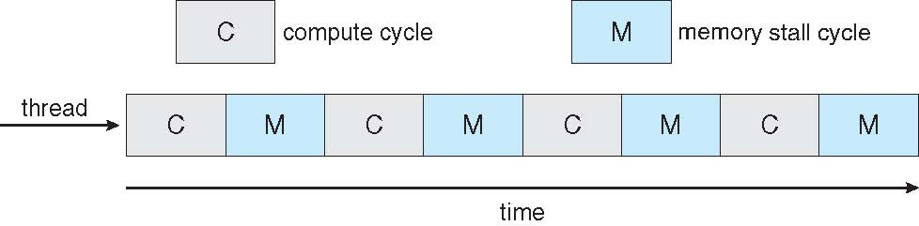

Multithreaded Multicore System

Slide 40
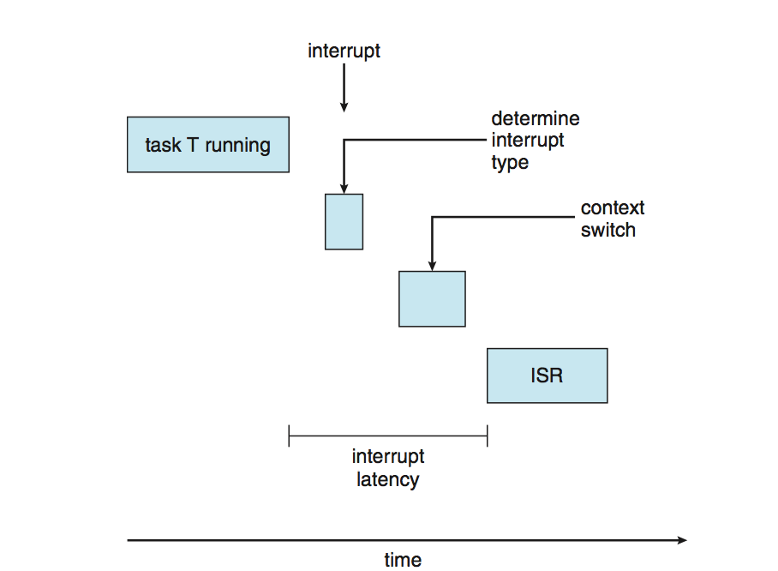
Real-Time CPU Scheduling
Can present obvious challenges
Soft real-time systems – no guarantee as to when critical real-time process will be scheduled
Hard real-time systems – task must be serviced by its deadline
Two types of latencies affect performance
  Interrupt latency – time from arrival of interrupt to start of routine that services interrupt
  Dispatch latency – time for schedule to take current process off CPU and switch to another

Slide 41
Real-Time CPU Scheduling (Cont.)
Conflict phase of dispatch latency:
  Preemption of any process running in kernel mode
  Release by low-priority process of resources needed by high-priority processes

Slide 42
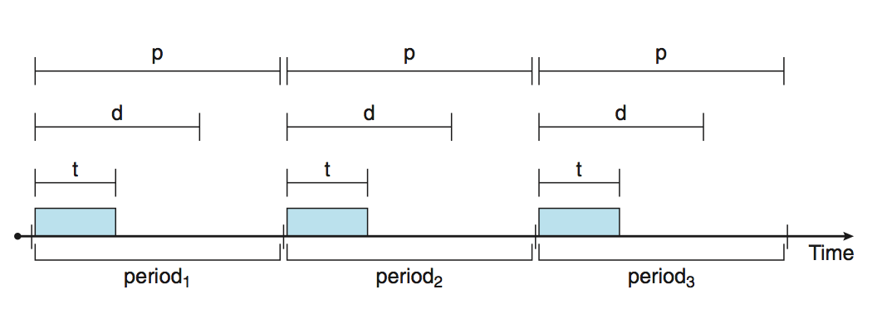
Priority-based Scheduling
For real-time scheduling, scheduler must support preemptive, priority-based scheduling
  But only guarantees soft real-time
For hard real-time must also provide ability to meet deadlines
Processes have new characteristics: periodic ones require CPU at constant intervals
  Has processing time t, deadline d, period p
  0 ≤ t ≤ d ≤ p
  Rate of periodic task is 1/p

Slide 43
Virtualization and Scheduling
Virtualization software schedules multiple guests onto CPU(s)
Each guest doing its own scheduling
  Not knowing it doesn’t own the CPUs
  Can result in poor response time
  Can effect time-of-day clocks in guests
Can undo good scheduling algorithm efforts of guests

Slide 44
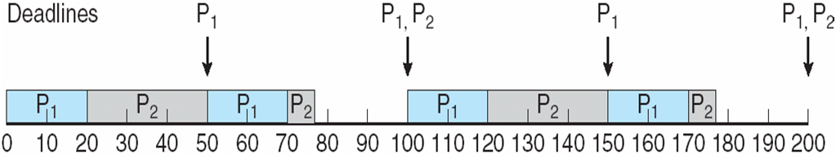
Rate Montonic Scheduling
A priority is assigned based on the inverse of its period
Shorter periods = higher priority;
Longer periods = lower priority
P₁ is assigned a higher priority than P₂.

Slide 45
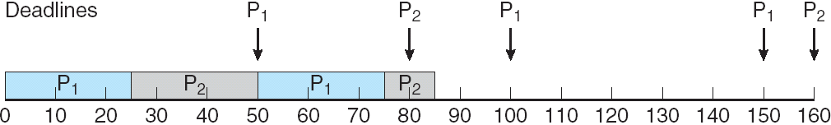
Missed Deadlines with
Rate Monotonic Scheduling

Slide 46
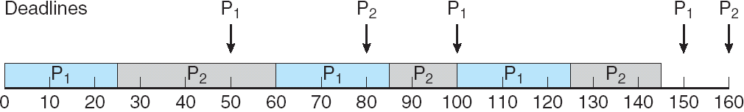
Earliest Deadline First Scheduling (EDF)
Priorities are assigned according to deadlines:
the earlier the deadline, the higher the priority;
the later the deadline, the lower the priority

Slide 47
Proportional Share Scheduling
T shares are allocated among all processes in the system
An application receives N shares where N < T
This ensures each application will receive N / T of the total processor time

Slide 48
POSIX Real-Time Scheduling
The POSIX.1b standard
API provides functions for managing real-time threads
Defines two scheduling classes for real-time threads:
SCHED_FIFO - threads are scheduled using a FCFS strategy with a FIFO queue. There is no time-slicing for threads of equal priority
SCHED_RR - similar to SCHED_FIFO except time-slicing occurs for threads of equal priority
Defines two functions for getting and setting scheduling policy:
pthread_attr_getsched_policy(pthread_attr_t *attr, int *policy)
pthread_attr_setsched_policy(pthread_attr_t *attr, int policy)

Slide 49
POSIX Real-Time Scheduling API
#include <pthread.h>
#include <stdio.h>
#define NUM_THREADS 5
int main(int argc, char *argv[])
{
int i, policy;
pthread_t_tid[NUM_THREADS];
pthread_attr_t attr;
/* get the default attributes */
pthread_attr_init(&attr);
/* get the current scheduling policy */
if (pthread_attr_getschedpolicy(&attr, &policy) != 0)
fprintf(stderr, "Unable to get policy.\n");
else {
if (policy == SCHED_OTHER) printf("SCHED_OTHER\n");
else if (policy == SCHED_RR) printf("SCHED_RR\n");
else if (policy == SCHED_FIFO) printf("SCHED_FIFO\n");
}

Slide 50
POSIX Real-Time Scheduling API (Cont.)
/* set the scheduling policy - FIFO, RR, or OTHER */
if (pthread_attr_setschedpolicy(&attr, SCHED_FIFO) != 0)
fprintf(stderr, "Unable to set policy.\n");
/* create the threads */
for (i = 0; i < NUM_THREADS; i++)
pthread_create(&tid[i],&attr,runner,NULL);
/* now join on each thread */
for (i = 0; i < NUM_THREADS; i++)
pthread_join(tid[i], NULL);
}
/* Each thread will begin control in this function */
void *runner(void *param)
{
/* do some work ... */
pthread_exit(0);
}

Slide 51
Operating System Examples
Linux scheduling
Windows scheduling
Solaris scheduling

Slide 52
Linux Scheduling Through Version 2.5
Prior to kernel version 2.5, ran variation of standard UNIX scheduling algorithm
Version 2.5 moved to constant order O(1) scheduling time
  Preemptive, priority based
  Two priority ranges: time-sharing and real-time
  Real-time range from 0 to 99 and nice value from 100 to 140
  Map into global priority with numerically lower values indicating higher priority
  Higher priority gets larger q
  Task run-able as long as time left in time slice (active)
  If no time left (expired), not run-able until all other tasks use their slices
  All run-able tasks tracked in per-CPU runqueue data structure
    Two priority arrays (active, expired)
    Tasks indexed by priority
    When no more active, arrays are exchanged
  Worked well, but poor response times for interactive processes

Slide 53
Linux Scheduling in Version 2.6.23 +
Completely Fair Scheduler (CFS)
Scheduling classes
  Each has specific priority
  Scheduler picks highest priority task in highest scheduling class
  Rather than quantum based on fixed time allotments, based on proportion of CPU time
  2 scheduling classes included, others can be added
    default
    real-time
Quantum calculated based on nice value from -20 to +19
  Lower value is higher priority
  Calculates target latency – interval of time during which task should run at least once
  Target latency can increase if say number of active tasks increases
CFS scheduler maintains per task virtual run time in variable vruntime
  Associated with decay factor based on priority of task – lower priority is higher decay rate
  Normal default priority yields virtual run time = actual run time
To decide next task to run, scheduler picks task with lowest virtual run time

Slide 54
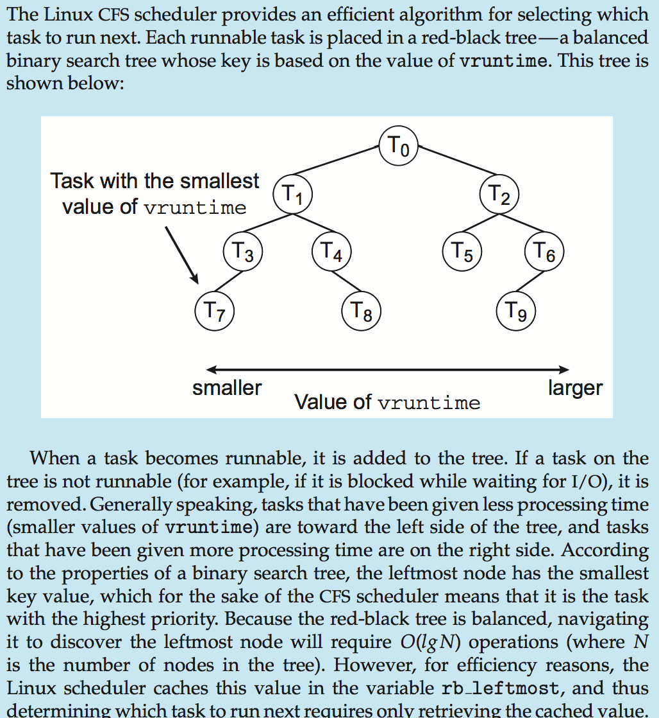
CFS Performance

Slide 55
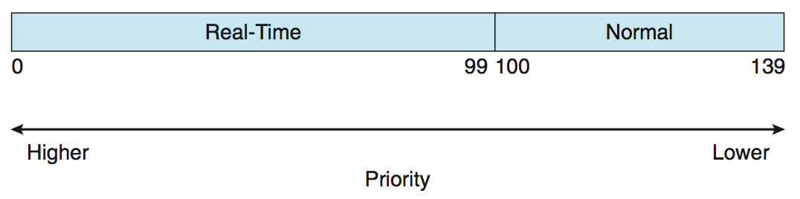
Linux Scheduling (Cont.)
Real-time scheduling according to POSIX.1b
  Real-time tasks have static priorities
Real-time plus normal map into global priority scheme
Nice value of -20 maps to global priority 100
Nice value of +19 maps to priority 139

Slide 56
Windows Scheduling
Windows uses priority-based preemptive scheduling
Highest-priority thread runs next
Dispatcher is scheduler
Thread runs until (1) blocks, (2) uses time slice, (3) preempted by higher-priority thread
Real-time threads can preempt non-real-time
32-level priority scheme
Variable class is 1-15, real-time class is 16-31
Priority 0 is memory-management thread
Queue for each priority
If no run-able thread, runs idle thread

Slide 57
Windows Priority Classes
Win32 API identifies several priority classes to which a process can belong
  REALTIME_PRIORITY_CLASS, HIGH_PRIORITY_CLASS, ABOVE_NORMAL_PRIORITY_CLASS,NORMAL_PRIORITY_CLASS, BELOW_NORMAL_PRIORITY_CLASS, IDLE_PRIORITY_CLASS
  All are variable except REALTIME
A thread within a given priority class has a relative priority
  TIME_CRITICAL, HIGHEST, ABOVE_NORMAL, NORMAL, BELOW_NORMAL, LOWEST, IDLE
Priority class and relative priority combine to give numeric priority
Base priority is NORMAL within the class
If quantum expires, priority lowered, but never below base
If wait occurs, priority boosted depending on what was waited for
Foreground window given 3x priority boost
Windows 7 added user-mode scheduling (UMS)
  Applications create and manage threads independent of kernel
  For large number of threads, much more efficient
  UMS schedulers come from programming language libraries like C++ Concurrent Runtime (ConcRT) framework

Slide 58
Windows Priorities

Slide 59
Solaris
Priority-based scheduling
Six classes available
  Time sharing (default) (TS)
  Interactive (IA)
  Real time (RT)
  System (SYS)
  Fair Share (FSS)
  Fixed priority (FP)
Given thread can be in one class at a time
Each class has its own scheduling algorithm
Time sharing is multi-level feedback queue
  Loadable table configurable by sysadmin

Slide 60
Solaris Dispatch Table

Slide 61
Solaris Scheduling

Slide 62
Solaris Scheduling (Cont.)
Scheduler converts class-specific priorities into a per-thread global priority
  Thread with highest priority runs next
  Runs until (1) blocks, (2) uses time slice, (3) preempted by higher-priority thread
  Multiple threads at same priority selected via RR

Slide 63
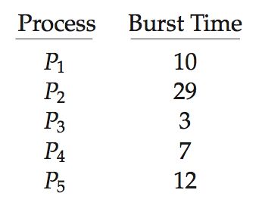
Algorithm Evaluation
How to select CPU-scheduling algorithm for an OS?
Determine criteria, then evaluate algorithms
Deterministic modeling
  Type of analytic evaluation
  Takes a particular predetermined workload and defines the performance of each algorithm for that workload
Consider 5 processes arriving at time 0:

Slide 64
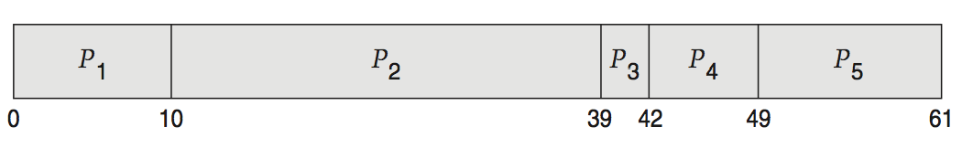
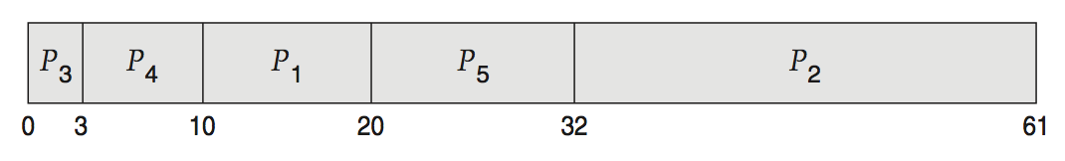
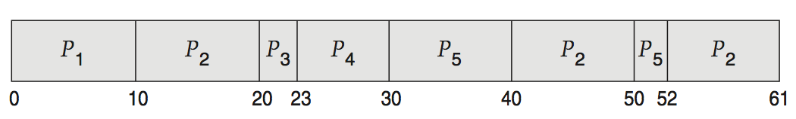
Deterministic Evaluation
For each algorithm, calculate minimum average waiting time
Simple and fast, but requires exact numbers for input, applies only to those inputs
  FCS is 28ms:
  Non-preemptive SFJ is 13ms:
  RR is 23ms:

Slide 65
Queuing Models
Describes the arrival of processes, and CPU and I/O bursts probabilistically
  Commonly exponential, and described by mean
  Computes average throughput, utilization, waiting time, etc
Computer system described as network of servers, each with queue of waiting processes
  Knowing arrival rates and service rates
  Computes utilization, average queue length, average wait time, etc

Slide 66
Little’s Formula
n = average queue length
W = average waiting time in queue
λ = average arrival rate into queue
Little’s law – in steady state, processes leaving queue must equal processes arriving, thus
n = λ x W
  Valid for any scheduling algorithm and arrival distribution
For example, if on average 7 processes arrive per second, and normally 14 processes in queue, then average wait time per process = 2 seconds

Slide 67
Simulations
Queueing models limited
Simulations more accurate
  Programmed model of computer system
  Clock is a variable
  Gather statistics indicating algorithm performance
  Data to drive simulation gathered via
    Random number generator according to probabilities
    Distributions defined mathematically or empirically
    Trace tapes record sequences of real events in real systems

Slide 68
Evaluation of CPU Schedulers by Simulation

Slide 69
Implementation
Even simulations have limited accuracy
Just implement new scheduler and test in real systems
  High cost, high risk
  Environments vary
Most flexible schedulers can be modified per-site or per-system
Or APIs to modify priorities
But again environments vary

Slide 70
End of Chapter 6

