Slide 1
ICT Policy سياسات تكنولوجيا المعلومات والاتصالات
Lecture (5)
Dr.Samah Mohammed

Slide 2
The International Telecommunications Union (ITU)
Intergovernmental Organization for development of telecommunications in which also non-governmental entities participate.
137 years old
189 Member States, 650 Sector Members
750 staff / 71 nationalities
Website: http://www.itu.int

Slide 3
Cont…
Founded on the principle of international cooperation between government and the private sector,
The ITU is the global forum through which government and industry can work towards consensus on a wide range of issues affecting the future direction of this industry.
ITU has adapted to the times and become more responsive to private companies.

Slide 4
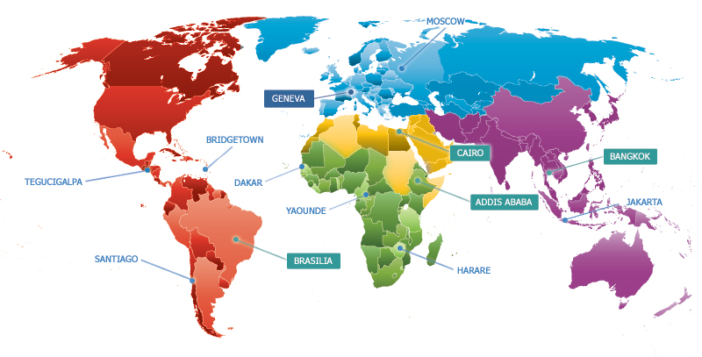
ITU’s Global presence
Headquarters in Geneva with Liaison Office in New York
Regional offices in Addis Ababa, Bangkok, Brasilia, Cairo
Area offices in Bridgetown, Dakar, Harare, Jakarta, Moscow, Santiago, Tegucigalpa, Yaoundé

Slide 5
ITU membership
Companies both large and small can become members of ITU sectors by paying membership fees.
companies provide much of the technical input to the decision-making process.
Lower fees are available for membership in the Telecommunications Development Sector.

Slide 6
ITU Mission
ITU’s mission covers technical, developmental and policy issues . Much of its authority derives from its World Conferences, which review,and adopt the regulations that form the framework for the provision of international telecommunications services.
Establishes the technical characteristics and operational procedures for wireless services.
manages the global radio frequency spectrum.

Slide 7
ITU Mission Cont…
coordinates international standard setting activities including standards for Internet Protocol (IP) networks and IP-based systems.
Development Sector implements communications development projects that are funded by the UN and other sources.
publishes definitive information on telecommunications trends.

Slide 8
How the ITU Works?
Plenipotentiary Conferences, Council
World Conferences on International Telecommunications.
Three ITU Sectors.
General Secretariat

Slide 9
Plenipotentiary(PP) Conferences
Highest authority of ITU.
Sets tasks, organization, plans, budget.
Elects Council Member Countries
Elects 5 high officials and 12 Radio Regulations Board (RRB) members.
One country –one voice. Consensus.
Meets every 4 years

Slide 10
Council
46 Member Countries.
Oversees the ITU work between PPs.
Meet every year

Slide 11
Structure of ITU
General Secretariat (SG)
Radiocommunication Sector (ITU-R)
Telecommunication Standardization Sector (ITU-T)
Telecommunication Development Sector (ITU-D)

Slide 12
ITU Radiocommunication Sector (ITU-R)
Tasks:-
World Radiocommunication Conferences
Radiocommunication Assemblies
Study Groups
Radio Regulations Board (RRB)
Radiocommunication Advisory Group (RAG)
Space services department
Terrestrial services department
Publications

Slide 13
Telecommunication Standardization Sector (ITU-T)
Tasks :-
Solve technical, operational and tariff questions with a view of standardizing all telecommunications (wired and wireless) on worldwide basis.
Telecommunications Standardization
Conferences and Study Groups

Slide 14
Without ITU-T standards:
You couldn’t make a telephone call from one side of the world to the other.
You wouldn’t be able to surf the Internet .
Modern communications, as we know them, just wouldn’t exist

Slide 15
Telecommunication Development Sector (ITU-D)
Tasks:-
To discharge the Union's dual responsibility as a UN specialized agency and executing agency for implementing projects under the UN development system or other funding arrangements.
Development Conferences, Study Groups

Slide 16
The General Secretariat
The ITU Secretary-General is the legal representative of the Union.
With the Coordination Committee and Secretariat, he coordinates the Union's activities and prepares policies and plans for the Union.
Assisted in these duties by the Deputy Secretary-General, he is also responsible to the PP and Council for the administrative and financial issues.

Slide 17
ITU Publications

Slide 18
World Intellectual Property Organization(WIPO)
WIPO is a specialized agency of the United Nations responsible for promoting the protection of intellectual property worldwide
179 countries are WIPO members; national and international non-governmental organisations may apply for observer status (www.wipo.org).
The ICT revolution has probably had a greater impact on WIPO than on any other UN agency.

Slide 19
WIPO Cont…
WIPO is responsible for administering 23 treaties(معاهدات) in the field of intellectual property.
The treaties define internationally-agreed basic standards of protection in each country.
WIPO faces large challenges in leading the way towards a system of intellectual property rights.

