Slide 1
Open Source Operating System نظم تشغيل مفتوحة المصدر Lecture (2)
Dr.Samah Mohammed

Slide 2
Objectives
Linux Interfaces
The LINUX GUI (Gnome,KDE)
Virtual machines
Use the CLI over the GUI
The Shell
Bash Shell
The Linux command line
Entering Linux commands
Simple Linux Commands
Multiple Commands
Commands with Options and Parameters
MAN PAGES
Components of a Linux shell
Bash Features

Slide 3
Linux Interfaces
There are two different types of user interfaces in Linux:
Graphical User Interface (GUI)
Command Line Interface (CLI)

Slide 4
THE LINUX GUIs
The two common GUIs in Red Hat Linux are Gnome and KDE(Komon Desktop Envronment).
Gnome environment is the default GUI for Red Hat.
Both of these GUIs are built on top of an older graphical interface system called X-Windows.
Gnome and KDE both GUIs offer very similar features with only their appearances differing.
Each comes with its own basic set of application software.

Slide 5
THE LINUX COMMAND LINE
The CLI is part of a shell. The Linux shell itself contains the CLI, an interpreter, and an environment of previously defined entities like functions and variables.

Slide 6
Why you should ever want to use the CLI over the GUI
1- Control: Controlling the full capabilities of the operating system:
Most Linux commands have a number of options that can be specified via the command line
Some of the Linux options are not available through the GUI.
2- Speed: graphics take more processing time which make it slower than CLI .
3- Resources: graphics take more hard disk memory, processing time and power.

Slide 7
VIRTUAL MACHINES
A VM is an extension to an older idea known as software emulation.
The VM is a related idea to the emulator. The VM, as the name implies, creates an illusionary computer in your physical computer.
The physical computer is set up to run a specific operating system and specific software. However, through emulation, the VM then can provide the user with a different operating system running different software.

Slide 8
The Shell
The interpreter is a program which accepts user input, interprets the command entered, and executes it.
The interpreter runs in an environment consisting of instructions (commands), command shortcuts (called aliases), and values stored in variables.
The combination of the interpreter, command line, and environment make up what is known as a shell.

Slide 9
The Shell Cont..
Linux has a variety of different shells:
Bourne shell (sh), C shell (csh), Korn shell (ksh), TC shell (tcsh), Bourne Again shell (bash).
A shell is an interface between the user and the core components of the operating system (kernel).
A shell is provided whenever a user opens a terminal window in the Linux GUI.
The power of a Linux shell goes beyond the ability to fill in your own pieces though.

Slide 10
Bash shell
Bourne-Again Shell or (BASH)
The original Linux shell was the Bourne shell with a built-in Bourne interpreter.
This shell was named after the program’s author, Stephen Bourne.
The intention of a shell was to provide the user with a command-line interpreter, but to also provide the user with an environment to work in

Slide 11
ENTERING LINUX COMMANDS
When logged into Linux your first shell will be open. There are a prompt awaiting your command
[user@localhost ~]$
The prompt is telling you who you are, where you are, who you are, and where you are:
Who you are is your user name (user in this case)
Where you are is the machine you are on. Localhost means that the shell you have opened is on this computer.
Where you are this tells you that your current working directory is ~.
Who you are: is provided by the $. The $ represents your prompt:
$ indicates that you are a normal user
# would indicate that you are root (the system administrator).
* Note: The ~ means “user’s home directory.

Slide 12
Simple Linux Commands
There are several simple Linux commands that can tell you who you are, where you are, and what can be found at your current location:
whoami: output the user’s username
pwd: output the current working directory
hostname: output the name of the host (this will either be localhost , localdomain or the IP address or IP alias of the machine logged in to)
passwd: used to change your password.

Slide 13
Simple Linux Commands Cont..
• uname: output basic information about your operating system.
• arch: output basic information about your computer’s hardware (architecture).
• who: list the users currently logged in to the computer you are operating on, including their terminal (which terminal window they have opened or whether they are on console).
• bash: start a new Bash shell (if in a shell, this starts a new session so that the outer shell session is hidden). A variation is sh, to start a new shell. The sh program may not start a Bash shell however depending on which version of Linux you are using.
exit: leave the current Bash shell and if this is the outermost Bash shell, close the window.

Slide 14
Multiple Commands
You can enter multiple commands from the prompt by separating each with a semicolon (;)
Example:
[root@localhost ~]$ whoami
root
[root@localhost ~]$ hostname
Localhost.localdomain
[root@localhost ~]$ uname
Linux
[root@localhost ~]$ whoami ; hostname ; uname
root
Localhost.localdomain
Linux

Slide 15
Commands with Options and Parameters
Most Linux commands expect arguments. Arguments come in two basic forms, options and parameters.
1- Options are user-specified variations to the command so that the command performs differently.
2- Parameters are commonly either file names or directories (or both).
The format of a Linux command is
command [option(s)] [parameter(s)]

Slide 16
MAN PAGES
A command available in Linux is called man, which is short for manual page.
There are manual contents that explain the intention of the command and how to use it.
We can learn about everything about the commands (options, parameters and how to use it) .
The command man is used to display the manual contents for a given Linux command.

Slide 17
MAN PAGES Cont..
The entries listed under the man page for the ls command.
man ls
• NAME
• ls—list directory contents
• SYNOPSIS
• ls [OPTION]…. [FILE]…
OPTION is the list of optional options and FILE is the optional list of files/directories.
The [] indicate that these entries are optional.
This is followed by approximately nine screens’ worth of options and their descriptions.
• AUTHOR
• Written by Richard Stallman and David MacKenzie.

Slide 18
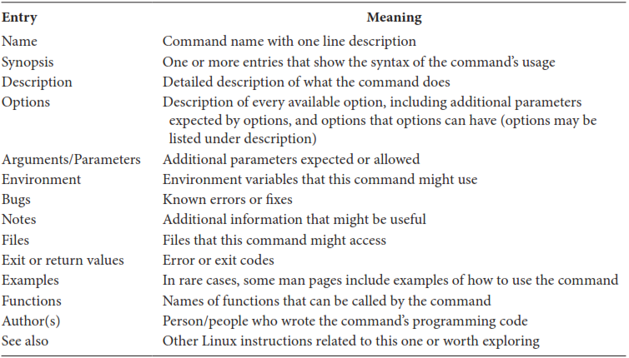
MAN PAGES Cont..

Slide 19
MAN PAGES Cont..
After each screen, the man page pauses with the “:” prompt. At this prompt, man awaits your keystroke to command how man should continue. You have the following options:

Slide 21
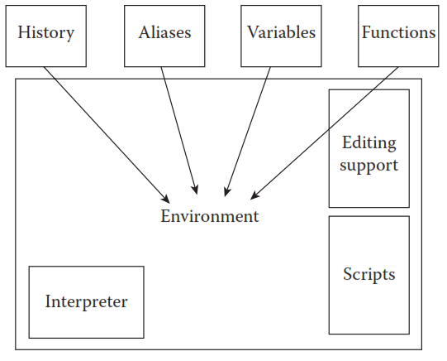
Components of a Linux shell(المجموعه الرابعه
The shell initializes itself which includes some predefined components as specified by initialization scripts.
The user has the ability to add to the shell’s components through aliases, variables, commands, functions, and so forth.

Slide 22
History
In the shell every time you enter a command, that command is stored in a history list. To recall the history list, type history
You can re-execute any command in the history list by typing !# where # is the number as shown in the history list
For Example:
1 ls
2 uname
3 vi
If you want to re-execute the ls command write !1

Slide 23
History Cont..
There are several different ways to recall commands from the history list using the ! (sometimes called a “bang”). These are:
• !#—Recall the instruction from line # in the history list
• !!—Recall the last instruction from the history list.
• !string—Where string is a string of character to recall the most recent instruction that started with the given string

Slide 24
Shell Variables
A variable is merely a name that references something stored in memory.
In the first use a variable, we assign it a value. The assignment statement takes the form:
var = value
where var is a variable name and,
value is a the initial value stored in the variable
To retrieve a value stored in a variable precede the variable name with a $ as in $X or $NAME
The command to output the value of a variable is echo. This is the general purpose output statement for Linux.
The format is : echo string

Slide 25
Shell Variables Cont..
The variable names must be preceded by a $ in order to output the values stored in the variables.
Assume name = Hiba , Then
echo name
Outputs: name
echo $name
Outputs: Hiba
The echo command has a few basic options:
• -n: Do not output a newline character at the end. If you use –n, then the next echo statement will output to the same line as this echo statement. By default, echo outputs a newline character at the end of the output.
• -e: Enable interpretation of backslash escapes .
• -E: Disable interpretation of backslash escapes.

Slide 26
Shell Variables Cont..
If the string is to include a character that has a special meaning, such as the $,
you must force the Bash interpreter to treat the character literally. You do this by preceding the character with a \ (backslash).
Example: if amount stores 183. To output this as a dollar amount:
echo \$ $amount
Outputs: $ 183

Slide 27
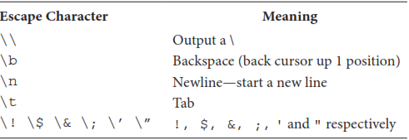
Shell Variables Cont..
Escape Characters for Linux echo:

Slide 28
Environment Variables
There are predefined variables these are known as environment variables.
To see the environment variables defined, use the command env

Slide 29
Useful Environment Variables in Bash

Slide 30
Aliases
An alias is an assignment of a name to a value, but in this case the value is a Linux command.
alias name = command
Where name is the alias name and command is the Linux command.
If the command includes any blank spaces at all, the command must be enclosed in single quote marks (‘ ’).

Slide 31
Aliases Cont..
Aliases are used by users for several reasons:
• To reduce the amount of typing
• So that complicated instructions do not have to be remembered
• So that common written mistake made by the user can be interpreted correctly
• So that dangerous commands are made safer
Example:
alias str1=ls $HOME
To remove an alias using unalias
Example: To remove the alias for str1
unalias str1

Slide 32
Redirection
In Linux, there are three predefined locations for interaction with the Linux commands (programs).
These are
1- standard input (STDIN default keyboard)
2- standard output (STDOUT default terminal window)
3- standard error (STDERR)
These three locations are actually file descriptors.
A file descriptor is a means for representing a file to be used by a process.

Slide 33
Redirection Cont..
In Linux, file descriptors are implemented as integer numbers with 0,1 and 2 reserved For STDIN, STDOUT, and STDERR
Linux command will receive its input from STDIN and send its output to STDOUT
A redirection is a command that alters the defaults of STDIN, STDOUT, and STDERR.

Slide 34
Output Redirection
We can store the results of a Linux command to a file by redirect the output of this command to that file rather than the Terminal.
There are two forms of output redirection:
> : Send output to the file whose name is specified after the >; if the file already exists, delete its contents before writing.
>> : Append output to the file whose name is specified after the >>; if the file does not currently exist, create it.
Example:
ls –l > try.txt
cat try.txt >> user1.txt

Slide 35
Input Redirection
There are two forms of input redirection:
< -Use the file whose name is specified after the < as input to the command.
<< -Use STDIN (keyboard) as input.

Slide 36
Linux pipe
The Linux pipe is used to send the output of one program to serve as the input to another.
| Redirect the output of one command to serve as the input to the next command.
Example:
ls -1 | wc –l

Slide 37
Other Useful Bash Features
Tilde expansion
the ~ is used to denote a user’s home directory
Wildcards
Wildcards are a shortcut approach to specify a number of similarly named files without having to enumerate all of them.
The * Linux interpreter replaces it with all entities in the given directory.
The * can be used as a portion of a name.
Example: All of the items that start with the name “file” and end with “.txt” but can have any characters in between would appear as file*.txt this will match file1.txt, file21.txt, file_a.txt, and also file.txt

Slide 38
Tutorial(1)
1-Given the following prompt, answer the questions below.
[khalid@English_server /ust]#
Who is logged in?
What is the current working directory?
c. What is the hostname?
2. What command would you use to change your password .

