Slide 1
University of Science and Technology
Faculty of Computer Science and Information Technology
Computer Science –Department
4th- Year
Computer Graphics
Introduction to Computer Graphics
Part-2
Dia Eldein Mustafa Ahmed
2018

Slide 2
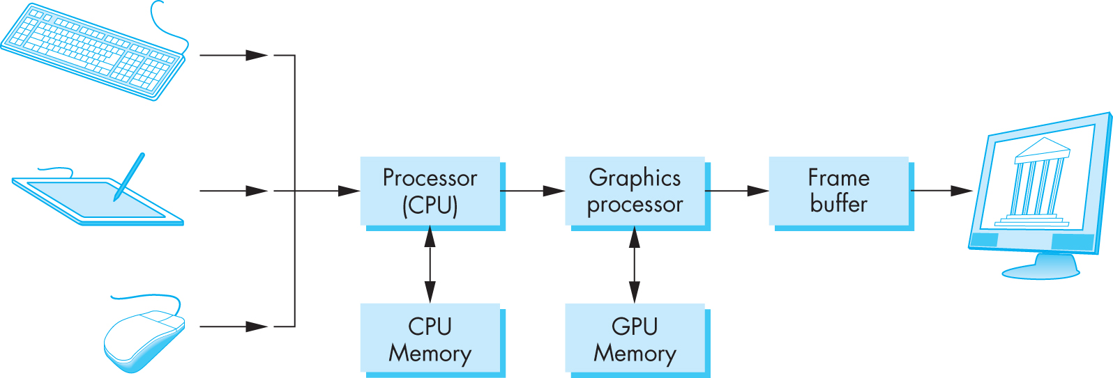
Basic Graphics System
Output device
Input devices
Image formed in frame buffer

Slide 3
Raster-Scan Display Systems
A simple raster system

Slide 4
The Video Controller
The most important task for the controller is the constant refresh of the display (60 frame per second)
1) Interlaced
1st field: odd lines
2nd field: even lines
2) Non-interlaced: updates every scan-line in every field
3) Output: RGB, monochrome, NTSC (video tape)
4) Sprites in animation: a sequence of fixed-size pixel maps.
5) Video Mixing:
6) FB + External Video --> VC --> display

Slide 5
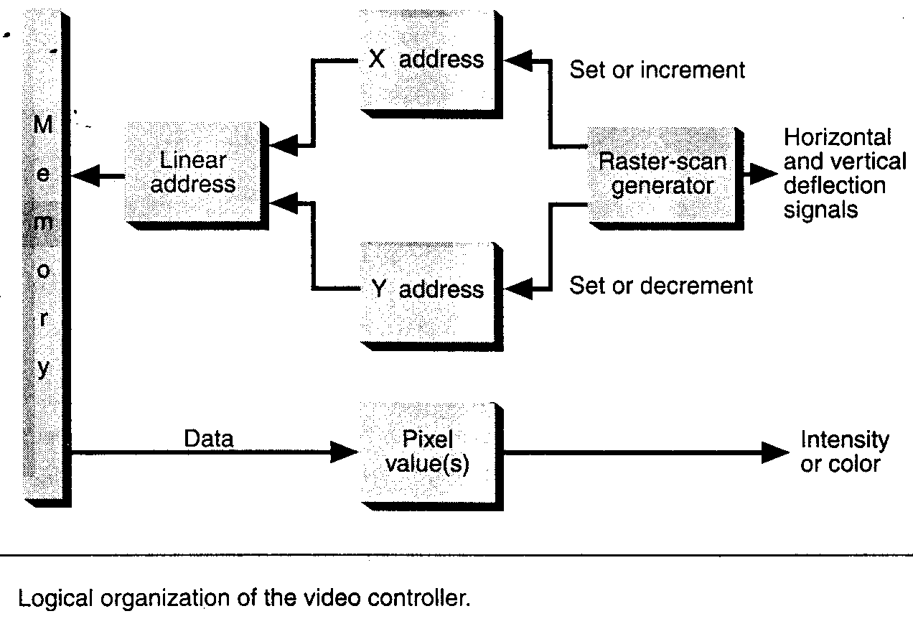
Frame Buffer: memory that stores the color data for each pixel on the screen.
Video controller reads the color value for each pixel and controls the intensity of the display at the pixel.

Slide 6
Memory Speed Problem:
1K pixels / line × 1K lines / frame × 60frame / second ➔ 60 million reads/second ==>16 ns per read
RAM speed ~ 50 ns/read
?
Interlacing odd and even lines.
VRAM: Video RAM (TI),
reads all the pixels on a scan line in one cycle.
Frame Buffer Depth
Number of bits for each pixel (n).
Also called number of planes.
Number of possible colors: 2^{n}

Slide 7
VRAM size >= screen resolution * depth
24 bits: 16 M colors, True Color
1K×1K×3 bytes =3MB VRAM
1K×768×3=2.3MB
800×600×3=1.5MB
640×480×3=1MB
32 bits: RGBA, 16 M colors + Transparency
(“Highest” in Windows)
16 bit: Pseudo True Color, 64K
(“Medium” in Windows)
1K×1K×2=2MB VRAM
1K×768×2=1.5MB
800×600×2=1 MB
640×480×2=0.6 MB
8 bit: Indexed Color, 256, SVGA
1K×1K×1=1MB VRAM
800×600×1=0.5MB

Slide 8
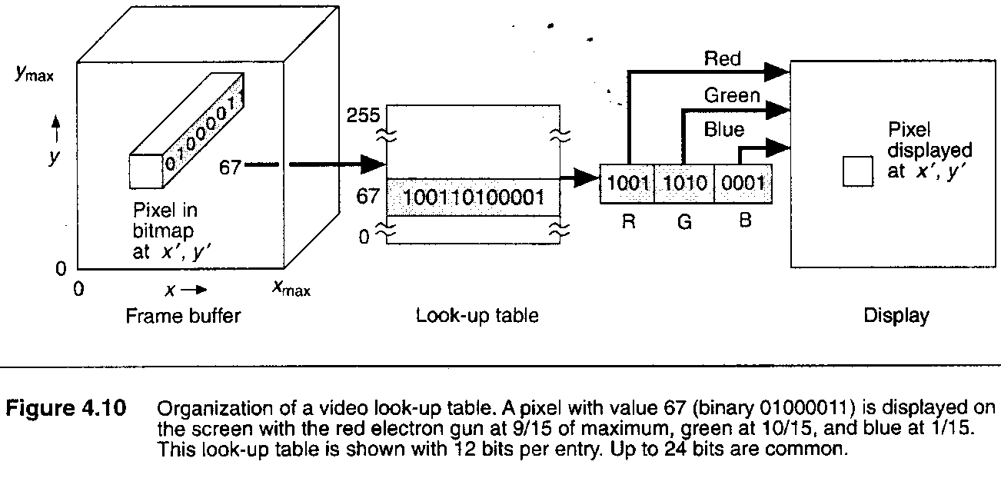
Look-up Table for Indexed Color(LUT)
With indexed colors, pixel values represent the index number into the LUT. The corresponding data value in the LUT represent the colors.
8 bits / pixel => 256 colors at a time.
12 bit / entry => 4k colors to chose the 256 from.

Slide 9
GPU (Graphics Processing Unit)
Specialized hardware to assist graphics display operations. (scan-convert, bitblt)
More to come on GPU and GPGPU.

Slide 10
Graphics Pipeline
Process objects one at a time in the order they are generated by the application
Pipeline architecture
All steps can be implemented in hardware on the graphics card display

Slide 11
OpenGL Architecture
geometry
pipeline
Immediate Mode
Per Vertex
Operations &
Primitive
Assembly
Polynomial
Evaluator
CPU
Display
List
Rasterization
Per Fragment
Operations
Frame
Buffer
Texture
Memory
Pixel
Operations

Slide 12
Programmable Vertex and Pixel Processors
3D Application
or Game
3D API Commands
CPU
3D API:
OpenGL or Direct3D
CPU – GPU Boundary
GPU Command & Data Stream
Assembled Polygons, Lines, and Points
GPU
Pixel Location Stream
Vertex Index Stream
Pixel Updates
GPU
Front End
Primitive
Assembly
Rasterization & Interpolation
Raster
Operations
Framebuffer
Pre-transformed Vertices
Transformed Vertices
Rasterized
Pre-transformed
Fragments
Transformed
Fragments
Programmable
Vertex
Processor
Programmable
Fragment
Processor
An example of separate vertex processor and fragment processor in a programmable graphics pipeline

Slide 13
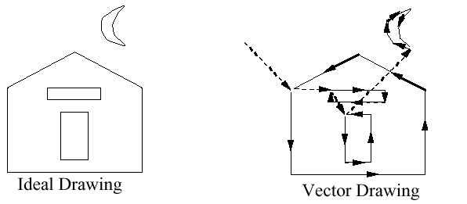

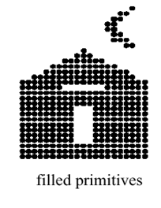
Graphics Display Hardware
Vector (calligraphic, stroke, random-scan)
Raster (TV, bitmap, pixmap) used in displays and laser rinters
Driven by display commands
  (move (x, y), char(“A”) , line(x, y)…)
Survives as “scalable vector graphics”
Driven by array of pixels (no semantics, lowest form of representation)
Note “jaggies” (aliasing errors) due to discrete sampling of continuous primitives
Ideal Drawing
Vector Drawing
Outline
Filled

Slide 14
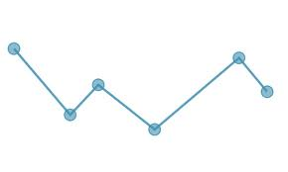
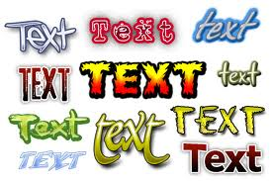
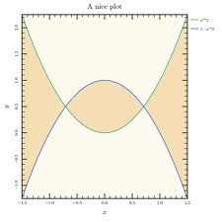
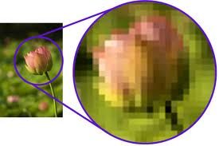
Elements Of Pictures Created In computer Graphics
Polylines
Text
Filled regions
Raster Images
Notes:
عناصر الصور المنشأة في رسوم الحاسب:

Slide 15

Polylines
A polyline is a connected sequence of straight lines
A curved line made up of straight-line segments.
Attributes of Lines and Polylines
. Line Thickness

Slide 16
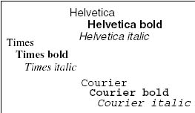
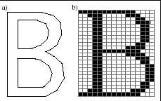
Text
Some graphics devices have two disitinct display modes.
  Text mode (graphics device is divided into lines and columns (25x80)
  Graphics mode (graphics device is divided into pixels( 480x640) at minimum based on the graphics card
A routine to draw a character string might Text Attributes look like drawString(x, y, string)
There are many text attributes, the most important of which are the test’s font , color, size, spacing, and orientation.

Slide 17
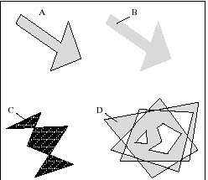
Filled-Regions
The filled-region primitive is d shape filled with some color or pattern.
Function
fillPolygon (poly, pattern);

Slide 18
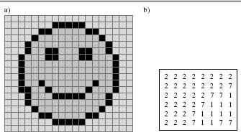
Raster Image
A raster Image is stored in a computer as an array of numerical values.
Hand-deisgned Images.
Computed Images.
Scanned Images.
Notes:
Raster: paint the image line by line; it is used for a grid of pixels by generalization

Slide 19
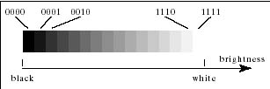
Representation of Shades of gray and Color in Raster Images.
Gray –scale Raster Images
If there are only two pixel values in a raster image, it is called bi-level.
An n-bit quantity has 2^{n} possible values, there can be 2^{n} gray levels in an image with pixel depth n.
.The most common values are as follows :
-Two bits per pixel produce 4 gray levels.
-Four bits per pixel produce 16 gray levels.
-Eight bits per pixel produce 256 gray levels.

Slide 20
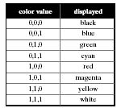
Representation of Shades of gray and Color in Raster Images.
Color Raster Image
Each pixel in a color image has a “color Value,” a numerical value that somehow represents a color.
Each value in the (red, green, blue) triple
has a certain number of bits, and the color
depth is the sum of these values.

Slide 21
Graphics Display Devices
Line-Drawing Display
  Creates pictures by drawing lines
  Pen plotter (Drawing with mechanical pens)
  Flatbed plotters
  Drum plotters
Vector displays
Vector displays cannot show smoothly-shaded regions or scanned images – (Cross-hatching)
Raster Displays
  Create pictures by displaying dots
  Other common displays produce hard copy of an image :

Slide 22
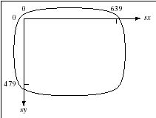
Graphics Display Devices
the laser printer, dot matrix printer, ink-jet plotter, and film recorder.
-.The built-in coordinate system for the surface for the surface of a raster display.
-.The memory is frame buffer.
-.The Scanning process
-.Video Monitors(CRT)
Notes:
أجهزة لإظهار مخرجات رسومات الحاسب

Slide 23
Indexed Color and the Lookup Table
Each pixel stores an index into a color table.
Allows a large range of colors to be displayed using less memory for the image. (LUT is much less expensive.)
The system has an 8-bit-per-pixel frame buffer along with an LUT, and the LUT is 24 bits wide. The system can display 2²⁴ different colors, but only 256 at a time.
The bits per pixel determines the size of the color table.
LUT (Look Up Table)

Slide 24
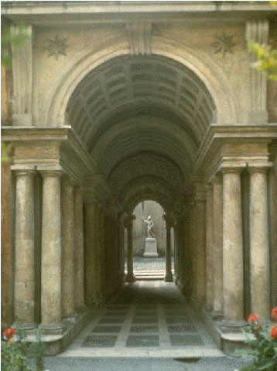
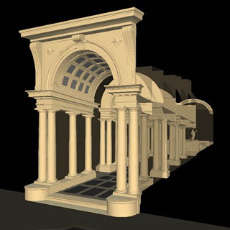
Image Based Rendering
Appearance in available views is used to determine appearance in novel views
Rendering is faster

Slide 25
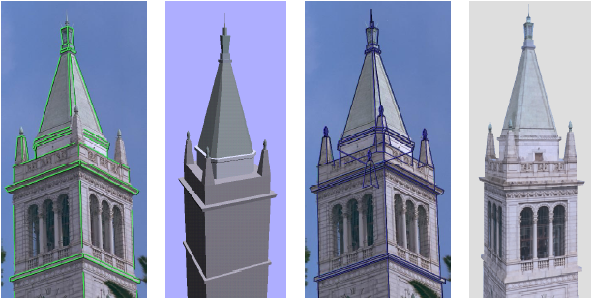

Slide 26
Output Devices
There are a range of output devices currently available:
  Printers/plotters
  Cathode ray tube displays
  Plasma displays
  LCD displays
  3 dimensional viewers
  Virtual/augmented reality headsets
We will look briefly at some of the more common display devices

Slide 27
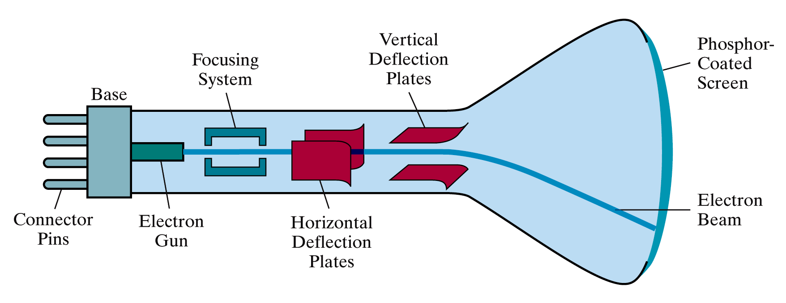
Basic Cathode Ray Tube (CRT)
Fire an electron beam at a phosphor coated screen

Slide 28
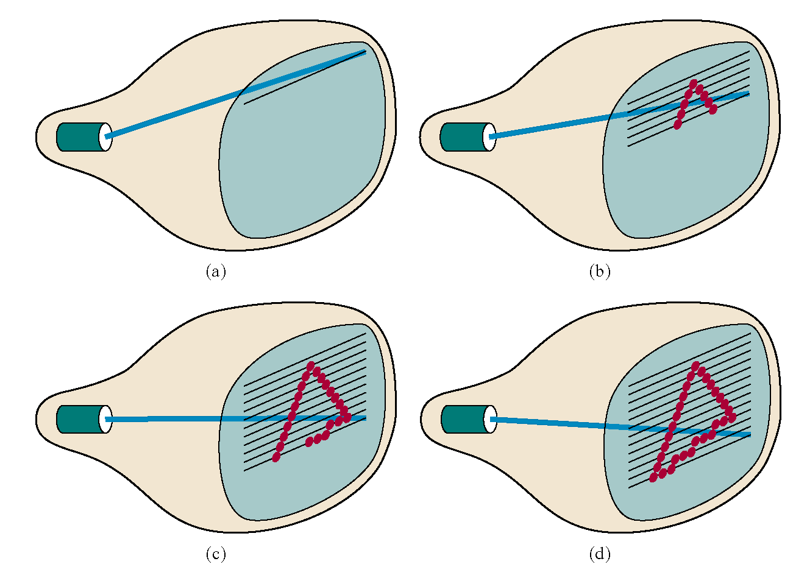
Raster Scan Systems
Draw one line at a time

Slide 29
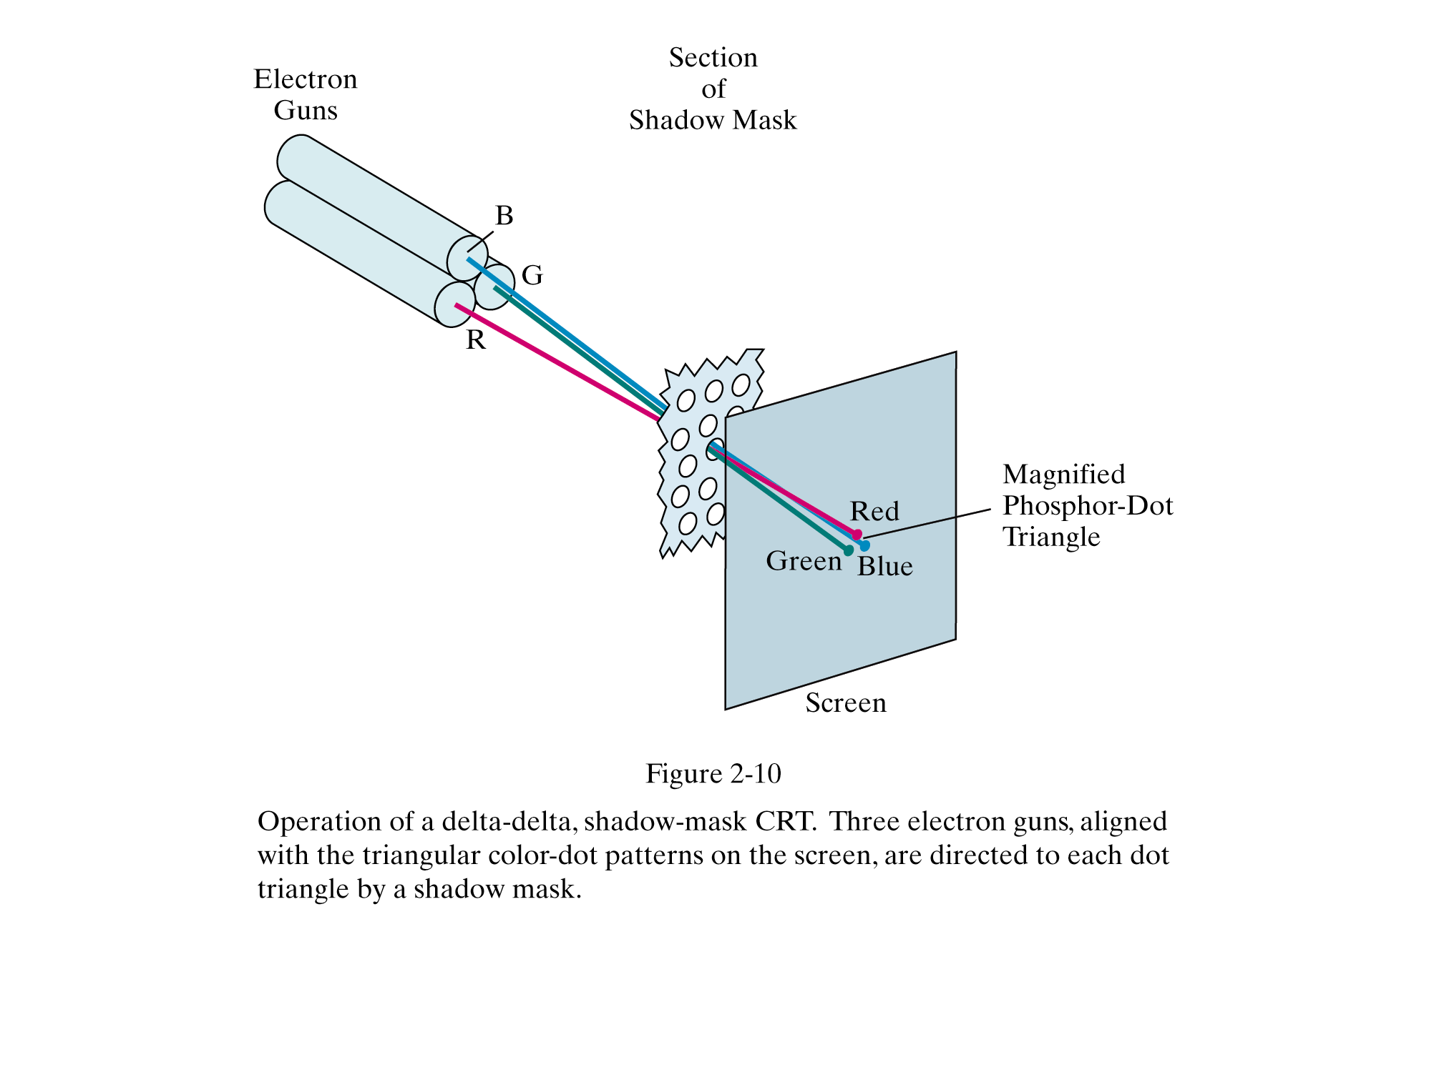
Colour CRT
An electron gun for each colour – red, green and blue

Slide 30
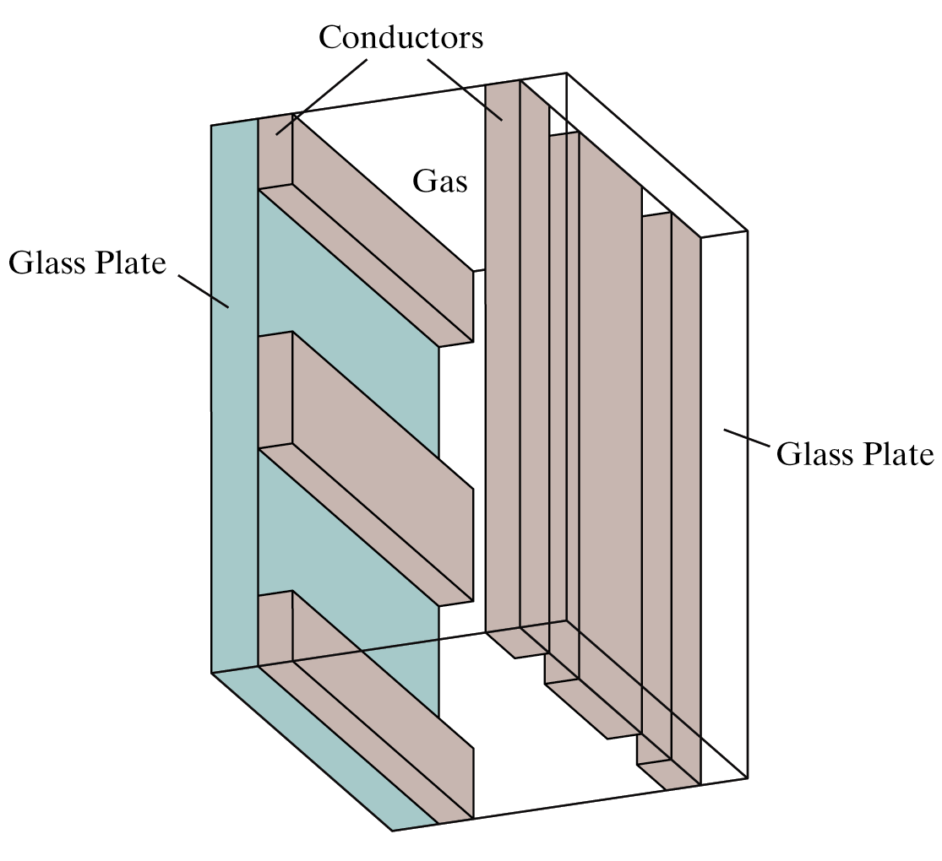
Plasma-Panel Displays
Applying voltages to crossing pairs of conductors causes the gas (usually a mixture including neon) to break down into a glowing plasma of electrons and ions

Slide 31
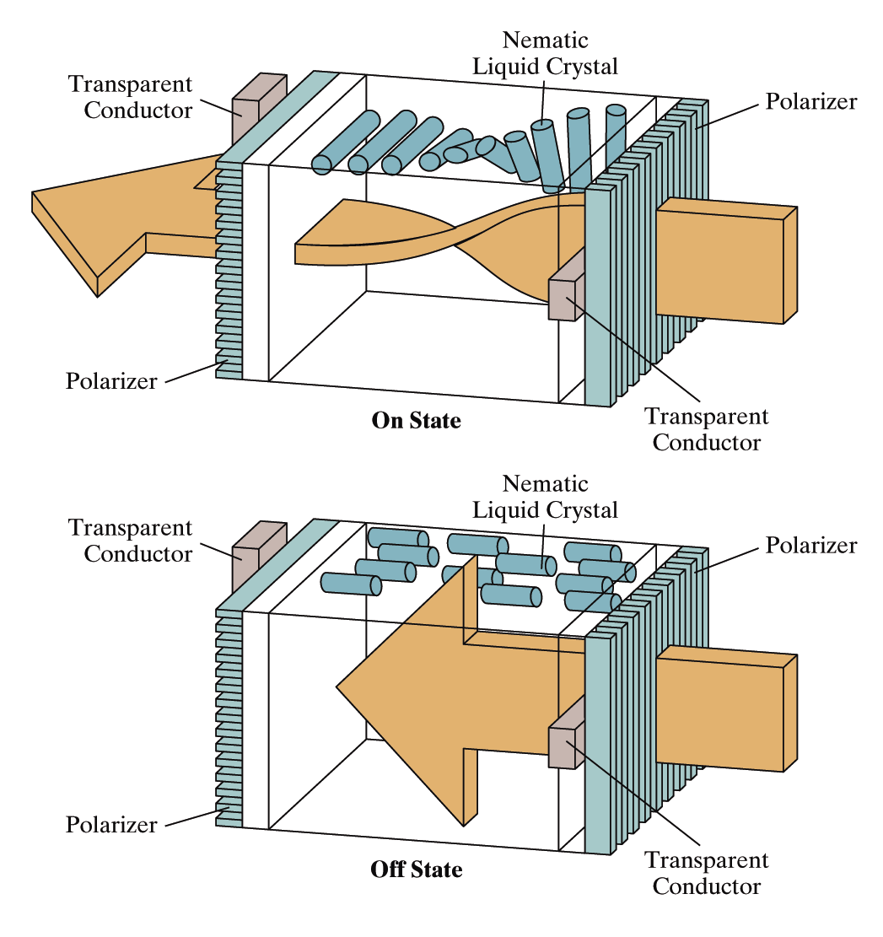
Liquid Crystal Displays
Light passing through the liquid crystal is twisted so it gets through the polarizer
A voltage is applied using the crisscrossing conductors to stop the twisting and turn pixels off

Slide 32
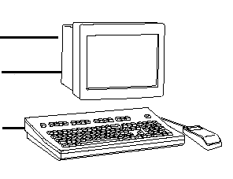
Conceptual Framework for Interactive Graphics
Graphics library/package is intermediary between application and display hardware (Graphics System)
Application program maps application objects to views (images) of those objects by calling on graphics library. Application model may contain lots of non-graphical data (e.g., non-geometric object properties)
User interaction results in modification of image and/or model
This hardware and software framework is 5 decades old but is still useful
Software
Hardware
Graphics
Library
Application
program
Graphics
System/
GPU
Application
Model / database

Slide 33





Graphics Library
Examples: OpenGL™, DirectX™, Windows Presentation Foundation™ (WPF), RenderMan™, HTML5 + WebGL™
Primitives (characters, lines, polygons, meshes,…)
Attributes
  Color, line style, material properties for 3D
Lights
Transformations
Immediate mode vs. retained mode
  immediate mode: no stored representation, package holds only attribute state, and application must completely draw each frame
  retained mode: library compiles and displays from scenegraph that it maintains, a complex DAG. It is a display-centered extract of the Application Model

Slide 34
Graphics Hardware

Slide 35
Primitives

Slide 36
Graphics Systems

Slide 37
Graphic Processor Unit (GPU)

Slide 38
Raster and Random Scan

Slide 39
Thank You
End
Questions ?

