Slide 1
University of Bakhat Elruda
Faculty of Science
Computer Science –Department
5th- Year
Computer Graphics
Course Overview
Dia Eldein Mustafa Ahmed
2018

Slide 2
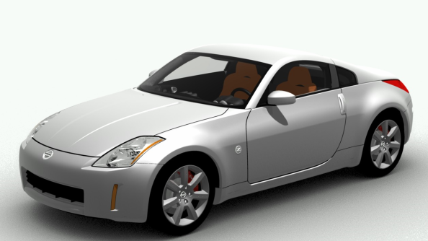
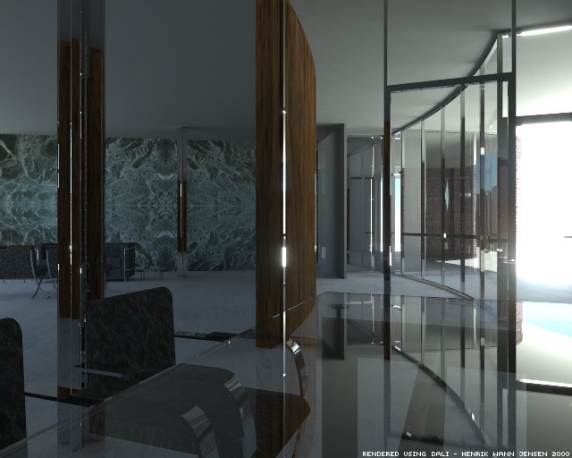
Is this real ?

Slide 3
Why Computer Graphics ?
Computers have become a powerful tool for the rapid and economical production of pictures.
There is virtually no area in which graphical displays cannot be used to some advantage, and so it is not surprising to find the use of computer graphics so widespread.

Slide 4
Why Computer Graphics ?
Today, we find computer graphics used routinely in such diverse areas as science, engineering, medicine, business, industry, government, art, entertainment, advertising, education, and training, simulations, education, and graph presentations.

Slide 5
Goal of the Course
The goal of this course is to provide an introduction to the theory and practice of computer graphics.
The course will assume a good background in programming in C++ and a background in mathematics including familiarity with the theory and use of coordinate geometry and of linear algebra such as matrix multiplication.

Slide 6
Components of Course
There will be three components to the course
You will gain an understanding of the fundamentals of computer graphics through study of the techniques, algorithms and hardware used in computer graphics.
You will gain experience in the techniques involved in low level computer graphics programming such as that used to create computer graphics packages (such as OpenGL).

Slide 7
Components of Course
3) You will use the industry standard based OpenGL library in several programming projects illustrating the theory and practice of programming computer graphics applications

Slide 8
Course Contents and Schedule
1-Introduction to Computer Graphics
  Definition , Applications ,Historical timeline, Graphics Hardware , Primitives
  Overview of graphics systems
  Video display devices: raster-scan & random scan
  Input devices
  Graphics software
2-Mathematics For Computer Graphics
  Coordinate Systems (Cartesian , Polar , Spherical)
  Vectors & Matrices (Algebra of matrices)
  Homogeneous Transforms

Slide 9
Course Contents and Schedule
3- Scan Conversion Algorithms (Output primitives)
  Point, Line ,Circle , Ellipse , Polygons , filling , Curves
4-Two-dimensional geometric transformation
  Basic transformations: translation, rotation, scaling, and other transformations (reflection ,shearing , clipping , etc..)
  Matrix representation and Homogenous coordinate systems.
  Composite or (successive) transformations.
  Other transformations: reflection and shear

Slide 10
Course Contents and Schedule
5- Two-dimensional viewing
  Window to view port coordinate transformations
  Two-dimensional viewing functions
  Clipping operations: line, point, polygon, and text
6-Three-dimensional concepts
  Parallel and perspective projections
  Depth cuing
  Surface rendering
  Visible line and surfaces
7- Three-dimensional transformations
  Translations
  Rotations
  Scaling

Slide 11
Course Contents and Schedule
8- Three-dimensional viewing
  Viewing coordinates
  Transformations to viewing plane
  General projection transformations
9- Lighting and Texture mapping
10- Modeling
  Surface Modeling
  Solid Modeling
  Procedure Modeling
  Simplification
11- Visible-Surface Detection Methods
12- Computer Animation

Slide 12
Schedule
1st week | Introduction to Computer Graphics | Chapter 1
2nd week | Mathematics for Computer Graphics | Appendix A
3rd week | Scan Conversion Algorithms Output Primitives | Chapter 3
4th week | 2D Geometric Transformations | Chapter 5
5th week | 2D Viewing | Chapter 6
6th week | 3D Object Representations | Chapter 10
7th week | 3D Geometric and Modeling Transformations | Chapter 11
8th week | 3D Viewing | Chapter 12
9th week | Lighting ,Texture mapping illumination Models | Chapter 14
10th week | Modeling ,Surface-Rendering Methods | Chapter 14
11th week | Visible-Surface Detection Methods | Chapter 13
12th week | Computer Animation | Chapter 16

Slide 13
Assessment (Grading)
Practical Work = 20 %
Projects = 20 %
Final Exam = 60%
Course Credit hours = 3
Examination hours = 3

Slide 14
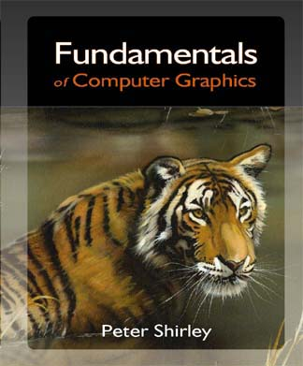
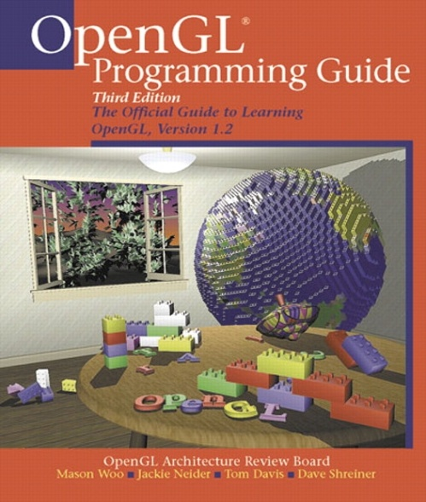
Course Material and Textbooks
All lectures and assignment dropped in www.acadox.com
1- Fundamentals of Computer Graphics 2- OpenGL Programming Guide
Author: Peter Shirley Authors :Mason Woo Jackle Neider, Tom Davis , Dave Shreiner

Slide 15
Thank You
End
Questions ?

