Slide 1
File Management & Organization

Slide 2
Lecture 7
Physical File Organization
(The Organization of Hard Disk)

Slide 3
Contents of Lecture:
Secondary Storage Devices
The Organization of Disks
Platters
Read/Write heads
Arm assembly
Spindle
Arms

Slide 4
Secondary Storage Devices
Since secondary storage is different from main memory we have to understand how it works in order to do good file design.
Two major types of secondary storage:
Direct Access Storage Devices (DASD)
Serial Access Storage Devices (SASD)

Slide 5
Secondary Storage Devices
Direct Access Storage Devices (DASD):
Magnetic Disks:
Hard Disk.
Floppy Disk.
Optical Disks:
CD-ROM (Compact Disk – Read Only Memory).
CD-R (Compact Disk – Recordable).
CD-RW (Compact Disk – ReWritable).
DVD (Digital Video Disk).
Serial Access Storage Devices (SASD):
Magnetic Tape

Slide 6
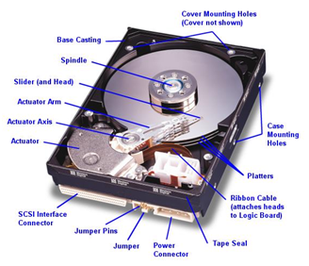
The Organization of Disks:
We can use disks or Hdd to refer to the hard disks.
Next figure show the component inside and outside the disks.

Slide 7
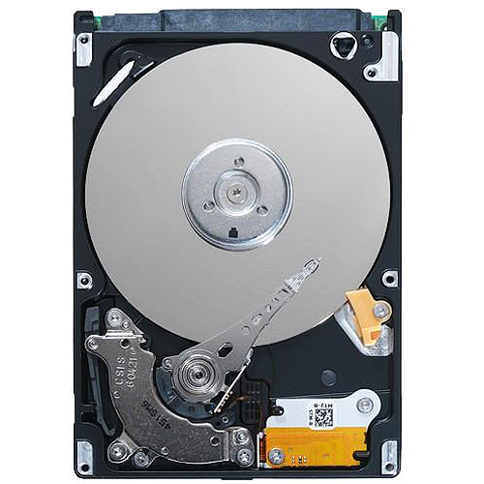
The Organization of Disks:
Figure below show the component inside disks.

Slide 8
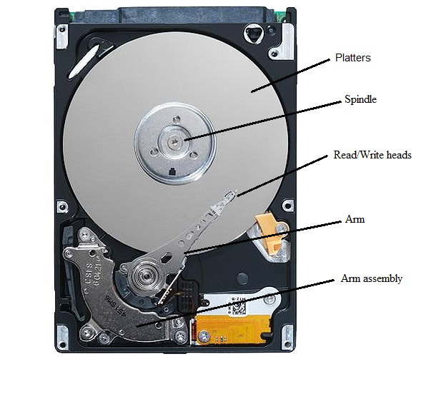
The Organization of Disks:
The important components in disks are:
Platters
Read/Write heads
Arm assembly
Spindle
Arms

Slide 9
1. Platter:
Platter is the circular disk on which magnetic data is stored in a hard disk drive.
Platter can store information on both sides (surface) of one or more platters.
All surfaces have the same components at the same position.
The platters inside a hard disk are structured to facilitate to storage and retrieval of data.

Slide 10
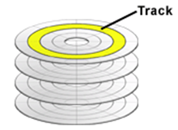
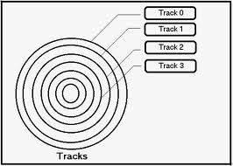
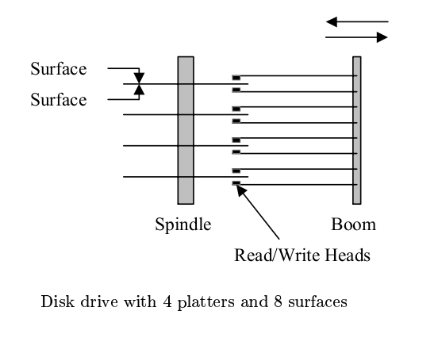
1. Platter:
Each platter is divided into concentric rings called Tracks.
There are thousands of tracks on each platter.
They look like the rings.
The information is stored in successive tracks on the surface of the disk.
Track Capacity = number of sectors per track *
bytes per sector

Slide 11
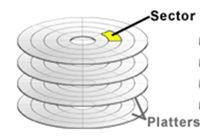
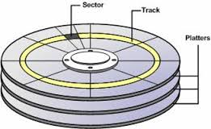
1. Platter:
Each track is divided into a number of Sectors.
A sector is the smallest addressable portion of a disk.
As a rule; sector holds 512 byte of data.

Slide 12
1. Platter:
Example:
If a platter has 1000 tracks, each track contains 33 sectors. Calculate track capacity.
Track Capacity = number of sectors per track * bytes per sector
= 33 * 512 = 16896 byte

Slide 13
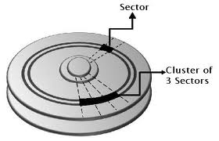
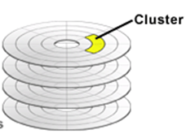
1. Platter:
Another view of sector organization is the one maintained by the O.S.’s file manager.
It views the file as a series of Clusters of sectors.
A cluster is fixed numbers of contiguous sectors.
Example:
If sectors size = 512 byte and cluster size = 3 sectors
The cluster size = 3 * 512 =1536 byte

Slide 14
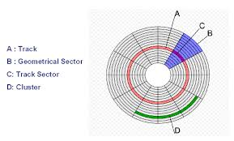
1. Platter:

Slide 15
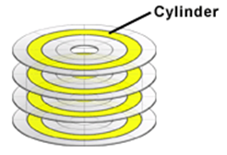
1. Platter:
Another view of Cylinder.
Cylinder is a set or number of tracks that are directly above /below each other.
All the information on a single cylinder can be accessed without moving the arm that holds the read/write heads.
Cylinder Rules:
Number of cylinder = the number of tracks in a surface.
Cylinder Capacity = number of tracks per cylinder * track capacity

Slide 16
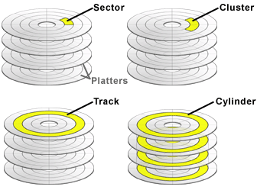
1. Platter:
So, platter has four components:
Sector
Cluster
Track
Cylinder

Slide 17
2. Read/Write heads:
Read/write heads are the small part of the disk, that move above the disk platter.
Heads only fly above the platter surface with clearance of as little as 3 nanometers.
A read-write head moves to the track that contains the data to be transferred.
Each surface has its own read/write head.

Slide 18
3. Arm assembly:
Arm assembly is an internal set of hard disk component containing arms which contain the read/write head.
The role of the arm assembly is to read and write information from a set of platters that are coated with a thin magnetic material.
When arm assembly stops working the drive is failure.

Slide 19
3. Arm assembly:
When a read statement calls for a particular byte from a disk file.
The computer’s operating system finds the correct platter, track and sector, reads the entire sector into a special area in memory called a buffer.
And then finds the requested byte within that buffer.

Slide 20
4. Spindle:
Spindle holds the platters in a fixed position with enough space for the read/write arms to get the data on the disks.
Also, spindle used to rotate the platters.
Spindle rotation moves the sector under the read-write head for reading or writing.

Slide 21
5. Arms:
Arms are used to carry, Gide and move the read/write head.
Moving this arm is called seeking.
The arm movement is usually the slowest part of reading information from a disk.

Slide 22
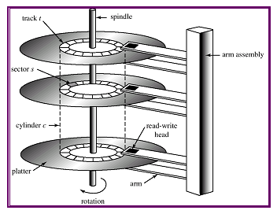

Slide 23
