Slide 1
File Management & Organization

Slide 2
Lecture 3
Chapter 1 Logical file Organization
File Structures

Slide 3
Contents of Lecture:
File Input and Output
File of records Structure
File structures
Stream Files structure
Field Structures
Record Structures
Managing Files of Records

Slide 4
File Input and Output
In general, there are two types of files:
Text File:
Treated as sequence of characters
e.g: C program source code
Can be viewed, edited with text editor
Binary File:
Treated as sequence of bytes
e.g: Movie, music files
Access requires specialized program
Files can be input files or output files

Slide 5
Input files and Output files
File
C-Program
user
OUTPUT/
Write
OUTPUT
INPUT
INPUT/
Read

Slide 6
File of records Structure
The logical structure of a file is how programmers see the file
File of records structure:
Data is viewed as a collection of records.
Record: A group of fields that forms a logical unit
Field: a data value, smallest unit of data with logical meaning
Fields have: names, types, lengths, and are assigned value

Slide 7
File structures
There are three file structure:
Stream Files structure
Field Structures
Record Structures

Slide 8
1. Stream Files structure
In Stream Files, the information is written as a stream of bytes containing no added information:
We have the following struct
Struct Books{
char B_number[5]
char B_Auther[7]
char B_Name[25]
}

Slide 9
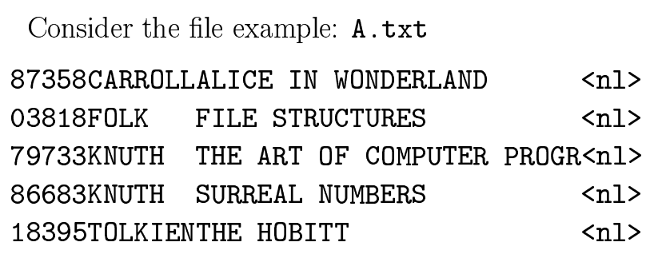
1. Stream Files structure
Example:
AmesMary123 MapleStillwaterOK74075MasonAlan90 EastgateAdaOK74820
Problem:
There is no way to get the information back in the organized record format.

Slide 10
2. Field Structures
There are many ways of adding structure to files to maintain the identity of fields:
Force the field into a fixed length
Begin each field with a length indicator
Use a “keyword = value” expression to identify each field and its content
Place delimiter at the end of field

Slide 11
Force the field into a fixed length

Slide 12
Begin each field with a length indicator

Slide 13
Use a “keyword = value” expression to identify each field and its content

Slide 14
Place delimiter at the end of field

Slide 15
3. Record Structures
A record can be defined as a set of fields that belong together when the file is viewed in terms of a higher level of organization.
Like the notion of a field, a record is another conceptual tool which needs to exist in the file in any physical sense.
Record Structures are an important logical notion included in the file’s structure.

Slide 16
3. Record Structures
Methods for organizing the records of a file include:
Fixed length records combined with fixed length field
Fixed length records combined with variable length field
Beginning each record with a length indicator consisting of a count of the number of bytes that the record contains.

Slide 17
3. Record Structures
Fixed length records combined with fixed length field

Slide 18
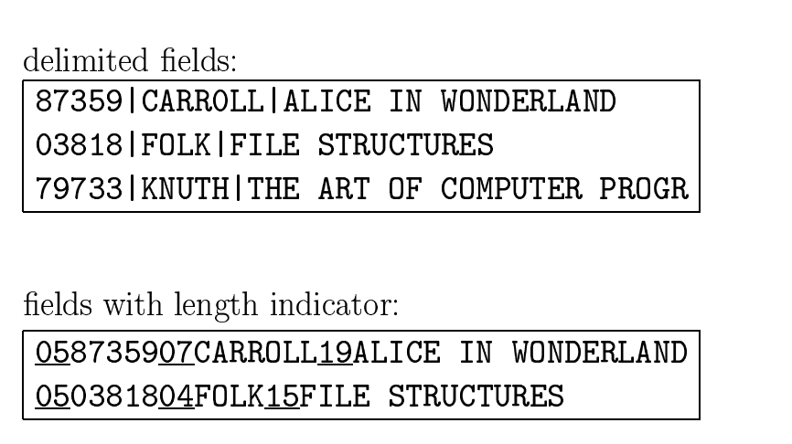
3. Record Structures
Fixed length records combined with variable length field

Slide 19
3. Record Structures
Beginning each record with a length indicator consisting of a count of the number of bytes that the record contains.

Slide 20
Managing Files of Records
Record Access: Keys:
When looking for an individual record, it is convenient to identify the record with a key based on the record’s content (e.g., the FOLK record).
Keys should uniquely define a record and be unchanging (Primary Key).
Records can also be searched based on a secondary key. Those do not typically uniquely identify a record.

Slide 21
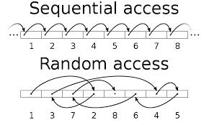
Managing Files of Records
Sequential Search:
Allows program to read and write in a sequence order .
Direct Access:
Allows program to read and write in a random order .
When is Sequential Search Useful?

