Slide 1

Operating System Concepts

Slide 2
Lecture 2
COperating System Structures
References for Lecture:
  Abraham Silberschatz, Peter Bear Galvin and Greg Gagne, Operating System Concepts, 9th Edition, Chapter 2

Slide 3
Contents of Lecture
Operating System Services
System Calls
Types of System Calls
Operating System Structure

Slide 4
Operating System Services
Operating systems provide an environment for execution of programs and services to programs and users.
One set of operating-system services provides functions that are helpful to the user

Slide 5
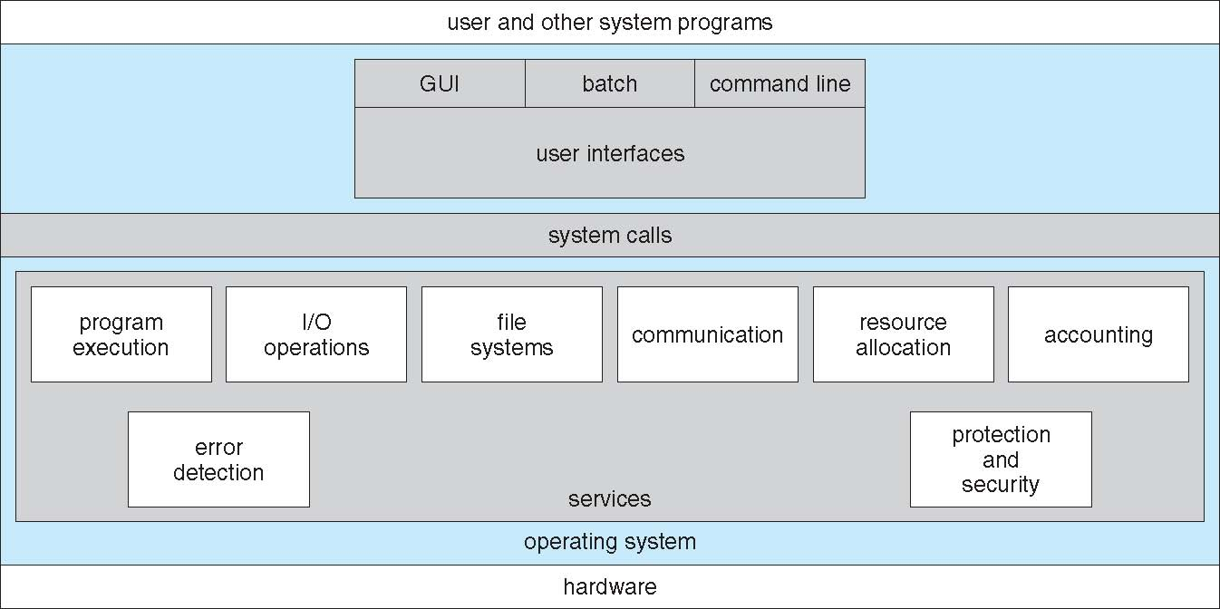
Operating System Services
File-system manipulation: The file system is of particular interest. Programs need to read and write files and directories, create and delete them, search them, list file Information, permission management
Communications: Processes may exchange information, on the same computer or between computers over a network. May be via shared memory or through message passing (packets moved by the OS).
For each type of error, OS should take the appropriate action to ensure correct and consistent computing. Debugging facilities can greatly enhance the user’s and programmer’s abilities to efficiently use the system.
User interface: Almost all operating systems have a user interface (UI).
Varies between Command-Line (CLI), Graphics User Interface (GUI), Batch.
Program execution: The system must be able to load a program into memory and to run that program, end execution, either normally or abnormally (indicating error).
I/O operations: A running program may require I/O, which may involve a file or an I/O device.
Error detection: OS needs to be aware of possible errors.
Error may occur in the CPU and memory hardware, in I/O devices, in user program

Slide 6
Protection and security: The owners of information stored in a multiuser or networked computer system may want to control use of that information, concurrent processes should not interfere with each other
Resource allocation: When multiple users or multiple jobs running concurrently, resources must be allocated to each of them.
Many types of resources - CPU cycles, main memory, file storage, I/O devices.
Protection, involves ensuring that all access to system resources is controlled
Security, of the system from outsiders requires user authentication, extends to defending external I/O devices from invalid access attempts.
Another set of OS functions exists for ensuring the efficient operation of the system itself via resource sharing
Accounting: To keep track of which users use how much and what kinds of computer resources

Slide 7
System Calls
System calls provide an interface to the services made available by an operating system.
These calls are generally available as routines written in C and C++, although certain low-level tasks (for example, tasks where hardware must be accessed directly) may have to be written using assembly-language instructions.

Slide 8
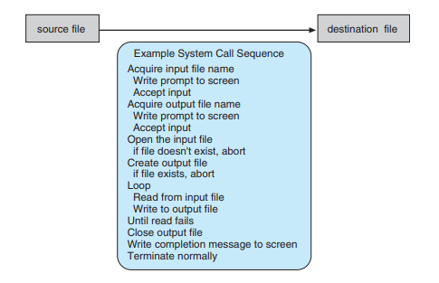
System Calls
Example of System Calls
An example to illustrate how system calls are used: writing a simple program to read data from one file and copy them to another file.

Slide 9
System Calls
As you can see, even simple programs may make heavy use of the operating system. Systems execute thousands of system calls per second.
Most programmers never see this level of detail, however. Typically, application developers design programs according to an application programming interface (API).
The API specifies a set of functions that are available to an application programmer, including the parameters that are passed to each function and the return values the programmer can expect.

Slide 10
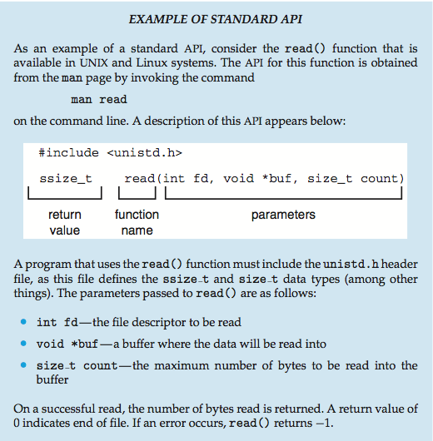
System Calls
Example of Standard API:

Slide 11
System Calls
Three of the most common APIs available to application programmers are:
    Windows (Win32) API for Windows systems.
    The POSIX API for POSIX-based systems (which include virtually all versions of UNIX, Linux, and Mac OS X).
    The Java API for programs that run on the Java virtual machine (JVM).
A programmer accesses an API via a library of code provided by the operating system.
  In the case of UNIX and Linux for programs written in the C language, the library is called libc.

Slide 12
System Calls
System Call Implementation
For most programming languages, the run-time support system (a set of functions built into libraries included with a compiler) provides a system call interface that serves as the link to system calls made available by the operating system.
The system-call interface intercepts function calls in the API and invokes the necessary system calls within the operating system.
Typically, a number is associated with each system call, and the system-call interface maintains a table indexed according to these numbers.

Slide 13
System Calls
System Call Implementation
The system call interface then invokes the intended system call in the operating-system kernel and returns the status of the system call and any return values.
The caller need know nothing about how the system call is implemented
  Just needs to obey API and understand what OS will do as a result call
  Most details of OS interface hidden from programmer by API
    Managed by run-time support library (set of functions built into libraries included with compiler)

Slide 14
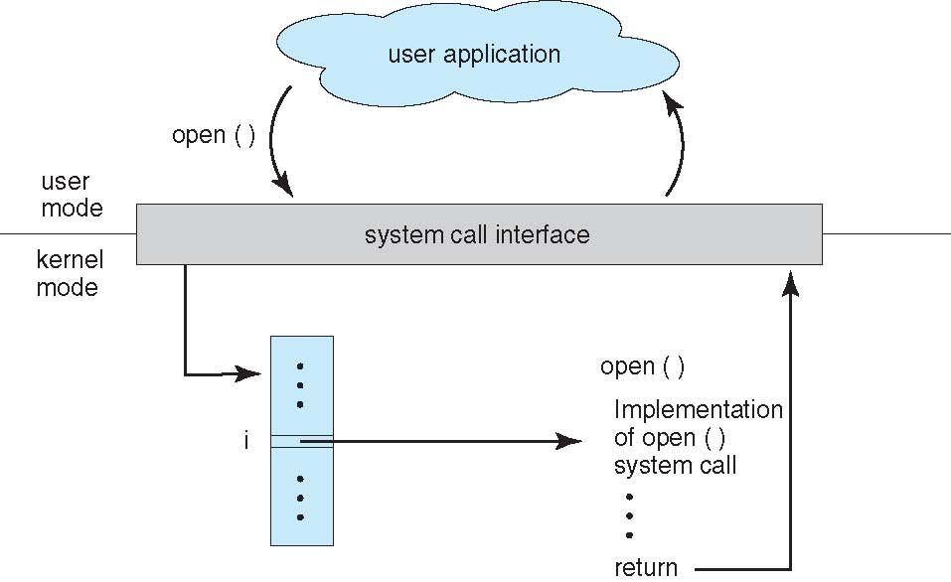
System Calls
System Call Implementation
The relationship between an API, the system-call interface, and the operating system is shown in next figure (Figure 2.6), which illustrates how the operating system handles a user application invoking the open() system call.

Slide 15
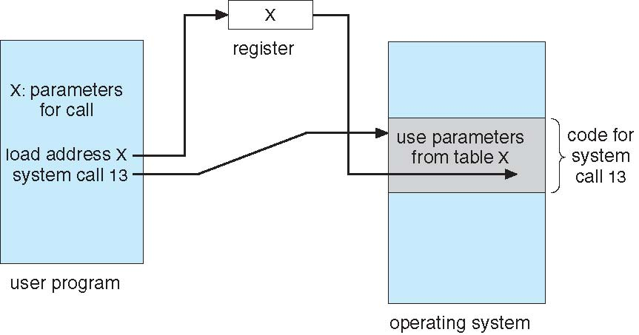
System Calls
System Call Parameter Passing
Often, more information is required than simply identity of desired system call
  Exact type and amount of information vary according to OS and call
Three general methods used to pass parameters to the OS
  1. Simplest: pass the parameters in registers
    In some cases, may be more parameters than registers
  2. Parameters stored in a block, or table, in memory, and address of block passed as a parameter in a register.
    This approach taken by Linux and Solaris
  3. Parameters placed, or pushed, onto the stack by the program and popped off the stack by the operating system.
Note
Some operating systems prefer the block and stack methods do not limit the number or length of parameters being passed

Slide 16
Types of System Calls
Process control
  create process, terminate process
  end, abort
  load, execute
  get process attributes, set process attributes
  wait for time
  wait event, signal event
  allocate and free memory
  Dump memory if error
  Debugger for determining bugs, single step execution
  Locks for managing access to shared data between processes

Slide 17
Types of System Calls
File management
  create file, delete file
  open, close file
  read, write, reposition
  get and set file attributes
Device management
  request device, release device
  read, write, reposition
  get device attributes, set device attributes
  logically attach or detach devices

Slide 18
Types of System Calls
Information maintenance
  get time or date, set time or date
  get system data, set system data
  get and set process, file, or device attributes
Communications
  create, delete communication connection
  send, receive messages if message passing model to host name or process name
  From client to server
  Shared-memory model create and gain access to memory regions
  transfer status information
  attach and detach remote devices

Slide 19
Types of System Calls
Protection
  Control access to resources
  Get and set permissions
  Allow and deny user access

Slide 20
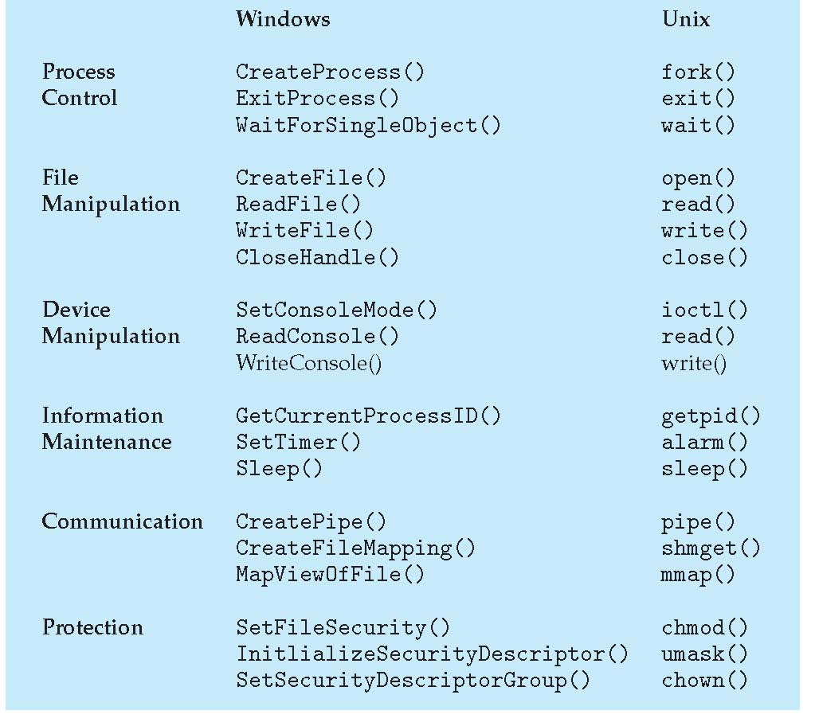
Types of System Calls
Examples of Windows and Unix System Calls

Slide 21
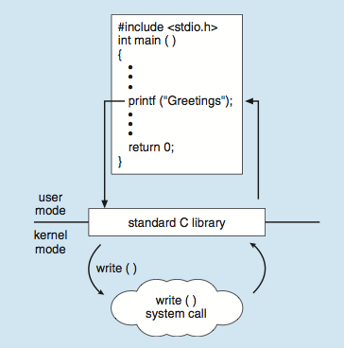
Types of System Calls
Standard C Library Example
The standard C library provides a portion of the system-call interface for many versions of UNIX and Linux. As an example, C program invokes the printf() statement.
The C library intercepts this call and invokes the necessary system call (or calls) in the operating system in this instance, the write() system call. The C library takes the value returned by write() and passes it back to the user program.

Slide 22
Operating System Structure
General-purpose OS is very large program
Various ways to structure ones:
  Simple structure – MS-DOS
  More complex -- UNIX
  Layered – an abstrcation
  Microkernel –Mach

Slide 23
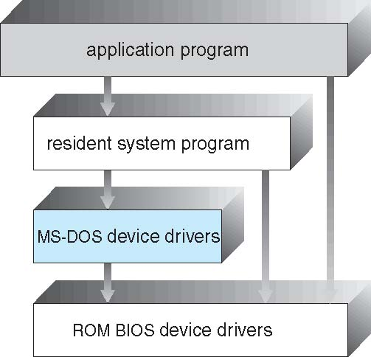
Operating System Structure
  Simple structure – MS-DOS
MS-DOS – written to provide the most functionality in the least space
  Not divided into modules.
  Although MS-DOS has some structure, its interfaces and levels of functionality are not well separated

Slide 24
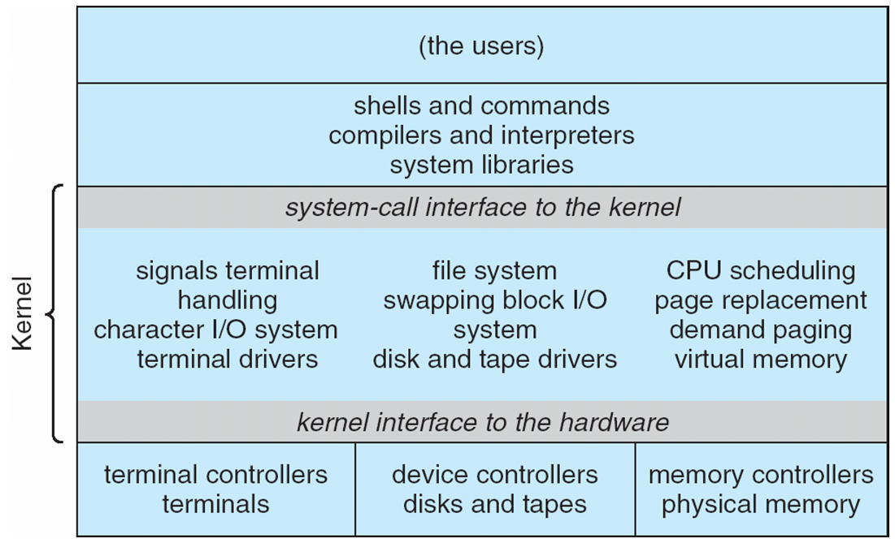
Operating System Structure
  More complex -- UNIX
UNIX – limited by hardware functionality, the original UNIX operating system had limited structuring.
The UNIX OS consists of two separable parts:
  Systems programs
  The kernel
    Consists of everything below the system-call interface and above the physical hardware
    Provides the file system, CPU scheduling, memory management, and other operating-system functions; a large number of functions for one level
Traditional UNIX System Structure beyond simple but not fully layered

Slide 25
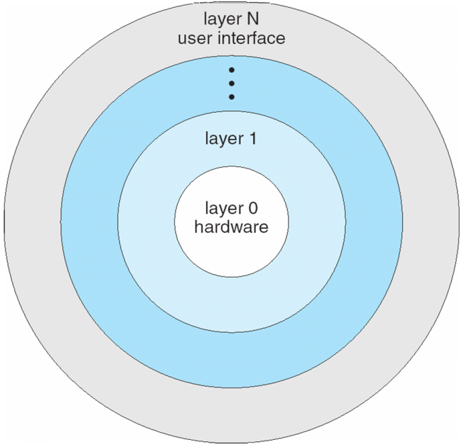
Operating System Structure
  Layered – an abstrcation
The operating system is divided into a number of layers (levels), each built on top of lower layers. The bottom layer (layer 0), is the hardware; the highest (layer N) is the user interface.
With modularity, layers are selected such that each uses functions (operations) and services of only lower-level layers

Slide 26
Operating System Structure
Microkernel –Mach
Moves as much from the kernel into user space
Mach example of microkernel
  Mac OS X kernel (Darwin) partly based on Mach
Communication takes place between user modules using message passing
Benefits:
  Easier to extend a microkernel
  Easier to port the operating system to new architectures
  More reliable (less code is running in kernel mode)
  More secure
Detriments:
  Performance overhead of user space to kernel space communication

